Slide 1
SEA REGION
PARTNER Training
TOPIC: AIR-FLUX product Features
08.09.2022
Manisa

Slide 2
19.10.2022 Wednesday
20.10.2022 Thursday
09:00 - 09:45 VRF ODU Product Line-Up
09:45 - 10:30 VRF IDU Product Line-Up
10:30 - 10:45 Break
10:45 - 12:15 Product Features of AF5300 (2 pipe system)
12:15 - 13:15 Lunch Break
13:15 - 14:00 Product Features of AF6300 (3 pipe system)
14:00 – 14:45 Product Features of Ahu kit & Hydrobox & ERV units (3 pipe system)
14:45 - 15:00 Break
15:00 - 16:30 Controllers & Gateway
16:30 - 16:45 Q & A
09:00 - 10:30 VRF Installation
10:30 - 10:45 Break
10:45 – 11:30 VRF Commissioning Theoratical
11:30 - 12:15 VRF Commissioning Practical
12:15 - 13:15 Lunch Break
13:15 - 14:00 Electrical Circuit and Components
14:00 - 14:45 Refrigerant Circuit and Components
14:45 - 15:00 Break
15:00 - 15:15 Defrost & Oil Return & Start-Up Trouble Shooting
15:15 - 16:45 Trouble Shooting
16:45 - 17:00 Q & A

Slide 3
09:00 - 09:45 VRF ODU Product Line-Up
09:45 - 10:30 VRF IDU Product Line-Up
10:45 – 11:00 Break
10:45 - 11:30 Product Features of AF5300 (2 pipe system)
11:30 - 12:15 Product Features of AF6300 (3 pipe system)
12:15 - 13:15 Lunch Break
13:15 - 14:00 Product Features of Ahu kit & Hydrobox (3 pipe system)
14:00 - 14:45 Controllers & Gateway
14:45 - 15:00 Break
15:00 - 16:45 VRF installations
16:45 - 17:00 Q & A
VRF Commissioning
16:45 - 17:00 Q&A session
17:00 - 19:00 Field Visit (Include Travel Time)

Slide 4
Product Line up & Feature
Af5300 ODU ( 2 Pipe)
AF6300 ODU ( 3 Pipe)
Ahu-Kit D
HydroBox
ERV unit
Controllers

Slide 5
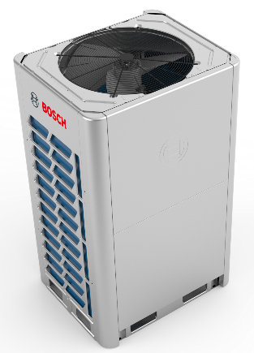
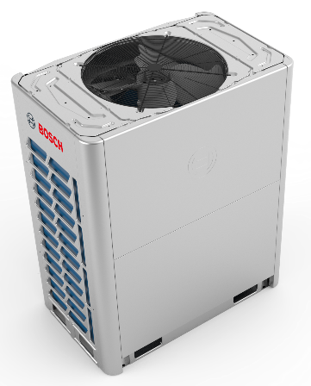
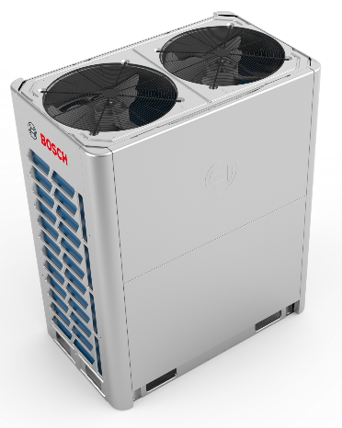
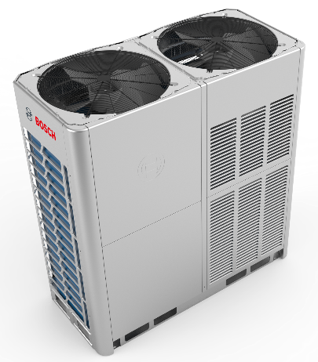
Product Line up & Feature
AF5300 ODU
HP | 8 ∼ 12 | 14 - 16 | 18 ∼ 22 | 24 ∼ 32
kW | 25 ∼ 33,5 | 40 - 45 | 50 ∼ 62 | 67 ∼ 90
HP | 32 ∼ 64 |  | 64 ∼ 96
kW | 90 ∼ 180 |  | 180 ∼ 270
13 different models with a capacity up to 90 kW
Free modular combination with 2HP increase up to 270 kW
Combination ratio min %50 ~ max %130
CE and Eurovent certified
- 2250 m² area can be air-conditioned with one system.
*Cooling load estimated as 120W/m²

Slide 6
Connectable Max. IDU Quantity
AF5300 ODU
Product Type | Rated Cooling Capacity |  | Maximum number of connected indoor units
 | kW | HP
AF5300A 25 C-3 | 25.2 | 8 | 13
AF5300A 28 C-3 | 28.0 | 10 | 16
AF5300A 33 C-3 | 33.5 | 12 | 20
AF5300A 40 C-3 | 40.0 | 14 | 23
AF5300A 45 C-3 | 45.0 | 16 | 26
AF5300A 50 C-3 | 50.0 | 18 | 29
AF5300A 56 C-3 | 56.0 | 20 | 33
AF5300A 62 C-3 | 61.5 | 22 | 36
AF5300A 67 C-3 | 67.0 | 24 | 39
AF5300A 73 C-3 | 73.0 | 26 | 43
AF5300A 79 C-3 | 78.5 | 28 | 46
AF5300A 85 C-3 | 85.0 | 30 | 50
AF5300A 90 C-3 | 90.0 | 32 | 53
AF5300A 95 C-3 | 95.0 | 34 | 56
AF5300A 102 C-3 | 101.5 | 36 | 59
AF5300A 107 C-3 | 106.5 | 38 | 63
AF5300A 112 C-3 ~ AF5300A 270 C-3 | 112 ∼ 270 | 40 ∼ 96 | 64

Slide 7
Combination Range
AF5300 ODU
System capacity |  | Number of units | Modules¹ |  |  |  |  |  |  |  |  |  |  |  |  | Outdoor branch joint kit²
kW | HP |  | 8 | 10 | 12 | 14 | 16 | 18 | 20 | 22 | 24 | 26 | 28 | 30 | 32
95.0 | 34 | 2 |  |  | ● |  |  |  |  | ● |  |  |  |  |  | AF-BJO 02
101.5 | 36 | 2 |  |  |  | ● |  |  |  | ●
106.5 | 38 | 2 |  |  |  |  | ● |  |  | ●
112.0 | 40 | 2 |  |  | ● |  |  |  |  |  |  |  | ●
117.5 | 42 | 2 |  |  |  |  |  |  | ● | ●
123.0 | 44 | 2 |  |  |  |  |  |  |  | ●●
128.5 | 46 | 2 |  |  |  |  |  |  |  | ● | ●
134.5 | 48 | 2 |  |  |  |  |  |  |  | ● |  | ●
140.0 | 50 | 2 |  |  |  |  |  |  |  | ● |  |  | ●
146.0 | 52 | 2 |  |  |  |  |  |  |  |  |  | ●●
151.5 | 54 | 2 |  |  |  |  |  |  |  |  |  | ● | ●
157.0 | 56 | 2 |  |  |  |  |  |  |  |  |  |  | ●●
163.5 | 58 | 2 |  |  |  |  |  |  |  |  |  |  | ● | ●
168.5 | 60 | 2 |  |  |  |  |  |  |  |  |  |  | ● |  | ●
175.0 | 62 | 2 |  |  |  |  |  |  |  |  |  |  |  | ● | ●
180.0 | 64 | 2 |  |  |  |  |  |  |  |  |  |  |  |  | ●●
185.0 | 66 | 3 |  |  | ● |  |  |  |  | ● |  |  |  |  | ● | AF-BJO 03
191.5 | 68 | 3 |  |  |  | ● |  |  |  | ● |  |  |  |  | ●
196.5 | 70 | 3 |  |  |  |  | ● |  |  | ● |  |  |  |  | ●
202.0 | 72 | 3 |  |  | ● |  |  |  |  |  |  |  | ● |  | ●
207.5 | 74 | 3 |  |  |  |  |  |  | ● | ● |  |  |  |  | ●
213.0 | 76 | 3 |  |  |  |  |  |  |  | ●● |  |  |  |  | ●
218.5 | 78 | 3 |  |  |  |  |  |  |  | ● | ● |  |  |  | ●
224.5 | 80 | 3 |  |  |  |  |  |  |  | ● |  | ● |  |  | ●
230.0 | 82 | 3 |  |  |  |  |  |  |  | ● |  |  | ● |  | ●
236.0 | 84 | 3 |  |  |  |  |  |  |  |  |  | ●● |  |  | ●
241.5 | 86 | 3 |  |  |  |  |  |  |  |  |  | ● | ● |  | ●
247.0 | 88 | 3 |  |  |  |  |  |  |  |  |  |  | ●● |  | ●
253.5 | 90 | 3 |  |  |  |  |  |  |  |  |  |  | ● | ● | ●
258.5 | 92 | 3 |  |  |  |  |  |  |  |  |  |  | ● |  | ●●
265.0 | 94 | 3 |  |  |  |  |  |  |  |  |  |  |  | ● | ●●
270.0 | 96 | 3 |  |  |  |  |  |  |  |  |  |  |  |  | ●●●
Notes:
1. The combinations of units shown in the table are factory-recommended. Other combinations of units are also possible.
2. For systems with two or more outdoor units, outdoor branch joints (sold separately) are required.
At beside there is suggested combination table for ODU‘s.
According to customer requirement and project design , it can be changed flexibly

Slide 8

Energy Specifications
AF5300
Model | Power Supply1 |  |  |  |  |  |  | Compressor |  | OFM
Product Type | Hz | Voltage | Min. voltage | Max. voltage | MCA2 | TOCA3 | MFA4 | MSC5 | RLA6 | kW | FLA
AF5300A 25 C-3 | 50/60 | 380~415 | 342 | 440 | 24.0 | 30.9 | 32 | / | 10 | 0.56 | 6.3
AF5300A 28 C-3 | 50/60 | 380~415 | 342 | 440 | 25.2 | 30.9 | 32 | / | 10.6 | 0.56 | 6.3
AF5300A 33 C-3 | 50/60 | 380~415 | 342 | 440 | 26.4 | 31.5 | 32 | / | 15.4 | 0.56 | 6.9
AF5300A 40 C-3 | 50/60 | 380~415 | 342 | 440 | 33.1 | 40.3 | 40 | / | 25.8 | 0.92 | 7.3
AF5300A 45 C-3 | 50/60 | 380~415 | 342 | 440 | 33.1 | 40.3 | 40 | / | 25.8 | 0.92 | 7.3
AF5300A 50 C-3 | 50/60 | 380~415 | 342 | 440 | 40.8 | 59.3 | 50 | / | 14+13 | 0.56×2 | 10.1
AF5300A 56 C-3 | 50/60 | 380~415 | 342 | 440 | 43.9 | 60.1 | 50 | / | 17+16 | 0.56×2 | 10.9
AF5300A 62 C-3 | 50/60 | 380~415 | 342 | 440 | 47.9 | 60.1 | 63 | / | 19+18 | 0.56×2 | 10.9
AF5300A 67 C-3 | 50/60 | 380~415 | 342 | 440 | 48.4 | 62.3 | 63 | / | 17.4+16.6 | 0.92×2 | 13.1
AF5300A 73 C-3 | 50/60 | 380~415 | 342 | 440 | 52.9 | 62.3 | 63 | / | 20+19.8 | 0.92×2 | 13.1
AF5300A 79 C-3 | 50/60 | 380~415 | 342 | 440 | 58.7 | 64.1 | 63 | / | 22+21.8 | 0.92×2 | 14.9
AF5300A 85 C-3 | 50/60 | 380~415 | 342 | 440 | 64.9 | 72.5 | 80 | / | 20+30 | 0.92×2 | 14.9
AF5300A 90 C-3 | 50/60 | 380~415 | 342 | 440 | 66.9 | 72.5 | 80 | / | 22+30 | 0.92×2 | 14.9
Abbreviations:
MCA : Minimum Circuit Amps
TOCA : Total Over-current Amps
MFA : Maximum Fuse Amps
MSC : Maximum Starting Current (A)
RLA : Rated Load Amps
FLA : Full Load Amps
OFM : Outdoor unit fan motor
MCA (Minimum Circuit Ampacity)
It is used for conductor sizing to ensure that the wiring does not overheat under normal operating conditions. . The minimum circuit ampacity (MCA) is the minimum wire size required for a field wired product. It is chosen to guarantee that the wiring will not overheat under the expected operating conditions.
MFA (Maximum Fuse Amps)
This value is required for the protection of motor (fan motor), given by manufacturers. And it is used for selecting the circuit breakers. This is also called MOP (Maximum overcurrent protection)

Slide 9
Operation Range
AF5300
Extended range of outdoor ambient temperature operation
-5˚C
Cooling mode range
+48˚C
-23˚C
Heating mode range
+24˚C
-23˚C
-15˚C
-10˚C
-5 ˚C
0 ˚C
5 ˚C
10 ˚C
15 ˚C
20 ˚C
25 ˚C
30 ˚C
35 ˚C
40 ˚C
45 ˚C
50 ˚C
55 ˚C

Slide 10



Operation Modes
AF5300
Auto mode (default)
Outdoor unit operates according to ambient temp. (T4)
Heating If T4 < 13 °C, Cooling if T4 > 18 °C
Continue Last time operation if 13 ≤ T4 ≤ 18
Cooling or Heating priority mode
During heating operation: If an indoor unit requests cooling, the outdoor unit stops and then restarts in cooling. During cooling operation: If an indoor unit requests heating, the outdoor units ignore the request and continue to run in cooling mode.
Lock cooling mode
The outdoor unit only operates in cooling mode
Lock heating mode
The outdoor unit only operates in heating mode
Voting priority
(Majorities’ requirement)
In voting priority mode, the outdoor unit operates in
whichever of heating and cooling modes is being
requested by the larger number of indoor units.
VIP priority
(default address No.63)
If the VIP indoor unit is operating, the
outdoor unit operates in the mode of the VIP indoor unit.
#63 Now the address can be changed

Slide 11

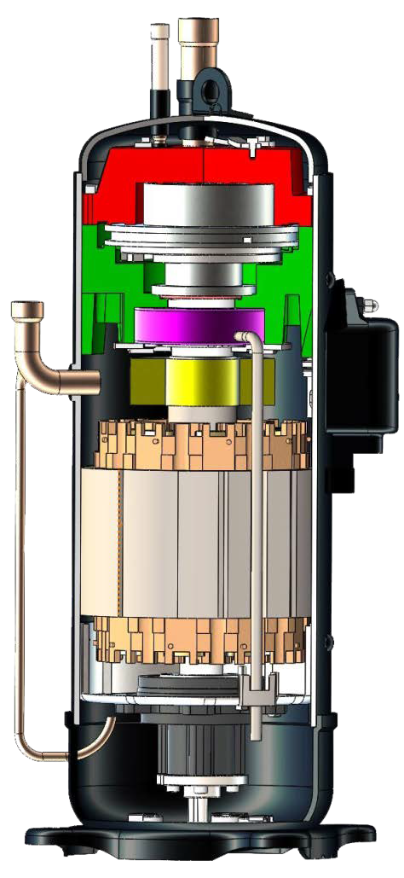
Compressor Technology
AF5300
Common With AF6300
Increased heating performance by 20% in average for outdoor temperatures below +7 °C
Wide running frequency 15~140Hz
Stable operation down to -23 °C (-25 °C for AF6300 Series )
Improved heating capacity at lower temperatures down to -15 °C
Vapor injection type scroll compressor also ensures efficient sub-cooling without loss during cooling operation
Gas Vapor Injection
Low-pressure refrigerant suction
High-pressure refrigerant discharge
Vapor injection type compressor

Slide 12
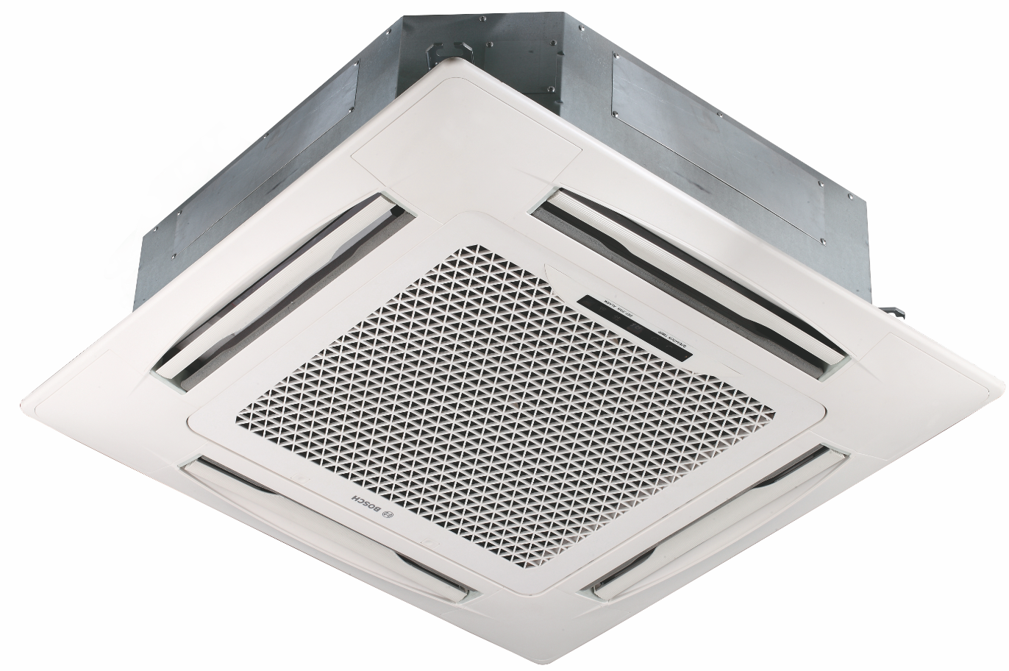
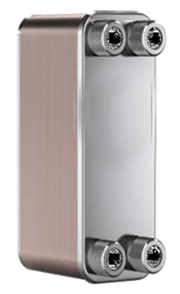
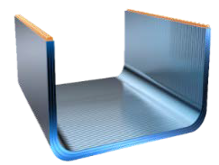
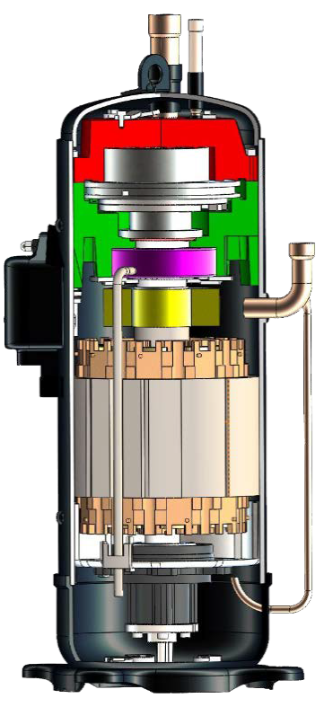
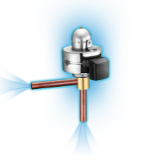
Sub-Cooling Circuits
AF5300
Common With AF6300
Improved cooling efficiency by 10%
Reduced refrigerant pressure loss
Lower refrigerant flow noise
Better refrigerant distribution
2nd Stage
Plate HEX
1st Stage
HEX
For more information
please refer to the EDBs and SMs
Notes:
New outdoor units use 2-stage sub cooling technology to cooling down the refrigerant. First, Outdoor heat exchanger cooling down the refrigerant and then the system will bypass a small amount of refrigerant and go across a auxiliary EXV, these a small amount of refrigerant will change to low pressure and low temperature state and further cooling down the main refrigerant, guaranteeing the whole refrigerant going to the indoor units is in pure liquid state. The liquid refrigerant flow has less pressure loss, lower noise and better refrigerant distribution

Slide 13
Efficient Refrigerant Control
AF5300
Common With AF6300
Floating refrigerant temperature ensures comfort and efficiency. The evaporation (in cooling) and condensation temperatures (in heating) are automatically adjusted according to indoor and outdoor ambient temperature.
Evaporating temperature (floating) ℃
Te
Perfect balance:
Top efficiency on the transition seasons and quick reaction in summer, hottest days.
Te (fix)
17℃ 32℃
Indoor Temperature
Top efficiency
Balance mode
Quick reaction speed
Notes:
Depends on the ambient temperature, the target evaporating temp changes automatically. For example, when the ambient temp is low, like in the transition season, lower capacity is required, higher evaporating temp brings higher energy efficiency. When the ambient is high, like in summer, higher capacity is required, lower evaporating temp brings quick reaction speed to cooling and larger cooling capacity. In normal seasons, the evaporating temp is adjusted automatically to balance the comfort and energy efficiency.

Slide 14
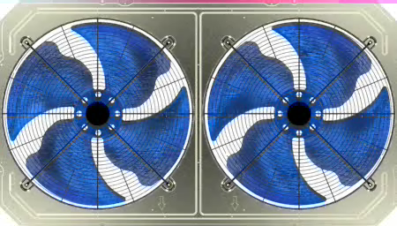
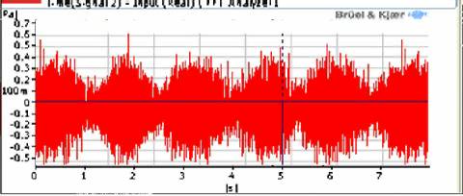
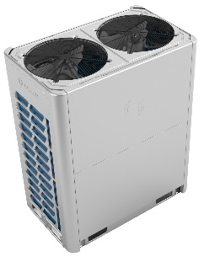
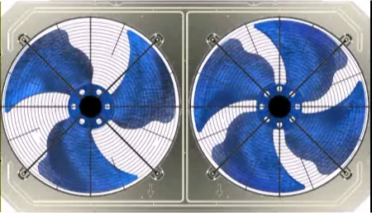
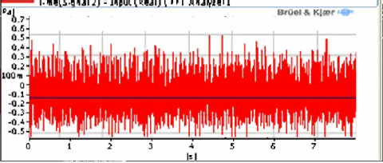
Patented Fan Design
AF5300
Common With AF6300
For models 18-20-22 HP
4+4 spectrogram
Patented
Conventional design:4+4
3+4 Spectrogram
Unique design :3+4

Slide 15
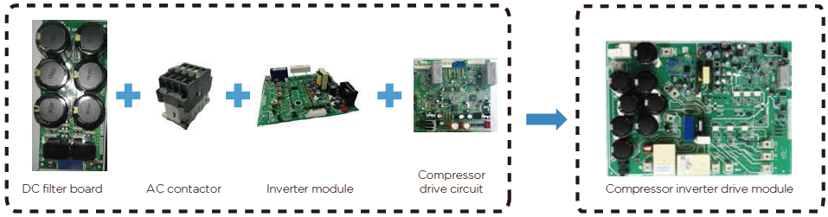
Simplified Electronical Circuit
AF5300
Common With AF6300
DC filter board, AC contactor, inverter module and compressor drive circuits are integrated to one compressor inverter drive board.
Integrated design reduces wiring connections at PCB and offers more reliable PCB.
old
new

Slide 16
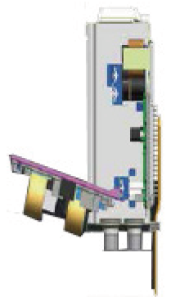
Easy Check & Maintenance
AF5300
Common With AF6300
The bottom layer can be easily accessed through rotatable PCB in case maintenance is needed.
Bottom layer of the electric control box
Rotatable upper PCB of the electric control box
For more information
please refer to the EDBs and SMs

Slide 17
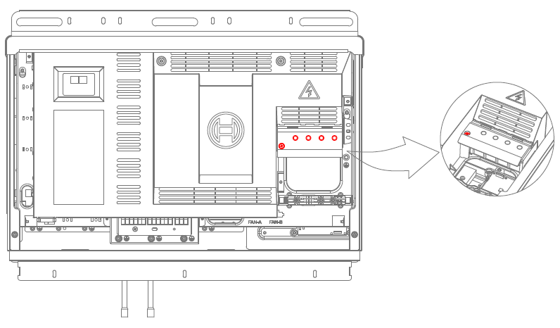
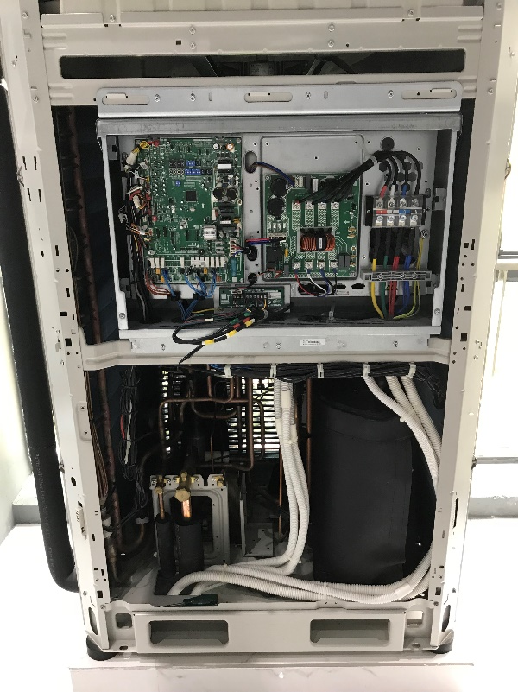
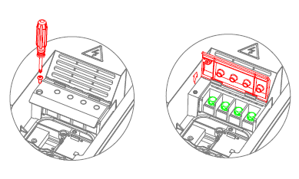
Safety Cover
AF5300
Common With AF6300
To prevent direct access to high voltage areas at PCB, a safety cover has been adapted.

Slide 18
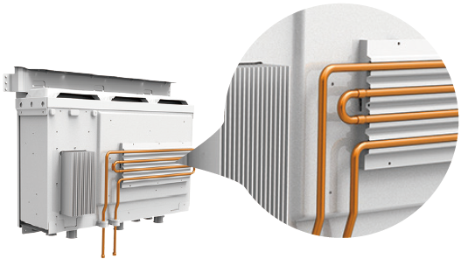
IPM Cooling Technology
AF5300
Common With AF6300
Double U-shape refrigerant pipe decreases the IPM temperature and ensures reliable operation
IPM : Intelligent power module
For more information
please refer to the EDBs and SMs

Slide 19
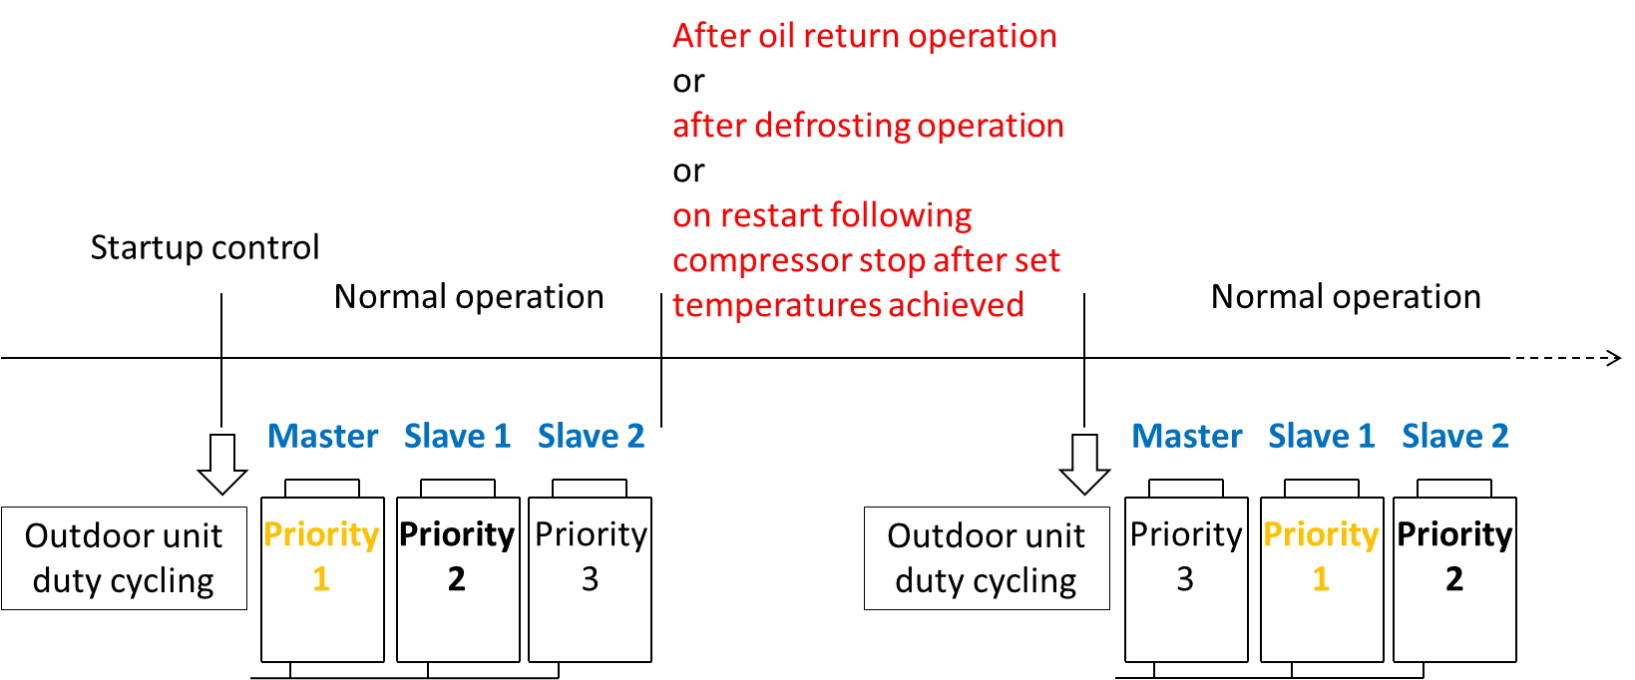
Equal Aging
AF5300
Common With AF6300
In systems with multiple outdoor units, outdoor unit duty cycling is used to equalize the compressor life span and balance the oil at compressors.

Slide 20
Combination
AF5300
Common With AF6300
There is no more oil balance piping needed at site.
No need for oil balance pipe

Slide 21
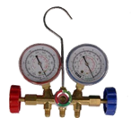
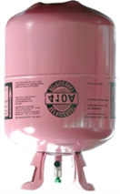
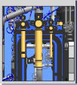
Automatical Ref. Charging
AF5300
Common With AF6300
VRF system can be charged with the necessary amount of refrigerant automatically
Automatic charging* decide appropriate amount of refrigerant to be chared to piping system
Conventional manual refrigerant charge:
Calculation of additional refrigerant charging volume
Measuring the weight of the cylinder
Charge system with additional refrigerant
* Setting is done via dip-switch at outdoor unit pcb
For more information
please refer to the EDBs and SMs

Slide 22

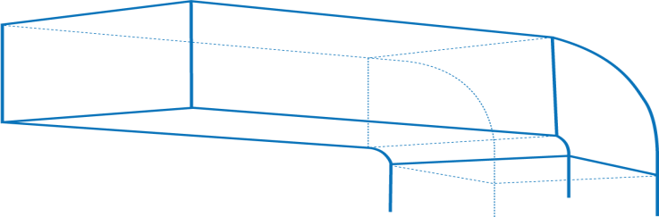




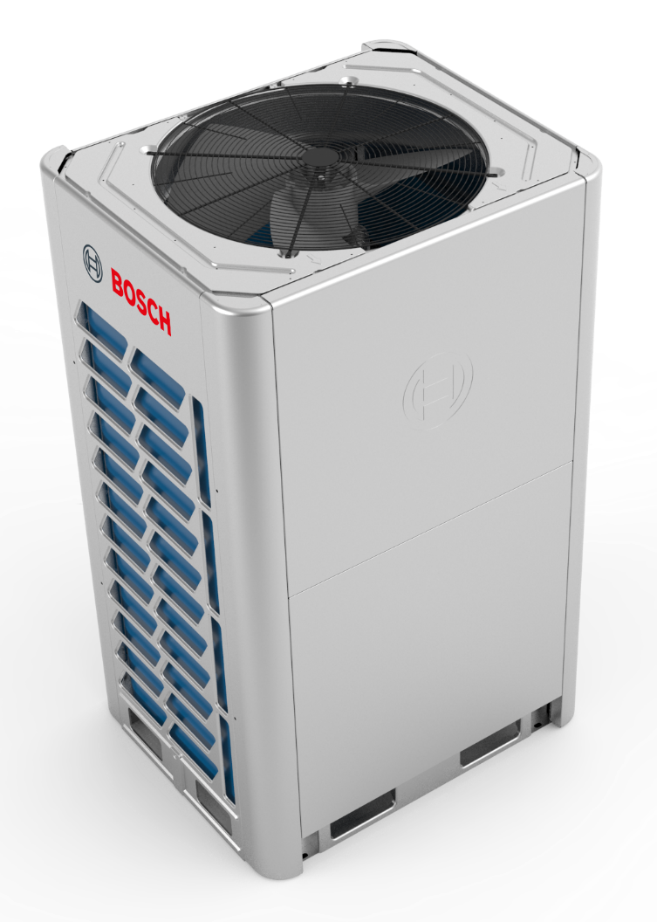

ESP Flexibility
AF5300
Common With AF6300
Outdoor unit fans can overcome external static pressure up to 40 Pa* , for AF6300 Ex.Static Pressure up to 80 Pa*
Types of application needs ;
  Floor by floor installation inside building with louver appl.
  Long air-duct applications
AF5300
Setting is done via dip-switch at outdoor unit pcb
Standart setting is 0 Pa
0,10,20,30,40 (Can be selected via dip-switch)
AF6300
Setting is done via dip-switch at outdoor unit pcb
Standart setting is 0 Pa
0,20,40,60,80
(Can be selected via dip-switch)

Slide 23



Auto Dust Clean
AF5300
Common With AF6300
Dust clean function enables outdoor units heat exchanger to clean itself and prevent from dust
Maintain system operate at high efficiency like installed and running as first day and ensure reliability
* Setting is done via dip-switch at outdoor unit pcb
Self-clean
For more information
please refer to the EDBs and SMs

Slide 24

Auto Snow Blowing
AF5300
Common With AF6300
Auto snow function enables outdoor units to be covered with snow
A special program at software controls fan(s) to start and work for a period to avoid snow covering outdoor unit
* Setting is done via dip-switch at outdoor unit pcb
For more information
please refer to the EDBs and SMs

Slide 25
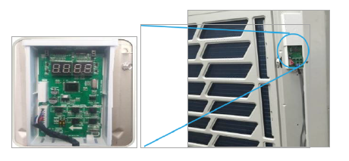
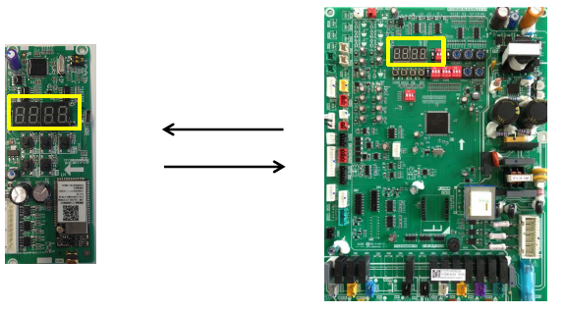
Check-Box
AF5300
Common With AF6300
The digital display on data transfer module displays the same information as the digital display on main PCB.
Main functions :
System check, Sync LED, Auto snowblowing setting,
Data acquisition, Fault data storage, Data reading,
Menu mode setting
For more information
please refer to the EDBs and SMs

Slide 26
Capacity Adjustment
AF5300
Common With AF6300
It is possible to set the capacity output from 100% to 40% in case needed (eg. During power generator is running)
Digital display code | Menu mode | Remarks
n41 | Power limitation mode 1 | 100% capacity output
n42 | Power limitation mode 2 | 90% capacity output
n43 | Power limitation mode 3 | 80% capacity output
n44 | Power limitation mode 4 | 70% capacity output
n45 | Power limitation mode 5 | 60% capacity output
n46 | Power limitation mode 6 | 50% capacity output
n47 | Power limitation mode 7 | 40% capacity output
Maximum
capacity output
100%
90%
80%
70%
60%
Minimum
capacity output
50%
40%
For more information
please refer to the EDBs and SMs

Slide 27
Silent Modes
AF5300
Common With AF6300
AF5300 Silent mode options
AF6300 Silent mode options
Mode | Description | Sound reduction (dBA) | Capacity Output %
0 | Night silent time 6h/10h | 8 dB(A) lower | 90%
1 | Night silent time 6h/12h | 8 dB(A) lower | 90%
2 | Night silent time 8h/10h | 8 dB(A) lower | 90%
3 | Night silent time 8h/12h | 8 dB(A) lower | 90%
4 | No silent mode | - | 100%
5 | Silent mode 1 | 8 dB(A) lower | 90%
6 | Silent mode 2 | 9 dB(A) lower | 85%
7 | Silent mode 3 | 10 dB(A) lower | 80%
8 | Super silent mode 1 | 12 dB(A) lower | 75%
9 | Super silent mode 2 | 14 dB(A) lower | 65%
10 | Super silent mode 3 | 16 dB(A) lower | 55%
11 | Super silent mode 4 | 18 dB(A) lower | 45%
Mode | Description | Sound reduction (dBA) | Capacity Output %
0 | Night silent time 6h/10h | 4 dB(A) lower | 85%
1 | Night silent time 6h/12h | 4 dB(A) lower | 85%
2 | Night silent time 8h/10h | 4 dB(A) lower | 85%
3 | Night silent time 8h/12h | 4 dB(A) lower | 85%
4 | No silent mode | - | 100%
8 | Silent mode | 4 dB(A) lower | 85%
A | Super silent mode | 8 dB(A) lower | 75%
F | Reserved
Night silent mode :
Is activated X hours after the peak daytime temperature, and is deactivated after Y hours
Silent Mode :
Maximum fan speed is limited
Super Silent Mode :
Maximum fan speed and maximum compressor frequency is limited

Slide 28
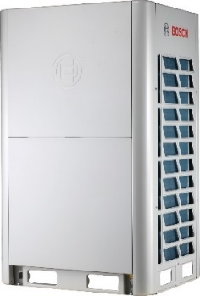
Back-Up Operation
AF5300
Common With AF6300
It is possible to set the compressor to run as emergency operation for 4 days if there are 2 compressors in one unit allowing time for maintenance or repair.
Compressor back up operation in case of cascaded application of outdoor units
Compressor is running
Compressor at stand-by
Compressor broken
In a multi-unit system, if one module fails, other modules can provide backup operation.
Remark : This function is valid where multi outdoor units are combined at installation and back-up can be applied manually at installation site by installer.

Slide 29
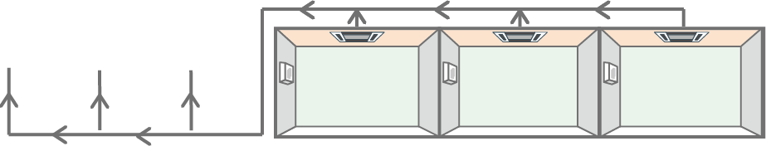

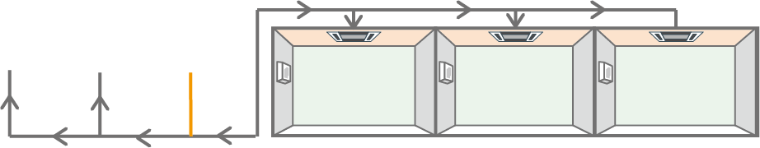
Pump Up&Down Operations
AF5300
Common With AF6300
Refrigerant recycle to outdoor units
Refrigerant can be recycled to ;
outdoor units
indoor units
outdoor units running normal
This function is for maintenance and commissionnig , stop valve must be closed manually.
Refrigerant re-cycle to indoor units and to outdoor units running normal

Slide 30
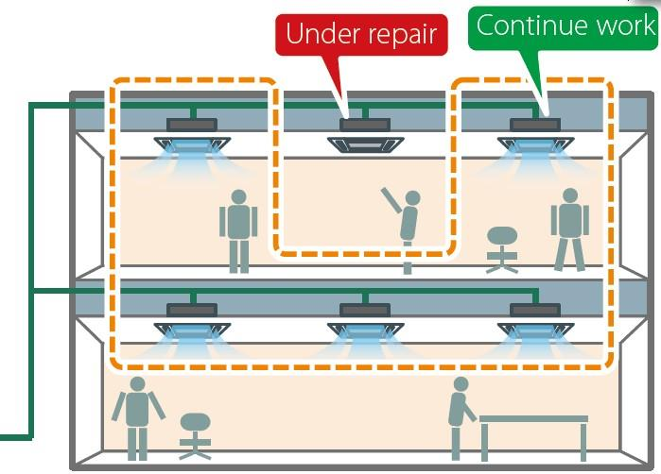
Maintenance Mode
AF5300
Common With AF6300
Maintenance feature allows shutdown of a vrf indoor unit without shutting down whole VRF system.
This feature allows easy & flexible maintenance as remaining indoor units continue to operate.
Normally if outdoor unit finds more than 1 indoor unit missing for 3 minutes, then H7 protection error occurs.
In maintenance mode, unit will not check the indoor unit quantity. Then installer have enough time for maintenance of indoor unit. This feature is valid only for electrical problems.
Remarks :
Activated via master outdoor unit PCB. Valid for 3 hours.
This function is not used for refrigerant side maintenance & problems.

Slide 31
Another Advantages
AF5300
Common With AF6300
Feature | Benefit | Reason why
Anti-vibration technology | Low noise level | New anti-vibration technology, soft metal pipe is used for compressor suction and injection. High quality rubber is used.
Auto refrigerant check | Reliable operation | Lack of refrigerant or over-charged refrigerant can be displayed at outdoor unit pcb.

Slide 32
Product Line up & Feature
Af5300 ODU ( 2 Pipe)
AF6300 ODU ( 3 Pipe)
Ahu-Kit D
HydroBox
ERV unit
Controllers

Slide 33


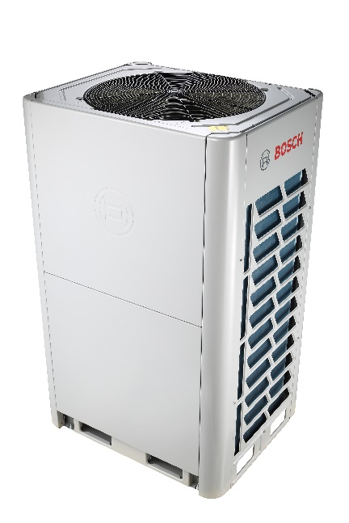
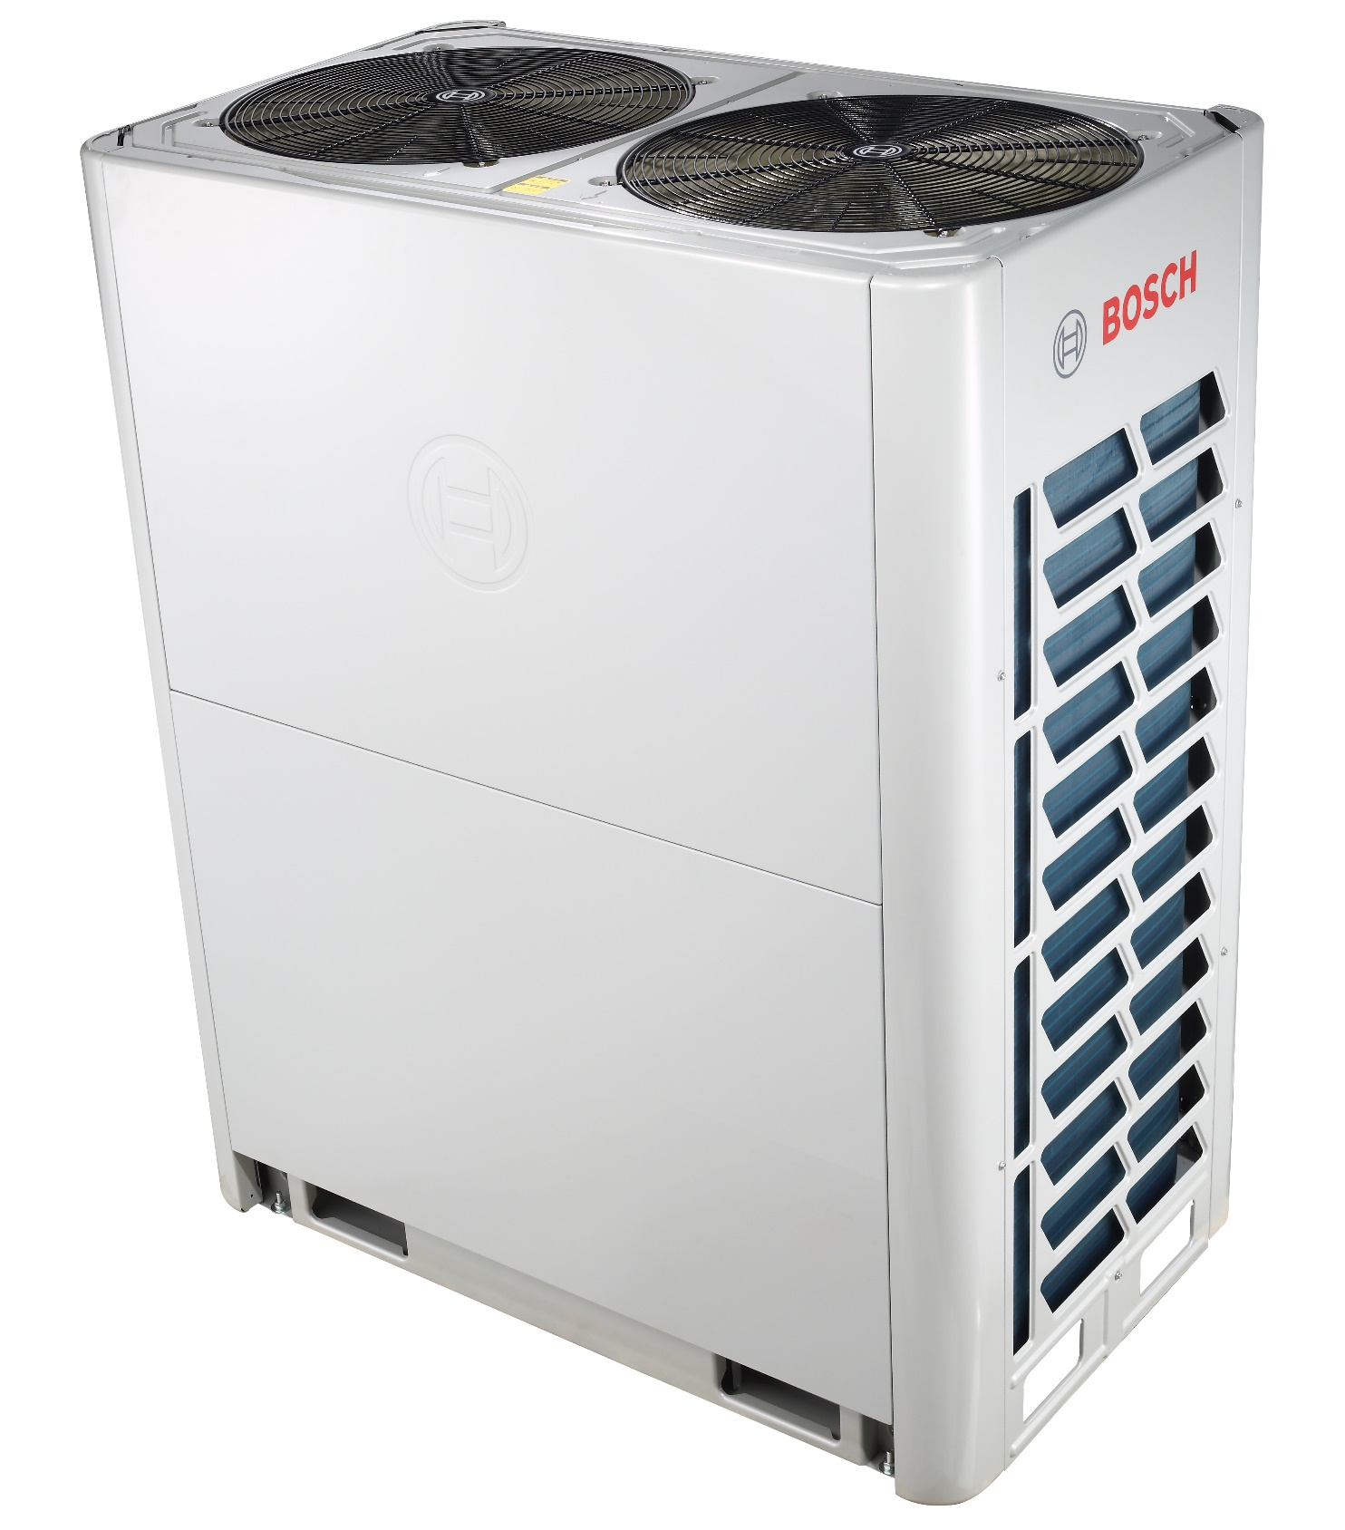
Product Line-Up
AF6300
HP | 8,10,12 | 14,16,18 | 20 ∼ 36 | 38 ∼ 54
kW | 22.4, 28, 33.5 | 40, 45, 50 | 56 ∼ 100 | 106 ∼ 150
ID
System | total combination ratio | Allowed combination ratio
 |  | VRF indoor units | Hydro box | AHU Kit
VRF indoor units only | 50%~200% (Single) 50%~150% (2 units combination) 50%~130% (3 units combination) | 50%~200% (Single) 50%~150% (2 units combination) 50%~130% (3 units combination) | / | /
VRF indoor units + HT hydro box | 50%~200% | 50%~130% | 0%~100% | /
VRF indoor units + AHU kits | 50%~100% | 50%~100% | / | 0%~50%
6 different models with a capacity up to 50 kW
Combination of 3 outdoor units up to 150 kW
Combination ratio min %50 ~ max %200
380-415V, 50Hz, triphase
CE and Eurovent

Slide 34
Combination Table
AF6300
System capacity |  | Number of units | Modules¹ |  |  |  |  |  | Outdoor unit Branch joint kit²
kW | HP |  | 8 | 10 | 12 | 14 | 16 | 18
22.4 | 8 | 1 | ● |  |  |  |  |  | —
28.0 | 10 | 1 |  | ●
33.5 | 12 | 1 |  |  | ●
40.0 | 14 | 1 |  |  |  | ●
45.0 | 16 | 1 |  |  |  |  | ●
50.0 | 18 | 1 |  |  |  |  |  | ●
56.0 | 20 | 2 |  | ●● |  |  |  |  | AF-BJRO 02
61.5 | 22 | 2 |  | ● | ●
68.0 | 24 | 2 |  | ● |  | ●
73.5 | 26 | 2 |  |  | ● | ●
78.5 | 28 | 2 |  |  | ● |  | ●
83.5 | 30 | 2 |  |  | ● |  |  | ●
90.0 | 32 | 2 |  |  |  |  | ●●
95.0 | 34 | 2 |  |  |  |  | ● | ●
100.0 | 36 | 2 |  |  |  |  |  | ●●
107.0 | 38 | 3 |  |  | ●● | ● |  |  | AF-BJRO 03
112.0 | 40 | 3 |  |  | ●● |  | ●
118.5 | 42 | 3 |  |  | ● | ● | ●
123.5 | 44 | 3 |  |  | ● |  | ●●
130.0 | 46 | 3 |  |  |  | ● | ●●
135.0 | 48 | 3 |  |  |  |  | ●●●
140.0 | 50 | 3 |  |  |  |  | ●● | ●
145.0 | 52 | 3 |  |  |  |  | ● | ●●
150.0 | 54 | 3 |  |  |  |  |  | ●●●
The combinations of units shown in the table are factory-recommended. Other combinations of units are also possible.
For systems with two or more outdoor units, outdoor units branch joints (sold separately) are required.

Slide 35
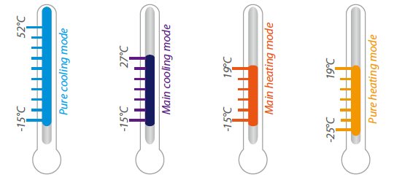
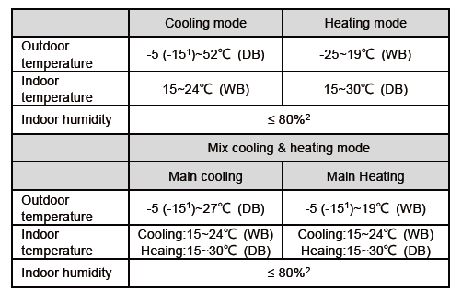
Working Range
AF6300
Pure cooling mode: -15°C ~ 52°C DB
Main cooling mode (mixed mode): -15°C ~ 27°C DB
Pure heating mode: -25°C ~ 27°C DB
Main heating mode (mixed mode): -15°C ~ 27°C DB

Slide 36
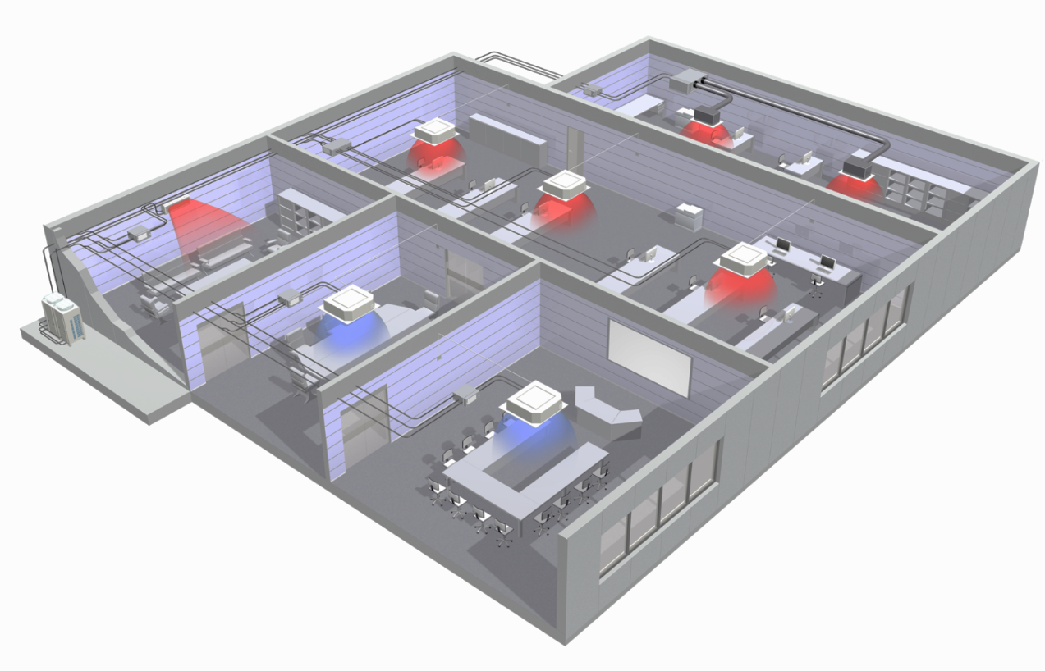
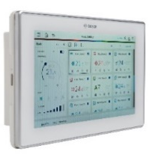

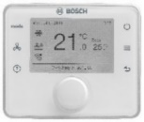

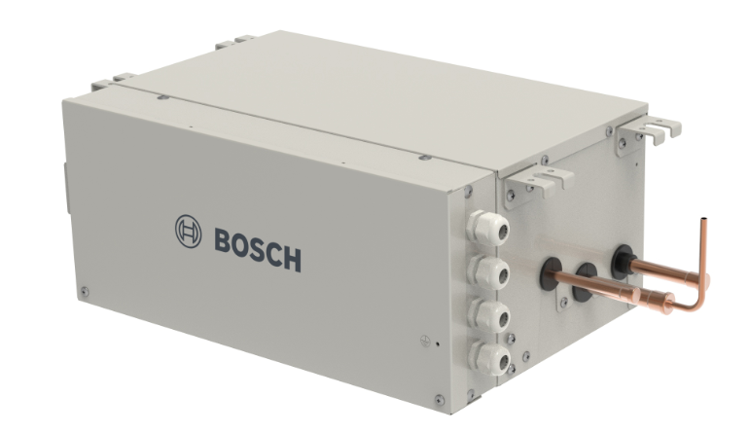
Design
AF6300
Air Cooled
Heat Recovery VRF System
Central
controller
Ducted type
indoor unit
High-wall type
indoor unit
System is able to run for at cooling, heating or simultaneously
Higher efficiency compared to 2-pipe VRF due to heat recovery
Single piping system (3 pipe, liquid/high pres gas/low pres gas)
R-410A refrigerant
Individual setting as on/off, set temp, air flow adjustment in rooms
Centralised control availibility
System capacity increase with by combining outdoor units up to 3, reaching max. 150 kW rated cooling capacity in one system
Room
controller
Outdoor
Unit(s)
Cassette type
indoor unit
Refrigerant piping
2 pipes
(after box)
Joints
Refrigerant piping
3 pipes
(main pipes)
Switch Box
(SBOX)
Infrared
controller

Slide 37
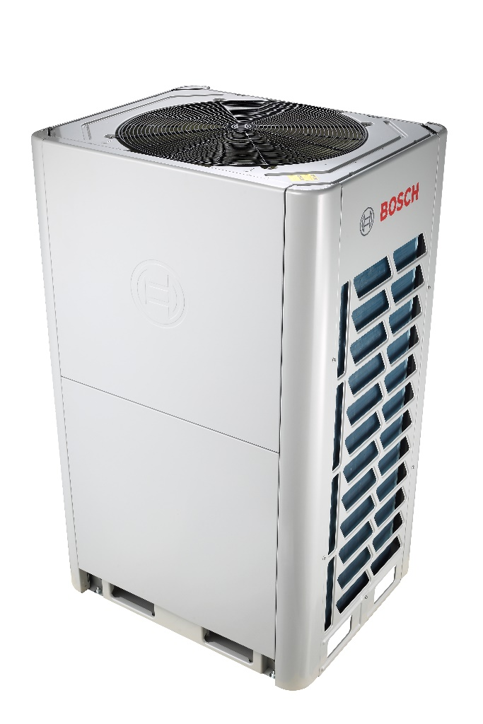
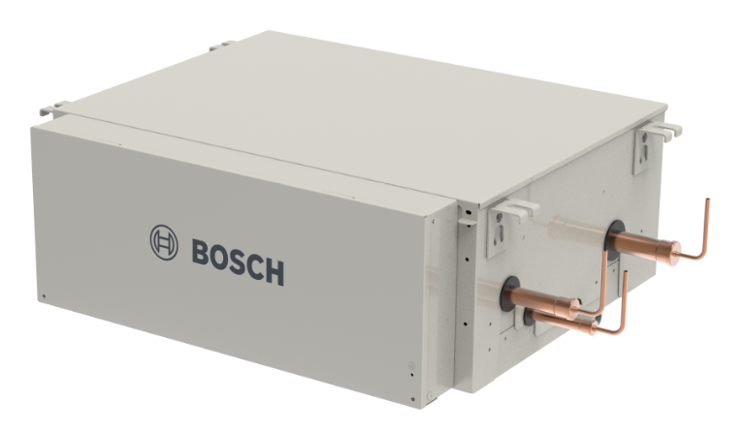
Working Principle
AF6300
A typical heat recovery system consists of outdoor unit(s), switch box (changeover box) and indoor units, as well the copper piping and joints
System offers high energy-saving efficiency by rejecting heat from the rooms to be cooled and effectively using it as a heat source for the rooms to be heated.
3 pipes
3 pipes
3 pipes
3 pipes
2 pipes
2 pipes
2 pipes
2 pipes
Heat rejection
2 pipes
C
H
H
OFF
C
OFF
H
Heat release
Heat release
Internal transfer
Heat rejection
Internal transfer
C : cooling mode
H : heating mode

Slide 38
Energy Specifications
AF6300
System | Outdoor Unit |  |  |  | Current
 | Voltage (V) | Frequency (Hz) | Min. (V) | Max. (V) | MCA (A) | MFA (A)
AF6300A 22 C-3 | 380-415 | 50 | 342 | 440 | 24,0 | 32
AF6300A 28 C-3 | 380-415 | 50 | 342 | 440 | 25,2 | 32
AF6300A 33 C-3 | 380-415 | 50 | 342 | 440 | 26,4 | 32
AF6300A 40 C-3 | 380-415 | 50 | 342 | 440 | 33,1 | 40
AF6300A 45 C-3 | 380-415 | 50 | 342 | 440 | 33,1 | 40
AF6300A 50 C-3 | 380-415 | 50 | 342 | 440 | 40,8 | 50
MCA (Minimum Circuit Ampacity)
It is used for conductor sizing to ensure that the wiring does not overheat under normal operating conditions. .
The minimum circuit ampacity (MCA) is the minimum wire size required for a field wired product. It is chosen to guarantee that the wiring will not overheat under the expected operating conditions.
The wire size takes into account the normal current draw, ageing of components and anticipated faults.
MFA (Maximum Fuse Amps)
This value is required for the protection of motor (fan motor), given by manufacturers.
And it is used for selecting the circuit breakers.
This is also called MOP (Maximum overcurrent protection)
MCA: Minimum Circuit Amps
MFA: Maximum Fuse Amps
Select the wire diameters separately for different unit models based on the relevant standards.
Maximum allowable voltage range variation between phases is 2%.
Select a circuit breaker that complies with the local laws and regulations.
Select the wire diameter and type of circuit breaker based on the table above where MCA is used to select the wire diameter, and MFA is used to select the current circuit breakers and residual current operation breakers

Slide 39
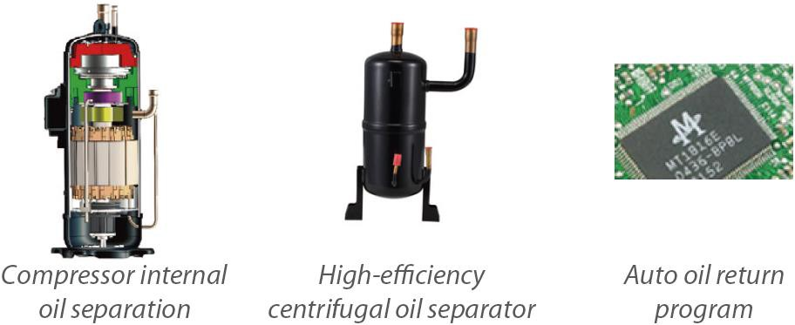
Oil Return Logic
AF6300
Three stage of oil control technology ensure outdoor unit’s compressor oil is always kept at a safe level, eliminating any compressor oil shortage problems.
  Compressor internal oil separation.
  High-efficiency centrifugal oil separator (with separation efficiency of up to 99%) ensures that oil is separated from the discharge gas and returned to the compressor.
  Auto oil-return program monitors the running time and system status to ensure reliable oil return.

Slide 40

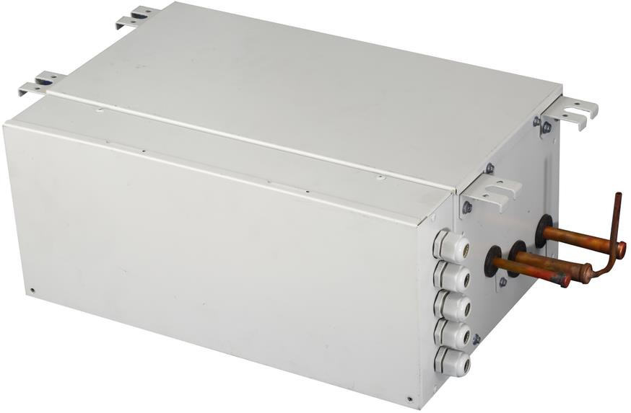
Continous Heating
AF6300
Normal Heating Operation
Continuous Heating Operation
Continuous Heating Operation
Heating
Heating
Heating
Defrost
Defrost
Heating
Normally, outdoor unit stops normal heating operation during defrost operation.
However, continuous heating operation feature makes it possible to perform defrosting while heating operation continues. In cascaded applications, (2 outdoor units or 3 outdoor units), units perform defrosting alternately. While one unit is performing defrosting, the other one continues heating.
Remark : This function is valid where multi outdoor units are combined at installation

Slide 41
Expanded HEX Area
AF6300
OTHER BRANDS
Compressor is running
Compressor is running
Compressor at stand-by
Compressor at stand-by
In cooling or heating mode, for a multi-unit system, outdoor unit heat exchanger (HEX) and compressor are independently controlled to improve energy efficiency. This means even compressor of outdoor unit is not running, heat exchanger of this outdoor unit can be used for heat transfer. This function maximize outdoor units heat exchanger area and improves efficiency.
Remark : This function is valid where multi outdoor units are combined at installation

Slide 42
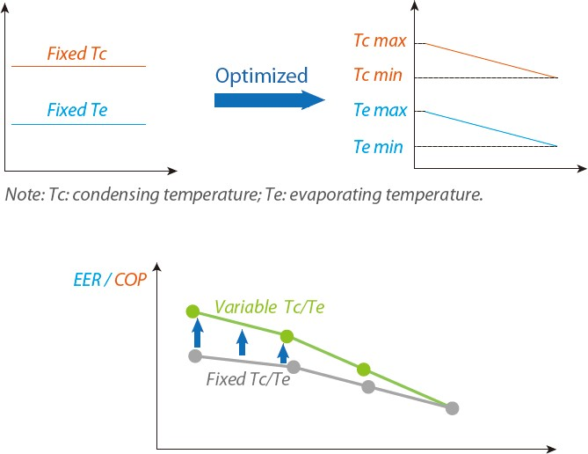
Refrigerant Control
AF6300
Smart Automatic Refrigerant Temperature Control: The evaporating temperature (in cooling) and condensing temperature (in heating) are automatically adjusted according to both indoor and outdoor temperature to maximize the comfort and energy efficiency.
Also manual setting is possible at outdoor unit.
Tevap auto control °C : 3, 6 (Default), 9
Tevap locking °C : -3, 0, 3, 6, 9
Tcond auto control °C : 42, 45, 48 (Default), 50
Tcond locking °C : 44, 46, 48, 51

Slide 43
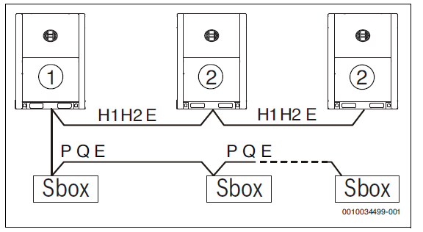
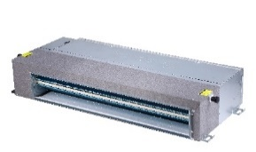
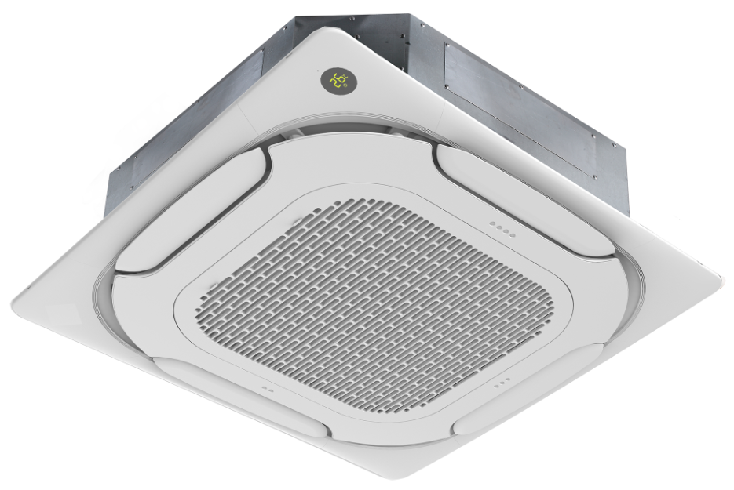
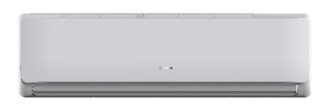

Communication Lines
AF6300
In case of outdoor units combination
Only one chain of 3-core connection cable is required for indoor unit, outdoor unit and centralized controller communication.
X Y E
P Q E
P Q E
1 : Master unit , 2 : Slave units
P Q E
P Q E
P Q E
P Q E
X1 X2
X1 X2
X1 X2
X1 X2
For more information please refer to the installation manual

Slide 44
Easy Addressing
AF6300
Outdoor unit can distribute addresses to indoor units automatically during commissioning.
Remote and wired controllers can be used to query or modify each indoor unit's address.
P Q E
P Q E
P Q E
P Q E
P Q E
P Q E
X1 X2
X1 X2
X1 X2
X1 X2

Slide 45


Remote Controls
AF6300
Remote Emergency Stop
Remote Alarm
Outdoor Unit Input / Output Dry Contact
Outdoor unit supports 12V input and 220V output dry contacts to extend functions.
For example, the input dry contact can achieve remote emergency stop function and output dry contact which can be connected to an alarm to achieve remote alarm function.
Normal run
Normal run
Stop Signal, 12V input
Error Signal, 220V output

Slide 46
Product Line up & Feature
Af5300 ODU ( 2 Pipe)
AF6300 ODU ( 3 Pipe)
Ahu-Kit D
HydroBox
ERV unit
Controllers

Slide 47






Models
AHU KIT -D
Type | AHU KIT 00 D | AHU KIT 01 D | AHU KIT 02 D | AHU KIT 03 D
kW | 2.2 ~ 9 | 9 ~ 20 | 20 ~ 36 | 36 ~ 56
AHU Kit
Product Content
PCB
EEV
Sensors
Controller
220 V, 50 Hz
Combination of 4 x AHU Kits is possible (up to 224 kW)

Slide 48
Models
AHU KIT -D
Product Number at SAP | EAN Number | Family | Product Name | Product Type | SAP Description
7733701731 | 4062321331726 | Accessory | NA | AHU KIT 00 D | AHU Kit, (2,2 - 9 kW)
7733701732 | 4062321331733 | Accessory | NA | AHU KIT 01 D | AHU Kit, (9 - 20 kW)
7733701733 | 4062321331740 | Accessory | NA | AHU KIT 02 D | AHU Kit, (20 - 36 kW)
7733701734 | 4062321331757 | Accessory | NA | AHU KIT 03 D | AHU Kit, (36 - 56 kW)
8750501740 | Spare part | Controller | NA | ARC AHU kit | Controller for AHU Kit
7739834425 | 4057749325778 | Accessory | NA | KIT-BJ 01 | Joint For AHU kit (20-46kW)
7739834426 | 4057749325785 | Accessory | NA | KIT-BJ 02 | Joint For AHU kit (46-66kW)
7739834427 | 4057749325792 | Accessory | NA | KIT-BJ 03 | Joint For AHU kit (66-135kW)
7739834428 | 4057749325808 | Accessory | NA | KIT-BJ 04 | Joint For AHU kit (>135kW)
Product is used for ventilation (Fresh air and exhaust air). It covers the ventilation needs within VRF projects and also can be used stand alone.

Slide 49




Working principle
AHU KIT -D
Use case: DX-AHU only
Option 2
3rd Party
DDC Controller
Option1
Wired controller
(factory supplied)
DX - AHU
AHU kit
VRF
Outdoor Unit
Gas pipe
Liquid pipe
Communication Wiring

Slide 50



Working principle
AHU KIT -D
5 temperature sensors (T1, TA, T2A, T2 and T2B) and 5 extension wires in delivery scope
Installation location for temperature sensors:
Sensor | Description | Location
T1 | AHU return air temperature sensor | Installed at return air inlet of AHU
T2A | AHU evaporator inlet temperature sensor | installed at the inlet pipe of the evaporator
T2 | AHU evaporator intermediate temperature sensor | installed at the intermediate pipe of the evaporator
T2B | AHU evaporator outlet sensor | installed at the outlet pipe of the evaporator
TA | Supply air temperature sensor | installed in case supply air temperature control is needed

Slide 51


Design
AHU KIT -D
Option 1: One AHU kit is connected to one DX-coil
Main pipes | L1,L2,L3
Branch joints | A,B
AHU Kits | N0,N1,N2
AHU Kit connection pipes | a1,a2,b1,b2,c1,c2
Gas pipes | a3,b3,c3
Max. Piping lengths
a2 ≤8 meters
b2 ≤8 meters
c2 ≤8 meters
Heat Pump VRF Outdoor Unit
AF5300A
AF5300A C
MDCI
DX-coil 1
DX-coil 2
Pipe diameters of AHU Kits (Liquid line):
DX-coil 3
Note:
1) The pipe L1 diameter is still related to outdoor unit, take the larger one for your selection.
2) The gas pipe should be confirmed according to the outdoor unit installation manual.
3) Branch joints should be confirmed according to the outdoor unit installation manual.

Slide 52


Design
AHU KIT -D
Option 2: Several AHU kits are connected to one DX-coil
Main pipes | L1,L2,L3,L4
Branch joints | A,B
AHU Kits | N0,N1,N2
AHU Kit connection pipes | a1,a2,b1,b2,c1,c2
Gas pipes | L5
Max. Piping lengths
a2+L4 ≤8m
b2+L2+L4 ≤8m
c2+L2+L4 ≤8m
Heat Pump VRF Outdoor Unit
AF5300A
AF5300A C
MDCI
DX-coil
Pipe diameters of AHU Kits (Liquid line):
Joint selection :
Note:
1) The pipe L1 diameter is still related to outdoor unit, take the larger one for your selection.
2) The gas pipe should be confirmed according to the outdoor unit installation manual.

Slide 53


Design
AHU KIT -D
Option 3: Connection at Heat Recovery VRF system

Slide 54
Product Line up & Feature
Af5300 ODU ( 2 Pipe)
AF6300 ODU ( 3 Pipe)
Ahu-Kit D
HydroBox
ERV unit
Controllers

Slide 55



Product Line up & Feature
Hydrobox AF-HB 140-1

Slide 56









Product Line up & Feature
Hydrobox AF-HB 140-1
System Schematic
3-way valve
Domestic hot water
Hydro box
For more information about hydro box applications,
Please refer to Hydro box product information presentation
Heat Recovery
VRF Outdoor Unit
Water
tank
SBOX
Underfloor heating
Hydro box
Controller
VRF indoor units
Free heating & hot water production
Smallest volume and weight in the industry
Hot water production up to 80°C
Heat recovery at cooling from indoor units, free hot water
Outlet water temperature is from 25 °C to 80°C
Wide operating temperature range -20 °C to +43°C
No need for an auxiliary electric heater
Connection ratio up to 200%
Several hot water production scenarios
Several functions including disinfenction for legionella
Rejected heat during cooling operation is used for heating and/or for domestic hot water at heat recovery vrf system
+
Cooling
Hot Water Production
Heating

Slide 57


Hydraulics
Hydrobox AF-HB 140-1
The system has two compressors (ODU and Hydrobox) and two refrigerant circuits. In low temperature stage, it is a R-410A refrigerant cycle. R-410A absorbs the heat from environment and release heat energy to the plate heat exchanger within the hydro-box.
In high temperature stage, it is a R-134a refrigerant system. R-134a absorbs heat from R-410A and release heat energy to water.

Slide 58


Hydraulics
Hydrobox AF-HB 140-1

Slide 59

Scenario 1
Hydrobox AF-HB 140-1

Slide 60

Scenario 2
Hydrobox AF-HB 140-1

Slide 61

Scenario 3
Hydrobox AF-HB 140-1

Slide 62

Scenario 4
Hydrobox AF-HB 140-1

Slide 63

Scenario 5
Hydrobox AF-HB 140-1

Slide 64

Scenario 6
Hydrobox AF-HB 140-1

Slide 65
Product Line up & Feature
Af5300 ODU ( 2 Pipe)
AF6300 ODU ( 3 Pipe)
Ahu-Kit D
HydroBox
ERV unit
Controllers

Slide 66

Models
ERV
ERV is used for ventilation (Fresh air and exhaust air). It covers the ventilation needs within VRF projects and also can be used stand alone.
SAP No | EAN No | Type | Product Type | SAP Description
7733700991 | 4062321204099 | ERV | ERV 300-1 | ERV Unit, 300m3/h
7733700992 | 4062321204105 | ERV | ERV 400-1 | ERV Unit, 400m3/h
7733700993 | 4062321204112 | ERV | ERV 500-1 | ERV Unit, 500m3/h
7733700994 | 4062321204129 | ERV | ERV 800-1 | ERV Unit, 800m3/h
7733700995 | 4062321204136 | ERV | ERV 1000-1 | ERV Unit, 1000m3/h

Slide 67

Working principle
ERV
Energy saving ventilation using indoor heating, cooling and moisture
Ideal solution for ventilation next to VRF cooling & heating system for shops, restaurants or offices requiring maximum floor space for furniture, decorations
Wide range : Air flow rate from 300 m³/h up to 1.000 m³/h
Thermal efficiency up to 80% (300 m³/h unit)
Special heat exchange element made by high efficient paper
In accordance with EU regulations
Built-in class F7 filter for air supply side and class M5 filter for exhaust air side ( x >%80 0,4µm)
Built-in CO2 sensor at unit ensures indoor air quality
Free cooling is possible when outdoor temperature is below indoor temperature (f.e. during night time or at pre-seasons)
Several operation modes : Energy recovery, By-pass, Auto, Free-cooling
Reduced energy consumption with DC fan motors
Free dry contacts to connect fire alarm, electrical heater

Slide 68

Installation
ERV
Air filter at
supply side
e-box
Access panel
Supply air
Supply
fan
Fresh air
Heat
Exchanger
Return air
Exhaust
fan
Exhaust air
By-pass damper
Air filter at
exhaust side
New heat exchanger element is produced from a special paper that is processed with chemical treatment and ensures optimum results in temperature, humidity and cooling recovery.

Slide 69






Controller
ERV
Stand alone operation with ARC
Mixed operation with VRF indoor units
(8)
ERV
(4)
VRF IDU…1
ERV…2 (≤ 16 units)
(9)
(4)
(3)
(10)
(3)
(5)
(7)
(1)
(2)
(6)
ARC C-1 (Slave)
ARC C-1 (Master)
X1-X2
ERV Unit
PQE (IDU-ODU connection)
VRF outdoor unit
XYE (ODU-ACC connection)
ACC MT central controller
VRF indoor unit
D1-D2 group control
(1)
(2)
Control with ARC and ACC MT
Control via ACC MT only
ERV…1
VRF IDU…1
(8)
VRF IDU…1
ERV…2 (≤ 16 units)
(8)
(4)
(9)
(4)
(3)
(3)
(5)
(7)
(5)
(7)
(6)
(6)
(1)
(2)
(2)

Slide 70
Installation
ERV
Energy Recovery Mode
Free Cooling Mode
In summer days, high temperature outdoor air gets cooled by indoor exhaust air; in winter, low temperature outdoor air gets heated by indoor exhaust air. So the energy contained in exhaust air can be reclaimed and energy efficiency gets improved.
In mild climate areas or pre-seasons, when temperature and humidity difference between indoor and outdoor ambient is small, the unit works as a conventional ventilation fan. Both supply fan and exhaust fan work at the same speed (Hi/mid/low/auto).
The controller chooses heat exchange mode or bypass mode according to the temperature difference between outdoor and indoor ambient temperature.
Fan speed must be auto fan speed – ERV is controlled according to C02 level
When |T1-T4|≥5℃, heat exchange mode
When T1-T4|＜5℃, by pass mode.Minimum change interval is 1 hour.
Fan speed can be set to L/M/H
When T1<T4, heat exchange mode is active
When T1≥T4, free-cooling mode is activated in bypass mode
Minimum change interval is 1 hour.
By-pass Mode
Auto Mode
T1: Indoor ambient temperature
T4:Outdoor ambient temperature

Slide 71
Energy saving (Example winter)
ERV
Let’s select ERV 1000-1 for a project in Istanbul and calculate the amount of energy saved in winter conditions.
Location : Istanbul, winter season average outdoor air temp : +5ºC (DB)
Temperature efficiency of ERV 1000-1 @110Pa, 75%
Air flow rate (V) : 1000 m³/h
Indoor design temperature (Ti) : +20ºC
Average seasonal outdoor temp (To) : +5ºC
Density of air (r) : 1,26kg/m³
Specific heat (Cp) : 1,004kJ/kg.K
ERV unit efficiency (eff) : % 75
Supply air temperature of ERV (Ts) : Ts=To + eff x (Ti –To) = 5 + 0,75 (20-5) = 16,25ºC
Energy needed to heat up fresh air supplied to room at room heating conditions :
Q = V x r x Cp (Ti - Ts) = 1000 x 1,26 x 1,004 x (20-5) / 3600 = 5,3 kW
Energy needed in case ERV unit is used :
Q = V x r x Cp (Ti - Ts) = 1000 x 1,26 x 1,004 x (20-16,25) / 3600 = 1,3 kW
Energy saved by using ERV = 5,3 – 1,3 = 4 kW
Energy saved for 1 winter season, (office project) : 6m x 20d x 8hrs x 4kW = 3840 kW
(Oct-March, 6m ; Daily opr. 8hrs, 5 days/wk)

Slide 72
Product Line up & Feature
Af5300 ODU ( 2 Pipe)
AF6300 ODU ( 3 Pipe)
Ahu-Kit D
HydroBox
ERV unit
Controllers

Slide 73
Controllers
ARC C IR
ARC C-1 & H-1
ACC – MT
Accessories
AC – CM
AC - XYE

Slide 74
Controllers
ARC C IR
ARC C-1 & H-1
ACC – MT
Accessories
AC – CM
AC - XYE

Slide 75


Features
ARC IR – Remote Controller
Dimension (GxYxD) mm | 170x47x25
On / Off Control
Modes (Auto,Cooling,heating, dry, fan)
Temperature setting | 0.5°C
7 Speed Fan Control
Auto Swing
5 step swing control
Address Setting
Follow me
Eco Mode
Show Room Temp.
Sleep Mode
Display Shut Off
Keyboard / Child Lock
Background Light
Timer
ARC IR

Slide 76





Features
ARC IR - Remote Controller
7 Step Fan Speed
NEW
Turn of LED light of Indoor Unit
NEW
Eco Mode
NEW
Follow-me function
NEW
With the follow me function, the indoor unit responds to the temperature measured by the temperature sensor built-in to the wireless remote controller, rather than the temperature sensor in the indoor unit itself, enabling more precise control of the temperature in the user's immediate environment.
Internal | TT-CA/PRM | 03/07/2018
Internal | TT-CA/PRM | 03/07/2018
© Robert Bosch GmbH 2017. All rights reserved, also regarding any disposal, exploitation, reproduction, editing, distribution, as well as in the event of applications for industrial property rights.

Slide 77


Features
ARC IR - Remote Controller
5 step swing louver
NEW
Sleep Mode
NEW
The air is comfortably spread upwards and downwards thanks to the 5-step swing louver that can be programmed via the controller.
Sleep mode logic, after receive the 'sleep mode' command, the unit will work in cooling/heating mode with auto fan. After 8 hours, or receive the OFF command, or switch to other mode, the unit will quit silent mode
Timer ON & Timer OFF
NEW
Key Lock Function
NEW
Internal | TT-CA/PRM | 03/07/2018
Internal | TT-CA/PRM | 03/07/2018
© Robert Bosch GmbH 2017. All rights reserved, also regarding any disposal, exploitation, reproduction, editing, distribution, as well as in the event of applications for industrial property rights.

Slide 78
Controllers
ARC C IR
ARC C-1 & H-1
ACC – MT
Accessories
AC – CM
AC - XYE

Slide 79

Button Functions
ARC C-1 & H-1 - Wired Controllers
4
Clock & Date
7 Speed Fan
New in market
1
Advanced Functions*
Away Mode, Eco
Sleep, Power Heat & Power Cool
5
Easy Usage
Context-sensitive help function
2
6
Schedule*
New Schedule function,
Bosch property
3
Easy Handling
Clear-text information line,
context sensitive
7
Wall Socket Lock
8
2 wire / 2 way communication
2 wire terminal type connection
* Some features are only available with ARC C-1

Slide 80





Features
ARC C-1 & H-1 - Wired Controllers
7 Step Fan Speed
NEW
Away Mode & Auto-changeover
NEW
Cool
Cool
28 C
28 C
24 C
24 C
Heat
Heat
2 wire / bi-directional com.
NEW
Schedules
NEW
The wired controller can query the system operating parameters thanks to the new bi-directional communication functionality. In addition, settings including static pressure, cold draft prevention and temperature compensation can be configured on the wired controller
Weekly and Seasonal Schedules
Daily Intervals (max 3)
User defined schedules (max 3)

Slide 81
Features
ARC C-1 & H-1 - Wired Controllers
Away Mode
NEW
Away-Mode is enabled for ARC H-1. The function now interlink with the Hotelcard / Window-Door Card. Options for away mode:
1. Always on
2. Always off
3. Only active if Hotelcard is plugged out
When this feature is activated, ARC always check the room temperature and it is lower or upper than defined temperature, unit runs by itself for ensuring to keep temperature in defined range.
Cool
28 C
24 C
Heat
Auto-changeover
NEW
This feature will be activated when auto mod selected by controller .
Set the temperature band starting from the set temperature, within which Auto Mode changeover between cooling and heating takes place.
Adjustment range: 2 ... 4 ... 6 °C e.g. Setting 4 °C: If the set temperature is exceeded by 2 °C, Auto Mode switches to cooling. If the temperature falls 2 °C below the set temperature, Auto Mode switches to heating
Cool
28 C
24 C
Heat

Slide 82




Features
ARC C-1 & H-1 - Wired Controllers
5 step swing louver
NEW
Sleep Mode
NEW
The air is comfortably spread upwards and downwards thanks to the 5-step swing louver that can be programmed via the controller.
Set flexible time between 2 – 10 hrs. During that time fan speed level will be changed to “auto” and set temperature will be increased/decreased to improve sleep quality and to reduce noise. After the timer has been elapsed the IDU will be turned off
Turbo Heat & Cool
NEW
Monitor System Parameters
NEW

Slide 83

Features
ARC C-1 & H-1 - Wired Controllers
Normally open contact, change before the application to normally closed contact
Can be linked with hotel card switch, door & window switch
option 1: card plugged out : AC is off and ARC is locked
card plugged in again: AC is OFF, ARC is unlocked, user need to turn AC with ARC.
option 2: card plugged out : AC is off and ARC is locked
card plugged in again: AC is ON, ARC is unlocked, user response is not needed.

Slide 84



Wiring
ARC C-1 & H-1 - Wired Controllers
Single Use cases
Twin Use cases
Group Use case up to 16
PQE
PQE
PQE
….16
X1-X2
X1-X2
X1-X2
X1-X2
D1-D2
X1-X2
X1-X2
X1-X2
Master
Slave
Master
Slave

Slide 85
Controllers
ARC C IR
ARC C-1 & H-1
ACC – MT
Accessories
AC – CM
AC - XYE

Slide 86

Key Functions
ACC MT - Central Controller
4
POE (Power Over Ethernet)
Internet connectivity
New in market: remote update
1
5
Local Remote (Web Access)
E-mail alerts
Easy Usage
Dashboard and tile view
2
6
Schedule
New Schedule function, Bosch property
Floor Plan Manager
3
Extendable Solution
One device for various application connected up to 256 Indoor Units
8
7
Monitor System Parameters

Slide 87





Features
ACC MT - Central Controller
Different View Options for Operation
Dashboard & Tile View
  Icon View
Quick Access to menus
Monitor system overview
Clear information
  List View
Native Languages for all markets
Floor Plan
English, Turkish, Spanish, German, Portuguese, French, Polish, Russian, Kazakh,

Slide 88




Features
ACC MT - Central Controller
Remote Update
Manual on device
  either over the Internet (remote software update)
  or locally via an USB stick
  Context sensitive manual on device in local language
Floor Plan Manager
Monitor System Parameters
Allocate indoor units on floor plan

Slide 89




Features
ACC MT - Central Controller
Group Editor
Schedules
Grouping Indoor Units
Renaming Indoor Units
Weekly schedules
Seasonal schedules
Exception management (bank holidays etc.)
Fault and event history
Permission Levels
User Level
Expert Level
Admin
Fault history
500 latest error
Low-Mid-High permission levels

Slide 90






Features
ACC MT - Central Controller
Local Remote (Web Access)
Software Update
E-Mail Alerts
Software Update
PC (via LAN)
LAN /
Wi-Fi
Internet-standard SMTP
LAN
E-mail
Extendable Solution
Done
POE (Power Over Ethernet)
Done
Standard Product
Extended Solution
State-of-the-art one-cable connection providing
  Ethernet data
  Power supply
+
AC-EXP
Expansion kit
64 IDUs
256 IDUs

Slide 91

Features
ACC MT - Central Controller
Robust Hardware
Superior 10.1” display and touch
State-of-the-Art commercial-grade DualCore processor platform (ARM Cortex A9)
1 GB of low-power RAM
2 GB of enhanced flash storage (extended life time)
  IPS for visibility from all angles incl. optical bonding to further enhance image quality
  Capacitive touch interface for tablet-like usability

Slide 92





Wiring
ACC MT - Central Controller
Air Center Control
Max. 256 IDUs, 10”
Max. 3 ODUs per system,
max. 8 systems per X,Y,E
= Max. 96 ODUs
Wired V6
(XYE - RS485)
ODUs
Power Supply
Optional in case of PoE being used
LAN
1 RS-485 for main device
3 add. RS-485 via Exp. Board
LAN /
Wi-Fi
2-pipe V6 systems
P,Q,E
Local connectivity only
Max. 64 IDUs per
system, AND
max. 256 IDUs
in total
End User
Installer
Service
IDUs
PC (via LAN)
Wired
(2-wire) X1-X2
Installer
Service
Room Controller
ARC C IR
IDU – In-Door Unit
ODU – Out-Door-Unit
IR – Infra-Red
End User

Slide 93





Wiring
ACC MT - Central Controller
Standart Product
Extended Product
One XYE port
One XYE port
Port 2
Port 3 ……………. 64 IDUs
Port 4 ……………. 64 IDUs
ONE XYE PORT = 64 IDUs (MAX)
1 port supports maximum 8 refrigerant system
ACC Standard Product = 1 XYE ports
ONE XYE PORT = 64 IDUs (MAX)
ACC Standard Product = 1 XYE port
1 port supports maximum 8 refrigerant system
With expansion kit : 4 XYE ports
Note: Manual addressing would be needed for maximum connectivity

Slide 94
Gateway Types & Capabilities
ACC – MOD -1
ACC – BAC -1
ACC – LON -1

Slide 95





Product Information
ACC MOD-1 -Modbus Gateways
Product Group:
Gateway for VRF Line Up
Product Type: ACC MOD-1
Compatible with Air Flux 5300 A, Air Flux 6300 A, MDCI (AC-CM), AC-XYE, AC-CM, AF-1 Indoor Units, ERV*, AF-HB (Hydro-box),new AHU KIT
Offices, shops, hotels, residences where integration to building managements systems are required.
WEU (SP, PT, PL, GB, DE, FR, IT) +CL
EEU (TR, RU, KZ, UA, RO, HR, TN, KE, RW, TZ, UG, SC)
ACC MOD-1
Scope Summary / Major Requirements
Secure Gateways released based on Bosch Security Process
Compatibility of Gateways with new VRF 3 pipe systems
* Note: Lonworks gateway is not compatible with the ERV units.

Slide 96




Wiring
ACC MOD-1 -Modbus Gateways
Only 8 refrigerant system
Port quantity: 1
Max IDU per port: 64
Max ODU per port: 24
Max IDU per gateway: 64
Max ODU per gateway: 24
Max system per gateway: 8
XYE
* 12 V power supply (in package)
Option 1
Modbus RTU
Option 2
Modbus TCP
TTNR | Product Type | Product Description | EAN Number
7-733-701-754 | ACC MOD-1 | Modbus Gateway | 4062321359850
© Robert Bosch GmbH 2017. All rights reserved, also regarding any disposal, exploitation, reproduction, editing, distribution, as well as in the event of applications for industrial property rights.

Slide 97
Gateway Types & Capabilities
ACC – MOD -1
ACC – BAC -1
ACC – LON -1

Slide 98

Product Information
ACC-BAC -1 Bacnet Gateway
Product Group:
Gateway for VRF Line Up
Product Type: ACC BAC-1
Compatible with Air Flux 5300 A, Air Flux 6300 A, MDCI (AC-CM), AC-XYE, AC-CM, AF-1 Indoor Units, ERV*, AF-HB (Hydro-box),new AHU KIT
Offices, shops, hotels, residences where integration to building managements systems are required.
WEU (SP, PT, PL, GB, DE, FR, IT) +CL
EEU (TR, RU, KZ, UA, RO, HR, TN, KE, RW, TZ, UG, SC)
ACC BAC-1
Scope Summary / Major Requirements
Secure Gateways released based on Bosch Security Process
Compatibility of Gateways with new VRF 3 pipe systems

Slide 99



Wiring
ACC-BAC -1 Bacnet Gateway
Up to
8 refrigerant systems
* External power supply
Port quantity: 4
Max IDU per port: 64
Max ODU per port: 24
(one port up to 8 systems)
Max IDU per gateway: 256
(one port up to 8 systems)
Max ODU per gateway: 96
(one port up to 8 systems)
Max system per gateway: 32
(one port up to 8 systems)
Up to
8 refrigerant systems
Up to
8 refrigerant systems
Up to
8 refrigerant systems
TTNR | Product Type | Product Description | EAN Number
7-733-701-753 | ACC BAC-1 | Bacnet Gateway | 4062321359843
© Robert Bosch GmbH 2017. All rights reserved, also regarding any disposal, exploitation, reproduction, editing, distribution, as well as in the event of applications for industrial property rights.
© Robert Bosch GmbH 2017. All rights reserved, also regarding any disposal, exploitation, reproduction, editing, distribution, as well as in the event of applications for industrial property rights.
© Robert Bosch GmbH 2017. All rights reserved, also regarding any disposal, exploitation, reproduction, editing, distribution, as well as in the event of applications for industrial property rights.
© Robert Bosch GmbH 2017. All rights reserved, also regarding any disposal, exploitation, reproduction, editing, distribution, as well as in the event of applications for industrial property rights.

Slide 100
Gateway Types & Capabilities
ACC – MOD -1
ACC – BAC -1
ACC – LON -1

Slide 101

Product Information
ACC LON -1 Lonworks Gateway
Product Group:
Gateway for VRF Line Up
Product Type: ACC LON-1
Compatible with Air Flux 5300 A, Air Flux 6300 A, MDCI (AC-CM), AC-XYE, AC-CM, AF-1 Indoor Units, AF-HB (Hydro-box),new AHU KIT
Offices, shops, hotels, residences where integration to building managements systems are required.
WEU (SP, PT, PL, GB, DE, FR, IT) +CL
EEU (TR, RU, KZ, UA, RO, HR, TN, KE, RW, TZ, UG, SC)
ACC LON-1
Scope Summary / Major Requirements
Secure Gateways released based on Bosch Security Process
Compatibility of Gateways with new VRF 3 pipe systems
* Note: Lonworks gateway is not compatible with the ERV units.

Slide 102


Wiring
ACC LON -1 Lonworks Gateway
Up to
8 refrigerant systems
Port quantity: 1
Max IDU per port: 32
Max ODU per port: 24
Max IDU per gateway: 32
Max ODU per gateway: 24
Max system per gateway: 8
XYE
* External power supply
Up to 32 indoor units
XYE
TTNR | Product Type | Product Description | EAN Number
7-733-701-755 | ACC LON-1 | Lonworks Gateway | 4062321359867
© Robert Bosch GmbH 2017. All rights reserved, also regarding any disposal, exploitation, reproduction, editing, distribution, as well as in the event of applications for industrial property rights.
© Robert Bosch GmbH 2017. All rights reserved, also regarding any disposal, exploitation, reproduction, editing, distribution, as well as in the event of applications for industrial property rights.
© Robert Bosch GmbH 2017. All rights reserved, also regarding any disposal, exploitation, reproduction, editing, distribution, as well as in the event of applications for industrial property rights.
© Robert Bosch GmbH 2017. All rights reserved, also regarding any disposal, exploitation, reproduction, editing, distribution, as well as in the event of applications for industrial property rights.
© Robert Bosch GmbH 2017. All rights reserved, also regarding any disposal, exploitation, reproduction, editing, distribution, as well as in the event of applications for industrial property rights.

Slide 103

Thanks for your
Time

