Slide 1
SEA REGION
PARTNER Training
TOPIC: AIR-FLUX AF5300 INSTALLATION & COMMISSIONING
08.09.2022
Manisa

Slide 2
Agenda
Installation
Commissioning
© Bosch Thermotechnik GmbH 2018. All rights reserved, also regarding any disposal, exploitation, reproduction, editing, distribution, as well as in the event of applications for industrial property rights.

Slide 3
Agenda
Installation
  Refrigerant piping design
  Installation material
  Installation main tools
  Indoor unit installation
  Outdoor unit installation
  Piping installation
  Electrical wiring
  Field settings
© Bosch Thermotechnik GmbH 2018. All rights reserved, also regarding any disposal, exploitation, reproduction, editing, distribution, as well as in the event of applications for industrial property rights.

Slide 4
Installation flowchart
Air Flux - Installation and Commissioning
© Bosch Thermotechnik GmbH 2018. All rights reserved, also regarding any disposal, exploitation, reproduction, editing, distribution, as well as in the event of applications for industrial property rights.

Slide 5
Agenda
Installation
  Refrigerant piping design
  Installation material
  Installation main tools
  Indoor unit installation
  Outdoor unit installation
  Piping installation
  Electrical wiring
  Field settings
© Bosch Thermotechnik GmbH 2018. All rights reserved, also regarding any disposal, exploitation, reproduction, editing, distribution, as well as in the event of applications for industrial property rights.

Slide 6
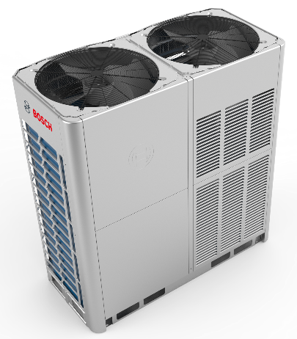
Refrigerant piping design
Air Flux - Installation and Commissioning
Permitted piping length and drop height
Total piping length |  | ≤ 1000m | L1 + 2 x Ʃ{L2 to L9} + Ʃ{a to j}
Longest length | Actual | ≤ 175m | L1 + Ʃ{L2 to L5} + e
 | Equivalent | ≤ 200m
Longest length after first branch |  | ≤ 40m / 90m | Ʃ{L2 to L5} + e
Largest level difference between indoor and outdoor unit | ODU up | ≤ 90m
 | ODU down | ≤ 110m
Largest level difference between indoor units |  | ≤ 30m
La
Lb
Lc
LA
L1
L7
L8
L9
L6
f
g
h
i
j
L2
L3
L4
L5
a
b
c
d
e
© Bosch Thermotechnik GmbH 2018. All rights reserved, also regarding any disposal, exploitation, reproduction, editing, distribution, as well as in the event of applications for industrial property rights.

Slide 7
Air Flux - Installation and Commissioning
Refrigerant piping design
The actual longest piping length ≤ 175m
La
Lb
Lc
LA
L1
L7
L8
L9
L6
f
g
h
i
j
L2
L3
L4
L5
L1+L2+L3+L4+L5+e ≤ 175 m
a
b
c
d
e
© Bosch Thermotechnik GmbH 2018. All rights reserved, also regarding any disposal, exploitation, reproduction, editing, distribution, as well as in the event of applications for industrial property rights.
Note: the equivalent length of each branch joint is 0.5m.

Slide 8
Air Flux - Installation and Commissioning
Refrigerant piping design
Longest length after first branch should not exceed 40m in length unless the following conditions are met, in which case the permitted length is up to 90m:
a to j ≤ 20m;
(Ʃ{L2 to L5} + e)-(L6 + f) ≤ 40m (the difference in length between the first indoor branch joint to the farthest IDU and to the nearest IDU ;
L2 to L9 diameter increase one size.
Longest length after first branch ≤ 40/90m
La
Lb
Lc
LA
L1
L7
L8
L9
L6
f
g
h
i
j
L2
L3
L4
L5
a
b
c
d
e
© Bosch Thermotechnik GmbH 2018. All rights reserved, also regarding any disposal, exploitation, reproduction, editing, distribution, as well as in the event of applications for industrial property rights.

Slide 9
Agenda
Installation
  Refrigerant piping design
  Installation material
  Installation main tools
  Indoor unit installation
  Outdoor unit installation
  Piping installation
  Electrical wiring
  Field settings
© Bosch Thermotechnik GmbH 2018. All rights reserved, also regarding any disposal, exploitation, reproduction, editing, distribution, as well as in the event of applications for industrial property rights.

Slide 10
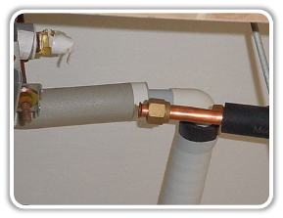
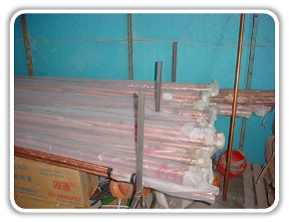
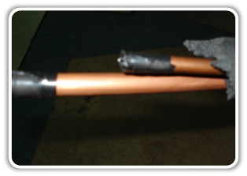
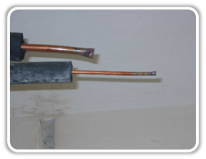
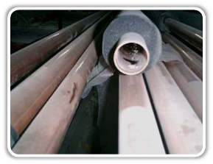
Installation material
Air Flux - Installation and Commissioning
Copper Piping storage
If pipes will be used soon, nozzle should be sealed by plastic bag or tape.
If pipes will be stored for a long time, the pipes should be charged with 0.2~0.5MPa Nitrogen and the nozzle should be sealed by welding.
© Bosch Thermotechnik GmbH 2018. All rights reserved, also regarding any disposal, exploitation, reproduction, editing, distribution, as well as in the event of applications for industrial property rights.

Slide 11
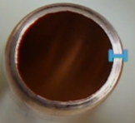
Air Flux - Installation and Commissioning
Pipe size (mm) | Φ6.35 | Φ9.53 | Φ12.7 | Φ15.9 | Φ19.1 | Φ22.2 | Φ25.4
Thickness (mm) | 0.8 | 0.8 | 0.8 | 1 | 1 | 1 | 1.2
Pipe size (mm) | Φ28.6 | Φ31.8 | Φ34.9 | Φ38.1 | Φ41.3 | Φ44.5 | Φ47.6
Thickness (mm) | 1.2 | 1.2 | 1.2 | 1.5 | 1.5 | 1.5 | 1.5
Remark: Max working pressure of refrigerant is 4.2 MPa (42 bar).
© Bosch Thermotechnik GmbH 2018. All rights reserved, also regarding any disposal, exploitation, reproduction, editing, distribution, as well as in the event of applications for industrial property rights.

Slide 12
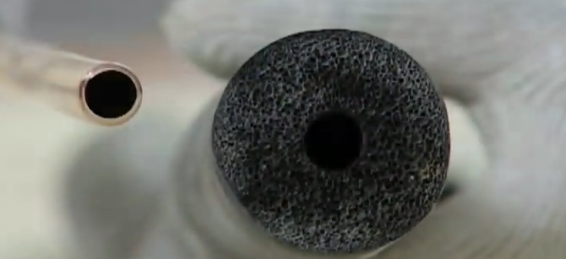
Installation material
Air Flux - Installation and Commissioning
Insulation material
The insulating material should be a suitable thickness and the inner diameter should match the size of refrigerant pipes
Pipe diameter | Thickness
Φ6.35~15.9mm | ≥15mm
Φ15.9~38.1mm | ≥20mm
Φ38.1~54.1mm | ≥25mm
© Bosch Thermotechnik GmbH 2018. All rights reserved, also regarding any disposal, exploitation, reproduction, editing, distribution, as well as in the event of applications for industrial property rights.

Slide 13
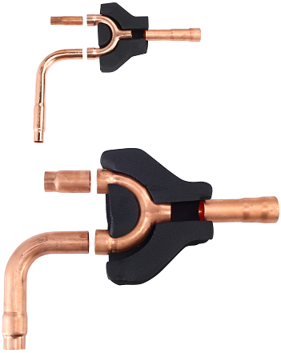
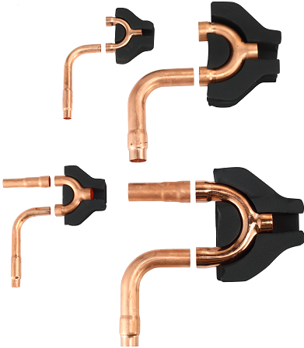
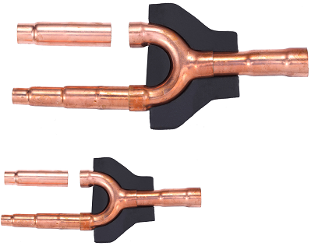
Installation material
Air Flux - Installation and Commissioning
Branch joints
The branch pipes must be supplied by Midea, otherwise will cause the unbalance of refrigerant distribution, which will reduce the system reliability.
Outdoor branch joints
Indoor branch joints
© Bosch Thermotechnik GmbH 2018. All rights reserved, also regarding any disposal, exploitation, reproduction, editing, distribution, as well as in the event of applications for industrial property rights.

Slide 14
Agenda
Installation
  Refrigerant piping design
  Installation material
  Installation main tools
  Indoor unit installation
  Outdoor unit installation
  Piping installation
  Electrical wiring
  Field settings
© Bosch Thermotechnik GmbH 2018. All rights reserved, also regarding any disposal, exploitation, reproduction, editing, distribution, as well as in the event of applications for industrial property rights.

Slide 15
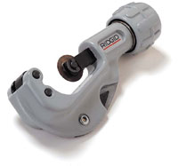
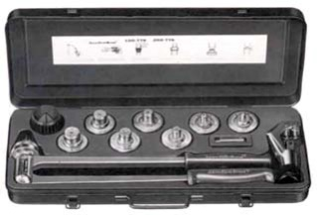
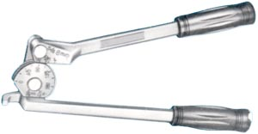
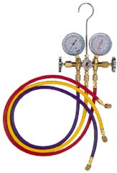
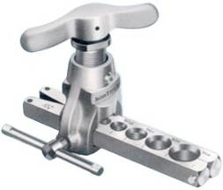
Main tools
Air Flux - Installation and Commissioning
Name | Appearance |  | Name | Appearance
Copper pipe cutter |  |  | Expander
Copper pipe bender |  |  | Pressure gauge
Flaring tool |  |  | Vacuum pump
© Bosch Thermotechnik GmbH 2018. All rights reserved, also regarding any disposal, exploitation, reproduction, editing, distribution, as well as in the event of applications for industrial property rights.

Slide 16
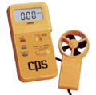

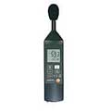
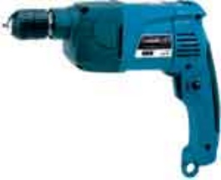
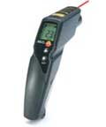
Main tools
Air Flux - Installation and Commissioning
Name | Appearance |  | Name | Appearance
Anemometer |  |  | Clamp meter
Acoustimeter |  |  | Electric drill
Infrared thermometer
© Bosch Thermotechnik GmbH 2018. All rights reserved, also regarding any disposal, exploitation, reproduction, editing, distribution, as well as in the event of applications for industrial property rights.

Slide 17
Agenda
Installation
  Refrigerant piping design
  Installation material
  Installation main tools
  Indoor unit installation
  Outdoor unit installation
  Piping installation
  Electrical wiring
  Field settings
© Bosch Thermotechnik GmbH 2018. All rights reserved, also regarding any disposal, exploitation, reproduction, editing, distribution, as well as in the event of applications for industrial property rights.

Slide 18
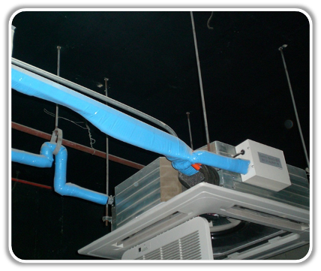
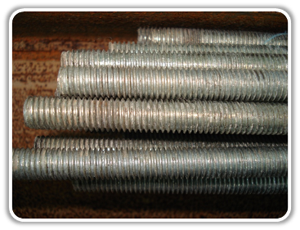
Indoor unit installation
Air Flux - Installation and Commissioning
4 Supports for indoor unit
Hoisting
Supports must be strong enough. The supports should be full thread hooks, and their diameters should be ≥ 10mm.
Full thread hooks
© Bosch Thermotechnik GmbH 2018. All rights reserved, also regarding any disposal, exploitation, reproduction, editing, distribution, as well as in the event of applications for industrial property rights.

Slide 19
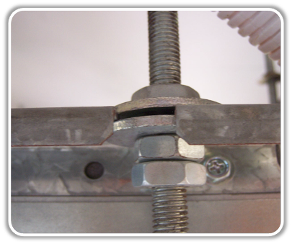
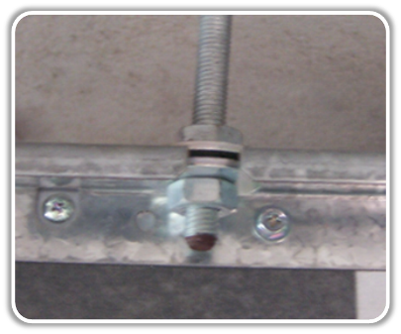
Indoor unit installation
Air Flux - Installation and Commissioning
Hoisting
Dual nuts
Single nut
© Bosch Thermotechnik GmbH 2018. All rights reserved, also regarding any disposal, exploitation, reproduction, editing, distribution, as well as in the event of applications for industrial property rights.

Slide 20
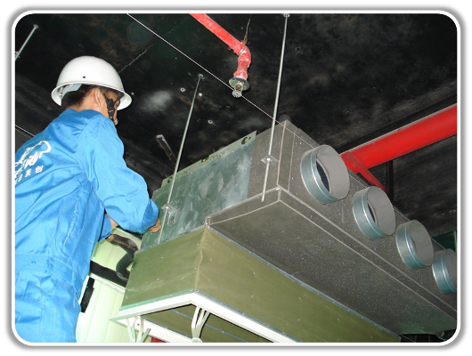

Indoor unit installation
Air Flux - Installation and Commissioning
Hoisting
Level meter
© Bosch Thermotechnik GmbH 2018. All rights reserved, also regarding any disposal, exploitation, reproduction, editing, distribution, as well as in the event of applications for industrial property rights.

Slide 21
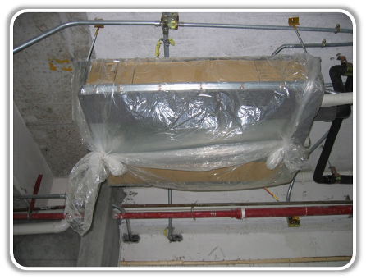
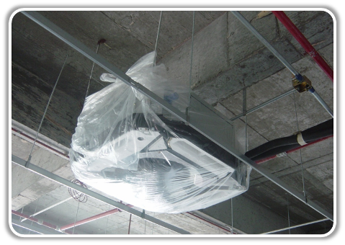
Indoor unit installation
Air Flux - Installation and Commissioning
Hoisting
Pack the indoor unit with plastic bag after hoisting to protect them from dust entering.
© Bosch Thermotechnik GmbH 2018. All rights reserved, also regarding any disposal, exploitation, reproduction, editing, distribution, as well as in the event of applications for industrial property rights.

Slide 22
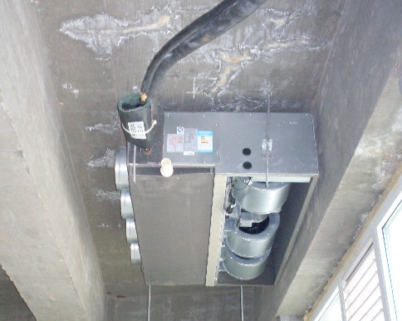
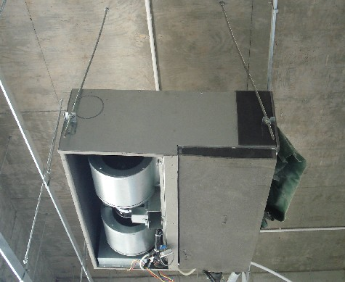
Indoor unit installation
Air Flux - Installation and Commissioning
Hoisting
Typical mistakes.
Air outlet too close to wall.
Full thread hooks not vertical.
© Bosch Thermotechnik GmbH 2018. All rights reserved, also regarding any disposal, exploitation, reproduction, editing, distribution, as well as in the event of applications for industrial property rights.

Slide 23
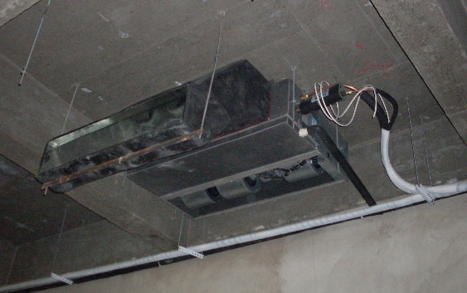
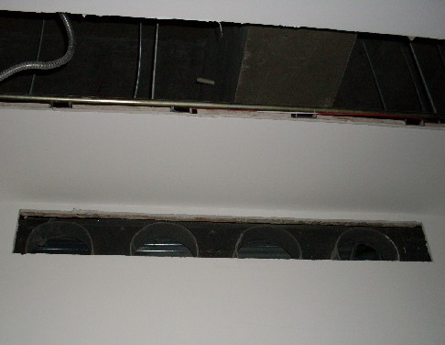
Indoor unit installation
Air Flux - Installation and Commissioning
Hoisting
Typical mistakes.
Improper duct connection.
Air outlet too small.
© Bosch Thermotechnik GmbH 2018. All rights reserved, also regarding any disposal, exploitation, reproduction, editing, distribution, as well as in the event of applications for industrial property rights.

Slide 24
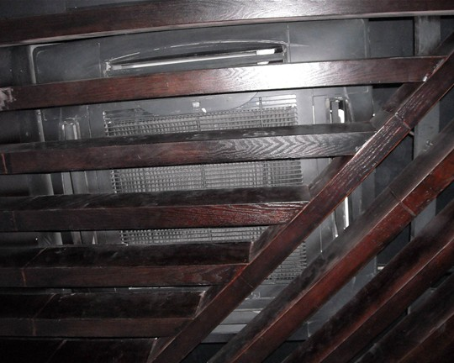
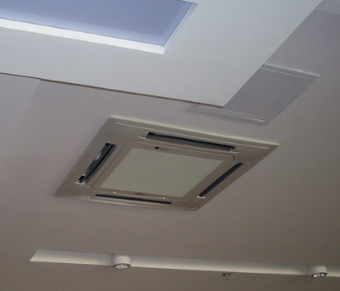
Indoor unit installation
Air Flux - Installation and Commissioning
Access hole
Access hole for easy maintenance and service
No access hole.
© Bosch Thermotechnik GmbH 2018. All rights reserved, also regarding any disposal, exploitation, reproduction, editing, distribution, as well as in the event of applications for industrial property rights.

Slide 25
Agenda
Installation
  Refrigerant piping design
  Installation material
  Installation main tools
  Indoor unit installation
  Outdoor unit installation
  Piping installation
  Electrical wiring
  Field settings
© Bosch Thermotechnik GmbH 2018. All rights reserved, also regarding any disposal, exploitation, reproduction, editing, distribution, as well as in the event of applications for industrial property rights.

Slide 26
Outdoor unit installation
Air Flux - Installation and Commissioning
For single row installation
Installation space requirements
For single unit installation
For multi-row installation
© Bosch Thermotechnik GmbH 2018. All rights reserved, also regarding any disposal, exploitation, reproduction, editing, distribution, as well as in the event of applications for industrial property rights.

Slide 27
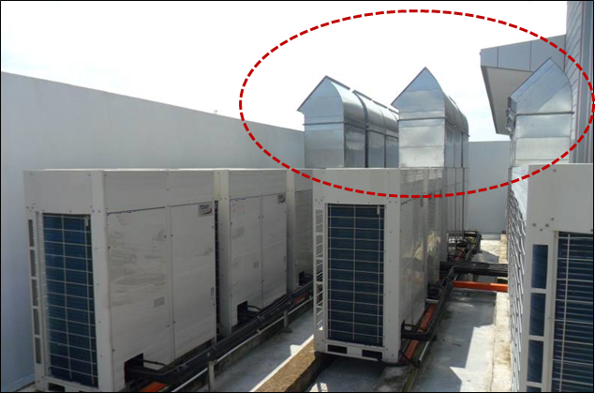
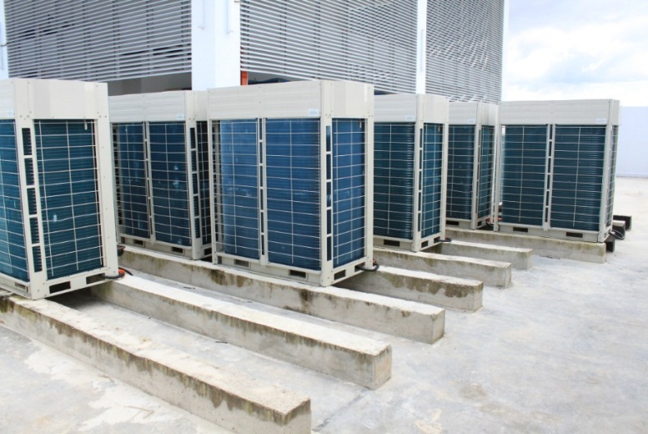
Outdoor unit installation
Air Flux - Installation and Commissioning
Installation space requirements
Depending on the height of adjacent walls relative to the height of the units, ducting may be required to ensure proper air discharge. In the situation depicted in below figure, the vertical section of ducting should be at least H-h high.
© Bosch Thermotechnik GmbH 2018. All rights reserved, also regarding any disposal, exploitation, reproduction, editing, distribution, as well as in the event of applications for industrial property rights.

Slide 28
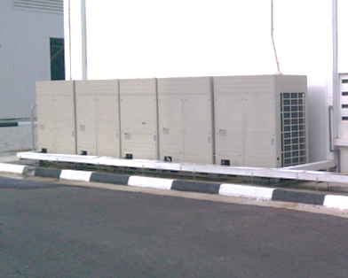
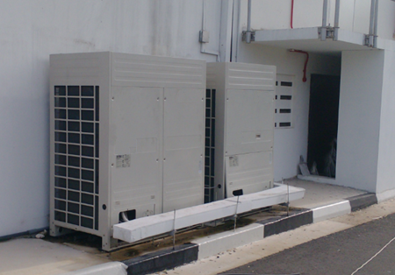
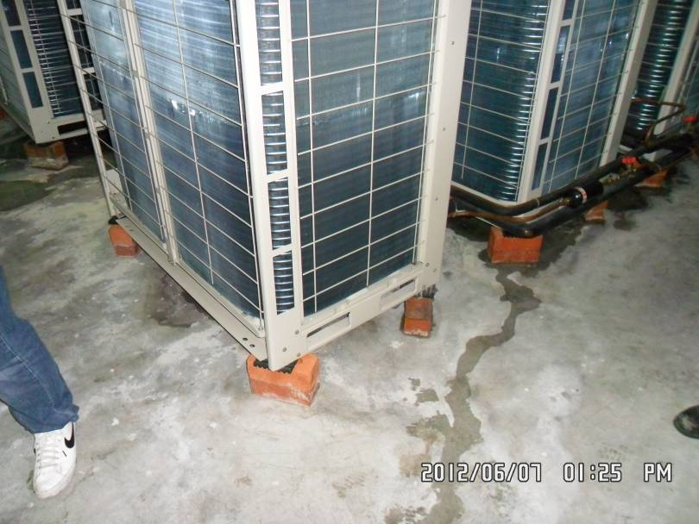
Outdoor unit installation
Air Flux - Installation and Commissioning
Wrong Examples;
© Bosch Thermotechnik GmbH 2018. All rights reserved, also regarding any disposal, exploitation, reproduction, editing, distribution, as well as in the event of applications for industrial property rights.

Slide 29
Outdoor unit installation
Air Flux - Installation and Commissioning
Master and slave unit positioning
In systems with multiple outdoor units, the units should be placed in order from largest capacity unit to smallest capacity unit. The largest capacity unit must be placed on the first branch, and be set as the master unit, while the others should be set as slave units.
All the outdoor units in one combination should be on the same level.
© Bosch Thermotechnik GmbH 2018. All rights reserved, also regarding any disposal, exploitation, reproduction, editing, distribution, as well as in the event of applications for industrial property rights.

Slide 30
Outdoor unit installation
Air Flux - Installation and Commissioning
Base structures
Bases should be constructed on solid ground or on structures of sufficient strength to support the units’ weight.
Bases should be at least 200mm high to provide sufficient access for installation of piping.
Either steel or concrete bases may be suitable.
bases should be completely level.
A drainage ditch should be provided to allow drainage of condensate.
© Bosch Thermotechnik GmbH 2018. All rights reserved, also regarding any disposal, exploitation, reproduction, editing, distribution, as well as in the event of applications for industrial property rights.

Slide 31
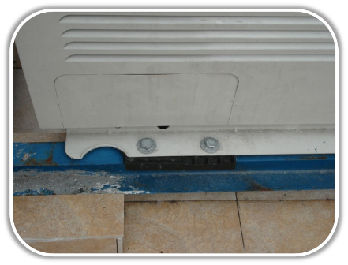
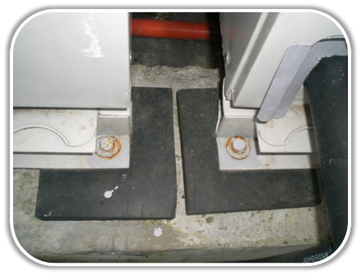
Outdoor unit installation
Air Flux - Installation and Commissioning
Base structures
Rubber anti-vibration pads are necessary to avoid vibration.
Rubber Pads
© Bosch Thermotechnik GmbH 2018. All rights reserved, also regarding any disposal, exploitation, reproduction, editing, distribution, as well as in the event of applications for industrial property rights.

Slide 32
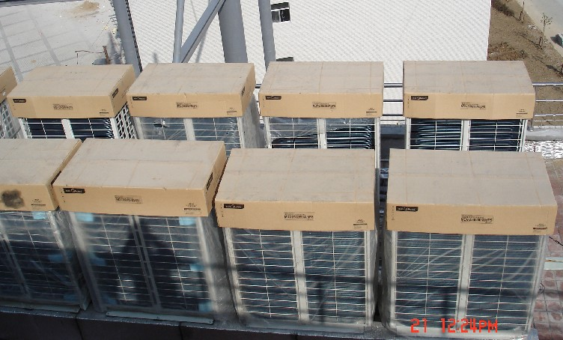
Outdoor unit installation
Air Flux - Installation and Commissioning
Protection
Do not remove the package before commissioning
© Bosch Thermotechnik GmbH 2018. All rights reserved, also regarding any disposal, exploitation, reproduction, editing, distribution, as well as in the event of applications for industrial property rights.

Slide 33
Agenda
Installation
  Refrigerant piping design
  Installation material
  Installation main tools
  Indoor unit installation
  Outdoor unit installation
  Piping installation
  Electrical wiring
  Field settings
© Bosch Thermotechnik GmbH 2018. All rights reserved, also regarding any disposal, exploitation, reproduction, editing, distribution, as well as in the event of applications for industrial property rights.

Slide 34
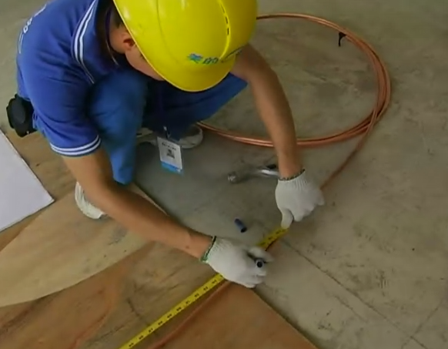
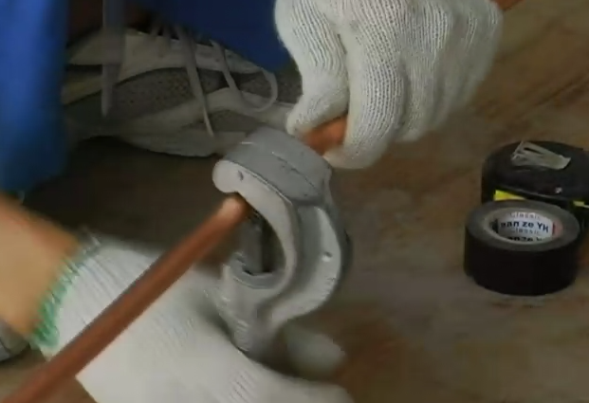
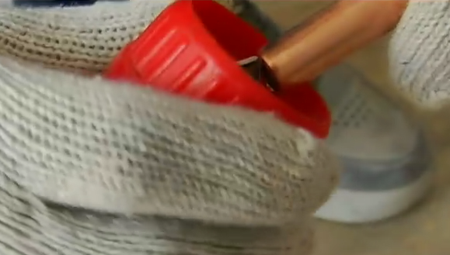
Piping installation
Air Flux - Installation and Commissioning
Pipe cutting
Measure the exact length of pipes.
Use the pipe cutter to cut the pipes.
Use scraper to remove the copper burrs.
© Bosch Thermotechnik GmbH 2018. All rights reserved, also regarding any disposal, exploitation, reproduction, editing, distribution, as well as in the event of applications for industrial property rights.

Slide 35
Piping installation
Air Flux - Installation and Commissioning
Pipe insulation
Caution: After finishing gastight test, the insulation work should be done on the pipe connection parts and branch pipes.
Purpose
Prevent condensate water adhere to the gas pipe
Protect people from hurt of high temperature
Avoid energy loss
© Bosch Thermotechnik GmbH 2018. All rights reserved, also regarding any disposal, exploitation, reproduction, editing, distribution, as well as in the event of applications for industrial property rights.

Slide 36
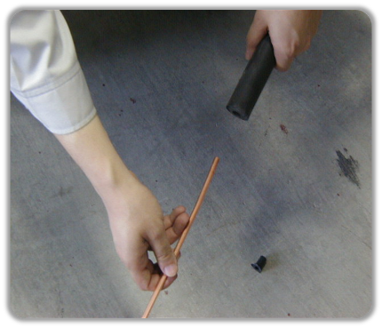
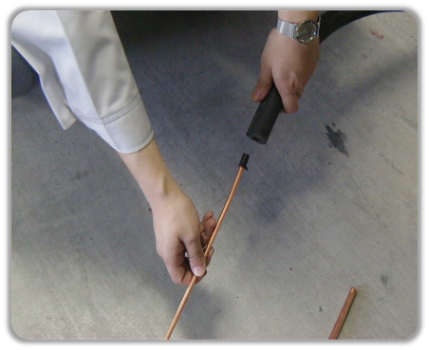
Piping installation
Air Flux - Installation and Commissioning
Pipe insulation
Block the nozzle of the pipe when make it through the insulation material.
Wrong
Avoid the dust entering the pipe
© Bosch Thermotechnik GmbH 2018. All rights reserved, also regarding any disposal, exploitation, reproduction, editing, distribution, as well as in the event of applications for industrial property rights.

Slide 37
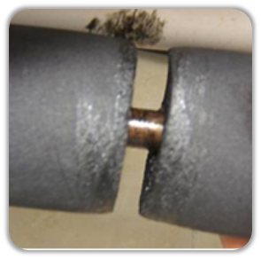
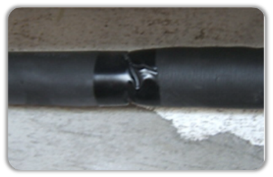
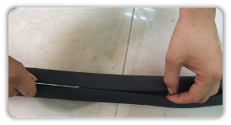
Piping installation
Air Flux - Installation and Commissioning
Pipe insulation
The gap between two parts should be well insulated by additional insulation material.
Wrong
Right
Insulation
© Bosch Thermotechnik GmbH 2018. All rights reserved, also regarding any disposal, exploitation, reproduction, editing, distribution, as well as in the event of applications for industrial property rights.

Slide 38
Piping installation
Air Flux - Installation and Commissioning
Pipe insulation
The gap between two parts should be well insulated by additional insulation material.
© Bosch Thermotechnik GmbH 2018. All rights reserved, also regarding any disposal, exploitation, reproduction, editing, distribution, as well as in the event of applications for industrial property rights.

Slide 39
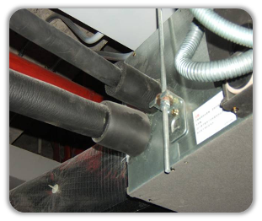

Piping installation
Air Flux - Installation and Commissioning
Pipe insulation
The insulation work must be done on every part of the refrigerant pipes.
© Bosch Thermotechnik GmbH 2018. All rights reserved, also regarding any disposal, exploitation, reproduction, editing, distribution, as well as in the event of applications for industrial property rights.

Slide 40



Piping installation
Air Flux - Installation and Commissioning
Pipe hanging
The distance between the supports of the copper pipes.
Diameter (mm) | ≤20 | 20~40 | ≥40
Distance (m) | 1 | 1.5 | 2
When the liquid pipe and gas pipe are hung up together, it is determined by the diameter of liquid pipe.
Record the actual liquid pipe length for future reference when charging additional refrigerant.
© Bosch Thermotechnik GmbH 2018. All rights reserved, also regarding any disposal, exploitation, reproduction, editing, distribution, as well as in the event of applications for industrial property rights.

Slide 41


Piping installation
Air Flux - Installation and Commissioning
Pipe hanging (wrong examples)
© Bosch Thermotechnik GmbH 2018. All rights reserved, also regarding any disposal, exploitation, reproduction, editing, distribution, as well as in the event of applications for industrial property rights.

Slide 42

Piping installation
Air Flux - Installation and Commissioning
Pipe connection
U-shaped branch of outdoor side must be installed horizontally.
The branch joint of indoor side can be installed horizontally or vertically.
© Bosch Thermotechnik GmbH 2018. All rights reserved, also regarding any disposal, exploitation, reproduction, editing, distribution, as well as in the event of applications for industrial property rights.

Slide 43



Piping installation
Air Flux - Installation and Commissioning
Pipe connection
To avoid accumulation of oil in the outdoor units, outdoor branch joints should be installed horizontally and must not be higher than the outdoor unit refrigerant outlets.
© Bosch Thermotechnik GmbH 2018. All rights reserved, also regarding any disposal, exploitation, reproduction, editing, distribution, as well as in the event of applications for industrial property rights.

Slide 44


Piping installation
Air Flux - Installation and Commissioning
Pipe connection
© Bosch Thermotechnik GmbH 2018. All rights reserved, also regarding any disposal, exploitation, reproduction, editing, distribution, as well as in the event of applications for industrial property rights.

Slide 45
Piping installation
Air Flux - Installation and Commissioning
Pipe connection
Horizontal branch joints must be installed at an angle to the horizontal not exceeding 10º in order to avoid uneven distribution of refrigerant and possible malfunction.
© Bosch Thermotechnik GmbH 2018. All rights reserved, also regarding any disposal, exploitation, reproduction, editing, distribution, as well as in the event of applications for industrial property rights.

Slide 46
Piping installation
Air Flux - Installation and Commissioning
Pipe connection
To ensure even distribution of refrigerant, branch joints should be installed:
More than 500mm of a 90º bend to an branch joint;
More than 500mm of an branch joint to another branch joint;
More than 500mm of the straight section of piping leading to an indoor units;
500 or more
500 or more
500 or more
500 or more
500 or more
Indoor unit
Indoor unit
Indoor unit
© Bosch Thermotechnik GmbH 2018. All rights reserved, also regarding any disposal, exploitation, reproduction, editing, distribution, as well as in the event of applications for industrial property rights.

Slide 47

Piping installation
Air Flux - Installation and Commissioning
Pipe connection
Refrigerant flow through bend of branch will cause Turbulent flow, turbulent flow may cause noise and make unbalance refrigerant distribution if not enough distance is satisfied
＞500mm
© Bosch Thermotechnik GmbH 2018. All rights reserved, also regarding any disposal, exploitation, reproduction, editing, distribution, as well as in the event of applications for industrial property rights.

Slide 48


Piping installation
Air Flux - Installation and Commissioning
Pipe connection
Sharp bend is too close to branch joint
Two branch joints are too close
© Bosch Thermotechnik GmbH 2018. All rights reserved, also regarding any disposal, exploitation, reproduction, editing, distribution, as well as in the event of applications for industrial property rights.

Slide 49
Piping installation
Air Flux - Installation and Commissioning
Pipe connection
Refrigerant piping connection method.
Item | Gas pipe | Liquid pipe
Outdoor unit | Welding | Welding
Indoor unit | Flaring nut | Flaring nut
Branch joint | Welding | Welding
© Bosch Thermotechnik GmbH 2018. All rights reserved, also regarding any disposal, exploitation, reproduction, editing, distribution, as well as in the event of applications for industrial property rights.

Slide 50


Piping installation
Air Flux - Installation and Commissioning
Welding
Never flow oxygen through piping as doing so aids oxidation and could easily lead to explosion and as such is extremely dangerous.
© Bosch Thermotechnik GmbH 2018. All rights reserved, also regarding any disposal, exploitation, reproduction, editing, distribution, as well as in the event of applications for industrial property rights.

Slide 51
Piping installation
Air Flux - Installation and Commissioning
Welding
Use a pressure reducing valve to flow nitrogen through copper piping at 0.02-0.03MPa during welding.
Start the flow before brazing starts and ensure that the nitrogen continuously passes through the section being welded until the welding is complete and the copper has cooled down completely.
Legend
1 | Copper piping
2 | Section being brazed
3 | Nitrogen connection
4 | Hand valve
5 | Pressure-reducing valve
6 | Nitrogen
© Bosch Thermotechnik GmbH 2018. All rights reserved, also regarding any disposal, exploitation, reproduction, editing, distribution, as well as in the event of applications for industrial property rights.

Slide 52


Piping installation
Air Flux - Installation and Commissioning
Welding
Why the Nitrogen is necessary?
High temp.
Copper oxide
Hard to be removed clearly
Damage the compressor
Jam the refrigerant system
© Bosch Thermotechnik GmbH 2018. All rights reserved, also regarding any disposal, exploitation, reproduction, editing, distribution, as well as in the event of applications for industrial property rights.

Slide 53
Piping installation
Air Flux - Installation and Commissioning
Flushing
Purpose: to remove dust, other particles and moisture, which could cause compressor malfunction.
Flushing should be performed once the piping connections have been completed with the exception of the final connections to the indoor units.
Only use nitrogen for flushing.
Do not connect to indoor units
© Bosch Thermotechnik GmbH 2018. All rights reserved, also regarding any disposal, exploitation, reproduction, editing, distribution, as well as in the event of applications for industrial property rights.

Slide 54
Piping installation
Air Flux - Installation and Commissioning
Flushing
The liquid and gas sides can be flushed simultaneously; alternatively, one side can be flushed first and then for the other side.
Use blind plugs to block all liquid (gas) side openings, except for the opening at the indoor unit which is farthest from the outdoor units .
Flush the pipe with 0.5 MPa Nitrogen.
Use your hand to block the opening, when the pressure is too high to block, then remove your hand.
Repeat the step 3 until on further dirt or moisture is emitted from the piping. Seal the opening once it has been flushed.
Flushing the other openings in the same manner, working in sequence from the farthest indoor unit towards the outdoor unit.
After flushing, seal all the openings.
Pipe flushing sequence (1-2-3-4-5-6 working towards the ODU)
© Bosch Thermotechnik GmbH 2018. All rights reserved, also regarding any disposal, exploitation, reproduction, editing, distribution, as well as in the event of applications for industrial property rights.

Slide 55

Piping installation
Air Flux - Installation and Commissioning
Flushing
© Bosch Thermotechnik GmbH 2018. All rights reserved, also regarding any disposal, exploitation, reproduction, editing, distribution, as well as in the event of applications for industrial property rights.

Slide 56
Piping installation
Air Flux - Installation and Commissioning
Gastightness test
Purpose: to prevent faults caused by refrigerant leakage, a gastightness test should be performed before system commission.
Only dry nitrogen should be used for gastightness testing.
Keep the liquid and gas stop valves fully closed.
The piping system is complete and the indoor and outdoor units have been connected.
Procedure
Charge N₂ until the gauge shows slowly and orderly through the needle valves on the liquid and gas stop valves
© Bosch Thermotechnik GmbH 2018. All rights reserved, also regarding any disposal, exploitation, reproduction, editing, distribution, as well as in the event of applications for industrial property rights.

Slide 57
Piping installation
Air Flux - Installation and Commissioning
Gastightness test
1st stage:
Large leakage check: 0.3MPa more than 3 minutes
2nd stage:
Small leakage check: 1.5MPa more than 3 minutes
3rd stage:
Micro leakage check: 4.0MPa more than 24 hours
Check for micro leakages:
If there’s 1ºC difference in temperature, there will be 0.01MPa difference in pressure.
Correcting formula:
Actual value = Pressure when finish charging +(current temp. – temp. when finish charging)
x 0.01MPa
© Bosch Thermotechnik GmbH 2018. All rights reserved, also regarding any disposal, exploitation, reproduction, editing, distribution, as well as in the event of applications for industrial property rights.

Slide 58
Piping installation
Air Flux - Installation and Commissioning
Gastightness test
Example:
Temp. when charging N2: 24ºC
N2 pressure when charging: 3.8MPa
Temp. after 24 hours: 22ºC
N2 pressure after 24hours
= 3.8MPa + (22ºC-24ºC) x 0.01MPa/ºC
= 3.8MPa -0.02MPa
= 3.78MPa
If the actual pressure after 24hours is lower than 3.78MPa, you need to check leakage.
© Bosch Thermotechnik GmbH 2018. All rights reserved, also regarding any disposal, exploitation, reproduction, editing, distribution, as well as in the event of applications for industrial property rights.

Slide 59
Piping installation
Air Flux - Installation and Commissioning
Vacuum
Purpose: to remove moisture and non-condensable gases from the system.
A vacuum pump capable of maintaining a pressure of -0.1MPa or lower should be used. Using a vacuum pump with a discharge in excess of 4L/s and a precision level of 0.02mmHg is recommended.
Keep the liquid and gas stop valves fully closed.
Procedure
Connect to the vacuum pump
Vacuum the system till the time when gauge shows -0.1Mpa
When vacuum to -0.1MPa, continue vacuuming for 2h
Stop vacuuming
After 1 hour, check the pressure gauge
© Bosch Thermotechnik GmbH 2018. All rights reserved, also regarding any disposal, exploitation, reproduction, editing, distribution, as well as in the event of applications for industrial property rights.

Slide 60
Piping installation
Air Flux - Installation and Commissioning
Vacuum
Pressure gauge
© Bosch Thermotechnik GmbH 2018. All rights reserved, also regarding any disposal, exploitation, reproduction, editing, distribution, as well as in the event of applications for industrial property rights.

Slide 61
Piping installation
Air Flux - Installation and Commissioning
Charging refrigerant
Only charge refrigerant after performing a gastightness test and vacuum drying.
Never charge more refrigerant than required as doing so can lead to liquid hammering.
Only use refrigerant R410A, use tools and equipment designed for use with R410A.
Always use protective gloves and protect your eyes when charging refrigerant.
Procedure
Calculate necessary amount of additional refrigerant according to the diameter and length of liquid pipe
Keep the liquid and gas stop valves fully closed, charge refrigerant through gas and liquid stop valves at the same time
When the amount charged reaches R (kg), finish charging
If the amount charged has not reached R (kg) but no additional refrigerant can be charged, open the gas and liquid stop valves, run the outdoor units in cooling mode, and continue charging until the full R (kg) of refrigerant has been charged
© Bosch Thermotechnik GmbH 2018. All rights reserved, also regarding any disposal, exploitation, reproduction, editing, distribution, as well as in the event of applications for industrial property rights.

Slide 62
Piping installation
Air Flux - Installation and Commissioning
Charging refrigerant
The additional refrigerant charge required depends on the lengths and diameters of the outdoor and indoor liquid pipes.
Assume 0.5m for the equivalent pipe length of each branch joint.
Liquid side piping (mm) | Additional refrigerant charge per meter of equivalent length of piping (kg)
Φ6.35 | 0.022
Φ9.53 | 0.057
Φ12.7 | 0.110
Φ15.9 | 0.170
Φ19.1 | 0.260
Φ22.2 | 0.360
Φ25.4 | 0.520
Φ28.6 | 0.680
Additional refrigerant charge R (kg) =L1(Φ6.35)×0.022+L2(Φ9.53)×0.057+L3(Φ12.7)×0.110+L4(Φ15.9)×0.170+L5(Φ19.1)×0.260+L6 (Φ22.2)×0.360+L7(Φ25.4)×0.520+L8(Φ28.6)×0.680
Where L1 to L8 represent the equivalent lengths of the liquid pipes of different diameters.
© Bosch Thermotechnik GmbH 2018. All rights reserved, also regarding any disposal, exploitation, reproduction, editing, distribution, as well as in the event of applications for industrial property rights.

Slide 63


Piping installation
Air Flux - Installation and Commissioning
Selection steps
Drain Piping
Condensate water volume (L/h) =
Indoor unit capacity (HP) × 2L/h
Select the diameter according to the below table
Condensate water volume : V (L/h) | I.D (mm) | Thickness (mm)
V ≤ 14 | Φ 25 | 3.0
14 ＜ V ≤ 88 | Φ 30 | 3.5
88 ＜ V ≤ 175 | Φ 40 | 4.0
175 ＜ V ≤ 334 | Φ 50 | 4.5
334 ＜ V | Φ 80 | 6.0
© Bosch Thermotechnik GmbH 2018. All rights reserved, also regarding any disposal, exploitation, reproduction, editing, distribution, as well as in the event of applications for industrial property rights.

Slide 64

Piping installation
Air Flux - Installation and Commissioning
Drain Piping
Caution：
The slope of main drain piping must be bigger than 1%.
If the slope < 1%, then select drain piping with bigger diameter.
The length of drain piping should be as short as possible.
The drain piping should be independent with other water pipe.
Never put the drain piping together with dirty water pipe.
© Bosch Thermotechnik GmbH 2018. All rights reserved, also regarding any disposal, exploitation, reproduction, editing, distribution, as well as in the event of applications for industrial property rights.

Slide 65

Piping installation
Air Flux - Installation and Commissioning
Drain Piping
To avoid the bending, recommended support/hanger spacing is 0.8 – 1.0m for horizontal piping and 1.5 – 2.0m for vertical piping.
Each vertical section should be fitted with at least two supports. For horizontal piping, spacing greater than those recommended leads to sagging and deformation of the pipe profile at the supports which impedes water flow and should therefore be avoided.
© Bosch Thermotechnik GmbH 2018. All rights reserved, also regarding any disposal, exploitation, reproduction, editing, distribution, as well as in the event of applications for industrial property rights.

Slide 66

Piping installation
Air Flux - Installation and Commissioning
Drain Piping
Air vents should be fitted at the highest point of each drain piping system to ensure that condensation is discharged smoothly.
U-bends or elbow joints should be used such that the vents face downwards, to prevent dust entering the piping.
Air vents should not be installed too close to indoor unit lift pumps.
© Bosch Thermotechnik GmbH 2018. All rights reserved, also regarding any disposal, exploitation, reproduction, editing, distribution, as well as in the event of applications for industrial property rights.

Slide 67
Agenda
Installation
  Refrigerant piping design
  Installation material
  Installation main tools
  Indoor unit installation
  Outdoor unit installation
  Piping installation
  Electrical wiring
  Field settings
© Bosch Thermotechnik GmbH 2018. All rights reserved, also regarding any disposal, exploitation, reproduction, editing, distribution, as well as in the event of applications for industrial property rights.

Slide 68
Electrical Wiring
Air Flux - Installation and Commissioning
Basic requirement
All wiring work must be done by qualified person
All wires, and electric devices must be conformed to local standards
Power Supply Wiring
Voltage range: rated voltage ±10%
Independent power supply
Capacity of power device is large enough
Well and reliable PE line
© Bosch Thermotechnik GmbH 2018. All rights reserved, also regarding any disposal, exploitation, reproduction, editing, distribution, as well as in the event of applications for industrial property rights.

Slide 69





Electrical Wiring
Air Flux - Installation and Commissioning
Power Supply Wiring
Power supply for outdoor unit
Leakage protector
/Manual switch
Power supply box
3-Phase
380/400/415V
© Bosch Thermotechnik GmbH 2018. All rights reserved, also regarding any disposal, exploitation, reproduction, editing, distribution, as well as in the event of applications for industrial property rights.

Slide 70
Electrical Wiring
Air Flux - Installation and Commissioning
Power Supply Wiring
Power supply for indoor unit
© Bosch Thermotechnik GmbH 2018. All rights reserved, also regarding any disposal, exploitation, reproduction, editing, distribution, as well as in the event of applications for industrial property rights.

Slide 71

Electrical Wiring
Air Flux - Installation and Commissioning
Power Supply Wiring
For indoor / outdoor unit power wire sizing and circuit breaker sizing, refer to indoor / outdoor unit “Electrical Characteristics”.
Select wire size based on the value of MCA in “Electrical Characteristics”.
Select overcurrent circuit breakers and residual-current circuit breakers based on the value of MFA in “Electrical Characteristics”.
© Bosch Thermotechnik GmbH 2018. All rights reserved, also regarding any disposal, exploitation, reproduction, editing, distribution, as well as in the event of applications for industrial property rights.

Slide 72

Electrical Wiring
Air Flux - Installation and Commissioning
Communication Wiring
0.75mm² 3-core shielded cable is recommended for communication wiring. Using other types of cable can lead to interference and malfunction.
In installations where no strong electromagnetic fields are present, 2-core non-polarized shielded communication wiring can be used for indoor and outdoor unit (P Q) communication.
© Bosch Thermotechnik GmbH 2018. All rights reserved, also regarding any disposal, exploitation, reproduction, editing, distribution, as well as in the event of applications for industrial property rights.

Slide 73



Electrical Wiring
Air Flux - Installation and Commissioning
Communication Wiring
The P Q E communication wires should be connected one unit after another in a daisy chain from the ODU to the final IDU for indoor and outdoor units communication.
The H1 H2 E communication wires should be connected one unit after another in a daisy chain from the master ODU to the final slave ODU for outdoor units communication.
NOTE:
At the final indoor unit, a 120Ω resistor should be connected between the P and Q terminals.
The shielding nets of the communication wires should be connected together and grounded.
Master unit
Slave unit
Slave unit
P,Q,E
H1,H2,E
H1,H2,E
H1,H2,E
P,Q,E
P,Q,E
P,Q,E
P,Q,E
© Bosch Thermotechnik GmbH 2018. All rights reserved, also regarding any disposal, exploitation, reproduction, editing, distribution, as well as in the event of applications for industrial property rights.

Slide 74
Electrical Wiring
Air Flux - Installation and Commissioning
Communication Wiring
Communication wiring configurations – correct and incorrect examples.
© Bosch Thermotechnik GmbH 2018. All rights reserved, also regarding any disposal, exploitation, reproduction, editing, distribution, as well as in the event of applications for industrial property rights.

Slide 75
Electrical Wiring
Air Flux - Installation and Commissioning
Communication Wiring
Communication wiring configurations – correct and incorrect examples.
© Bosch Thermotechnik GmbH 2018. All rights reserved, also regarding any disposal, exploitation, reproduction, editing, distribution, as well as in the event of applications for industrial property rights.

Slide 76
Electrical Wiring
Air Flux - Installation and Commissioning
Communication Wiring
Communication wiring configurations – correct and incorrect examples.
© Bosch Thermotechnik GmbH 2018. All rights reserved, also regarding any disposal, exploitation, reproduction, editing, distribution, as well as in the event of applications for industrial property rights.

Slide 77

Electrical Wiring
Air Flux - Installation and Commissioning
Communication Wiring
The X Y E communication wires should be connected to master unit for indoor units and indoor unit centralized controller communication.
IDU centralized controller
Master unit
Slave unit
Slave unit
X,Y,E
P,Q,E
H1,H2,E
H1,H2,E
H1,H2,E
P,Q,E
P,Q,E
P,Q,E
P,Q,E
© Bosch Thermotechnik GmbH 2018. All rights reserved, also regarding any disposal, exploitation, reproduction, editing, distribution, as well as in the event of applications for industrial property rights.

Slide 78


Electrical Wiring
Air Flux - Installation and Commissioning
Communication Wiring
To prevent signal interference, the power wiring and communication wiring should not be run in the same conduit.
If the power supply is less than 10A, a separation of at least 300mm between power wiring and communication wiring conduits should be maintained
If the power supply is in the range 10A to 50A then a separation of at least 500mm should be maintained.
© Bosch Thermotechnik GmbH 2018. All rights reserved, also regarding any disposal, exploitation, reproduction, editing, distribution, as well as in the event of applications for industrial property rights.

Slide 79
Agenda
Installation
  Refrigerant piping design
  Installation material
  Installation main tools
  Indoor unit installation
  Outdoor unit installation
  Piping installation
  Electrical wiring
  Field settings
© Bosch Thermotechnik GmbH 2018. All rights reserved, also regarding any disposal, exploitation, reproduction, editing, distribution, as well as in the event of applications for industrial property rights.

Slide 80

Field setting
Air Flux - Installation and Commissioning
PCB switches and
switch settings
© Bosch Thermotechnik GmbH 2018. All rights reserved, also regarding any disposal, exploitation, reproduction, editing, distribution, as well as in the event of applications for industrial property rights.

Slide 81
Field setting
Air Flux - Installation and Commissioning
Switch settings
NOTE:
Black denotes the switch position.
© Bosch Thermotechnik GmbH 2018. All rights reserved, also regarding any disposal, exploitation, reproduction, editing, distribution, as well as in the event of applications for industrial property rights.

Slide 82
Field setting
Air Flux - Installation and Commissioning
Switch settings
NOTE:
Black denotes the switch position.
© Bosch Thermotechnik GmbH 2018. All rights reserved, also regarding any disposal, exploitation, reproduction, editing, distribution, as well as in the event of applications for industrial property rights.

Slide 83
Field setting
Air Flux - Installation and Commissioning
Switch settings
NOTE:
Black denotes the switch position.
© Bosch Thermotechnik GmbH 2018. All rights reserved, also regarding any disposal, exploitation, reproduction, editing, distribution, as well as in the event of applications for industrial property rights.

Slide 84
Field setting
Air Flux - Installation and Commissioning
Switch settings
NOTE:
Black denotes the switch position.
© Bosch Thermotechnik GmbH 2018. All rights reserved, also regarding any disposal, exploitation, reproduction, editing, distribution, as well as in the event of applications for industrial property rights.

Slide 85
Field setting
Air Flux - Installation and Commissioning
Switch settings
ACC – MT (Central Controller)
NOTE:
Black denotes the switch position.
© Bosch Thermotechnik GmbH 2018. All rights reserved, also regarding any disposal, exploitation, reproduction, editing, distribution, as well as in the event of applications for industrial property rights.

Slide 86
Field setting
Air Flux - Installation and Commissioning
Switch settings
NOTE:
Black denotes the switch position.
© Bosch Thermotechnik GmbH 2018. All rights reserved, also regarding any disposal, exploitation, reproduction, editing, distribution, as well as in the event of applications for industrial property rights.

Slide 87
Field setting
Air Flux - Installation and Commissioning
Switch settings
NOTE:
Black denotes the switch position.
© Bosch Thermotechnik GmbH 2018. All rights reserved, also regarding any disposal, exploitation, reproduction, editing, distribution, as well as in the event of applications for industrial property rights.

Slide 88

Field setting
Air Flux - Installation and Commissioning
Switch settings
NOTE:
Black denotes the switch position.
© Bosch Thermotechnik GmbH 2018. All rights reserved, also regarding any disposal, exploitation, reproduction, editing, distribution, as well as in the event of applications for industrial property rights.

Slide 89


ODU Sockets Descriptions
Field Settings
© Bosch Thermotechnik GmbH 2018. All rights reserved, also regarding any disposal, exploitation, reproduction, editing, distribution, as well as in the event of applications for industrial property rights.

Slide 90




Odu Parameter Settings
Field Settings
1- Rotary Switches
2- Digital Screen DSP2
3- Digital Screen DSP1
4- SW3 - SW6 buttons
5- Dip Switch
6- Main Processor of Board
Display Output
3
2
1
4
SW3-SW6 button functions
5
6
© Bosch Thermotechnik GmbH 2018. All rights reserved, also regarding any disposal, exploitation, reproduction, editing, distribution, as well as in the event of applications for industrial property rights.

Slide 91
Odu Parameter Monitoring
Field Settings
Display Screen Parameters
DSP1 | Parameters displayed on DSP2 | Remarks
0 | Unit address | For ODU’s : 0-2
1 | Unit capacity | Values: 0 (8HP); 1 (10HP); 2 (12HP); 3 (14HP); 4 (16HP); 5 (18HP); 6 (20HP); 7 (22HP); 8 (24HP); 9 (26HP); A (28HP); B (30HP); C (32HP)
2 | Number of outdoor units | Only available for master unit.
3 | Number of indoor units as set on PCB | Only available for master unit.
4 | Total capacity of the outdoor units | Only available for master unit. display on slave units makes no sense
5 | Total capacity requirement of the indoor units | Only available for master unit.
6 | Total capacity requirement correction of the master unit | Only available for master unit.
7 | Operating mode | Operation mode: 0 (OFF); 2 (cooling); 3 (heating); 4 (forced cooling)
8 | Actual operating capacity of the outdoor unit
9 | Fan A speed index | Range 1 (slowest) --- 35 (fastest)
10 | Fan B speed index | Range 1 (slowest) --- 35 (fastest)
11 | T2/T2B average temperature [ °C]
12 | Main heat exchanger pipe (T3) temperature [ °C]
13 | Outdoor ambient (T4) temperature [ °C]
© Bosch Thermotechnik GmbH 2018. All rights reserved, also regarding any disposal, exploitation, reproduction, editing, distribution, as well as in the event of applications for industrial property rights.

Slide 92
Odu Parameter Monitoring
Field Settings
Display Screen Parameters
14 | Plate heat exchanger cooling refrigerant inlet (T6A) temperature [ °C]
15 | Plate heat exchanger cooling refrigerant outlet(T6B) temperature [ °C]
16 | Discharge temperature of compressor A [ °C]
17 | Discharge temperature of compressor B [ °C]
18 | Inverter-module heatsink temperature A [ °C]
19 | Inverter-module heatsink temperature B [ °C]
20 | Plate exchanger degree of superheat [ °C]
21 | Discharge superheat degree
22 | Inverter compressor A current [A]
23 | Inverter compressor B current [A]
24 | EEVA position | Opening angle of EEV: Actual value = Display value x 4(480P) or Actual value = Display value x 24(3000P)
25 | EEVB position | Opening angle of EEV: Actual value = Display value x 4(480P) or Actual value = Display value x 24(3000P)
26 | EEVC position | Opening angle of EEV: Actual value = Display value x 4(480P)
27 | Compressor discharge pressure [MPa] | High pressure: Actual value = Display value x 0.1 MPa
© Bosch Thermotechnik GmbH 2018. All rights reserved, also regarding any disposal, exploitation, reproduction, editing, distribution, as well as in the event of applications for industrial property rights.

Slide 93
Odu Parameter Monitoring
Field Settings
Display Screen Parameters
29 | Number of indoor units currently in communication with master unit
30 | Number of indoor units currently operating | Only available for master unit.
31 | Priority mode | Priority mode: 0 (auto priority); 1 (cooling priority); 2 (VIP priority or voting priority); 3(heating only); 4 (cooling only)
32 | Silent mode | Silent mode: 0 (night silent time is 6h/8h); 1 (night silent time is 6h/12h), 2 (night silenttime is 8h/10h); 3 (night silent time is 8h/12h); 7 (silent mode 3); 8 (super silent mode1); 9 (super silent mode 2); 10 (super silent mode 3); 11 (super silent mode 4)
33 | Static pressure mode | Static pressure mode: 0 (standard static pressure); 1 (low static pressure); 2 (medium static pressure); 3 (high static pressure); 4 (super high static pressure)
36 | DC bus voltage A | DC bus voltage: Actual value = Display value x 10 V
37 | DC bus voltage B | DC bus voltage: Actual value = Display value x 10 V
38 | Reserved
39 | Address of VIP indoor unit
40 | Reserved
41 | Reserved
42 | Refrigerant state | Refrigerant quantity: 0 (normal); 1 (slightly excessive); 2 (significantly excessive); 11 (slightly insufficient); 12 (significantly insufficient); 13 (critically insufficient)
© Bosch Thermotechnik GmbH 2018. All rights reserved, also regarding any disposal, exploitation, reproduction, editing, distribution, as well as in the event of applications for industrial property rights.

Slide 94
Odu Parameter Monitoring
Field Settings
Display Screen Parameters
44 | Power mode | 00 (100% capacity output); 01 (90% capacity output); 02 (80% capacity output); 03(70% capacity output); 04 (60% capacity output); 05 (50% capacity output); 06 (40%capacity output); 10 (auto power save mode, 100% capacity output); 11 (auto power save mode, 90% capacity output); 12 (auto power save mode, 80% capacity output); 13(auto power save mode 70% capacity output); 14 (auto power save mode, 60% capacityoutput); 15 (auto power save mode, 50% capacity output); 16 (auto power save mode, 40% capacity output)
45 | Most recent error or protection code
– | – | End Check
© Bosch Thermotechnik GmbH 2018. All rights reserved, also regarding any disposal, exploitation, reproduction, editing, distribution, as well as in the event of applications for industrial property rights.

Slide 95
Odu Parameter Settings
Field Settings
Display Screen Parameters
Menu Details
Only reachable by master ODU unit
Press&hold 5 sec. To SW5 for accessing to ‘Menu’ parameters
n1 will be shown on digital screen. SW3 / SW4 UP / DOWN buttons will direct you to select n1, n2, n3, n4 veya nb parameters. Use SW6 OK button for entering to selected menu
If you select n4, then second digit will be blinking. Use SW3 / SW4 UP / DOWN for selecting paramaters which is between n41 - n47
For example n43 you selected then pushed to SW6 OK button. It means you set limit for ODU unit working capacity
For turning back to previous menü, please push SW5
MENÜ | Açıklama | Not
n14 | Debug mode 1 | Only available for master unit. All indoor units will run in cooling mode.
n15 | Debug mode 2 | Only available for master unit. If all the indoor units in the system are the 2nd heating mode. If there is one or more old indoor units in the system, all the indoor units will run in force cooling mode.
n16 | Maintenance Mode | Only available for the master unit. The system does not check the number of the indoor units.
n26 | Backup run | Only available for outdoor units with two compressors. If one of the two compressors fails, the other compressor runs for up to 4 days and then stops automatically.
n27 | Vacuum mode | Only used for maintenance process. Display shows “R006”. All solenoid valves and EXVs are open at maximum.
n31 | History error codes | Displays the last ten error codes.
n32 | Cleaning history error codes
n34 | Restore factory settings | Only available for the master unit.
© Bosch Thermotechnik GmbH 2018. All rights reserved, also regarding any disposal, exploitation, reproduction, editing, distribution, as well as in the event of applications for industrial property rights.

Slide 96
Odu Parameter Settings
Field Settings
Display Screen Parameters
MENÜ | Descriptions | Notice
n41 | Power limitation mode 1 | Only available for the master unit, 100% capacity output.
n42 | Power limitation mode 2 | Only available for the master unit, 90% capacity output.
n43 | Power limitation mode 3 | Only available for the master unit, 80% capacity output.
n44 | Power limitation mode 4 | Only available for the master unit, 70% capacity output.
n45 | Power limitation mode 5 | Only available for the master unit, 60% capacity output.
n46 | Power limitation mode 6 | Only available for the master unit, 50% capacity output.
n47 | Power limitation mode 7 | Only available for the master unit, 40% capacity output.
nb1 | Fahrenheit degree ( °F) | Only available for master unit.
nb2 | Celsius degree ( °C) | Only available for master unit.
nb3 | Exit auto energy saving mode | Only available for master unit.
nb4 | Enter auto energy saving mode | Only available for master unit.
nb5 | Auto snowblowing mode 1 | Depends on ODU ambient temp. (T4), fans work 2 min in each 15 min. regularly
nb6 | Auto snowblowing mode 2 | Depends on ODU ambient temp. (T4), fans work 2 min in each 30 min. regularly
nb7 | Exit auto snowblowing mode
nb8 | VIP address setting | It shows the VIP address
nc1 | Auto dust-clean mode
© Bosch Thermotechnik GmbH 2018. All rights reserved, also regarding any disposal, exploitation, reproduction, editing, distribution, as well as in the event of applications for industrial property rights.

Slide 97



Adressing by Remote Controller
Field Settings
Setting & monitoring the address
Addressing by Remote Controller
Push & hold 8 sec to the buttons (left 3 button) which are colored to grey.
Then push on/off button which is shown at fig.2. After that define your address by using up/down button.
Push fan button to set idu address then number will be shown on idu display
For exiting from menu, please use same button which you used for entering the menü (left 3 button)
Fig. 2
Fig. 1
Monitoring the address by Remote Controller
First 2 conditions are same as at above. In 3rd condition use ‘mode’ instead of ‘fan speed’
© Bosch Thermotechnik GmbH 2018. All rights reserved, also regarding any disposal, exploitation, reproduction, editing, distribution, as well as in the event of applications for industrial property rights.

Slide 98
Agenda
Installation
Commissioning
© Bosch Thermotechnik GmbH 2018. All rights reserved, also regarding any disposal, exploitation, reproduction, editing, distribution, as well as in the event of applications for industrial property rights.

Slide 99
Pre-commissioning checks
Power / communication wiring
Refrigerant pipe & insulation
Are the electrical wiring connected?
Are the wiring specifications correct?
Are the power cables well insulated?
Are they all properly connected ? (PQE,XYE and F1F2E)
Pressure test & vacuum dry
Additional refrigerant charge
Check valves
© Bosch Thermotechnik GmbH 2018. All rights reserved, also regarding any disposal, exploitation, reproduction, editing, distribution, as well as in the event of applications for industrial property rights.
Notes:
Labyrinth structure
Frame integrated with the thermal insulation panel through the high-pressure polyurethane foam of the density of 50kg/m³.
Connection between panels enabled by tenon structure
Inside steel frame with double side reinforcements at each joint (as illustrated in the figure), provide a good solution for unit rigidity.

Slide 100
Pre-commissioning checks
Power / communication wiring
Refrigerant pipe & insulation
Are the pipe diameters correct?
Are all pipes well insulated?
Pressure test & vacuum dry
Additional refrigerant charge
Check valves
© Bosch Thermotechnik GmbH 2018. All rights reserved, also regarding any disposal, exploitation, reproduction, editing, distribution, as well as in the event of applications for industrial property rights.
Notes:
Labyrinth structure
Frame integrated with the thermal insulation panel through the high-pressure polyurethane foam of the density of 50kg/m³.
Connection between panels enabled by tenon structure
Inside steel frame with double side reinforcements at each joint (as illustrated in the figure), provide a good solution for unit rigidity.

Slide 101
Pre-commissioning checks
Power / communication wiring
Has the pressure test been inspected & achieved?
Has the vacuum dry been carried out and reached -0.1MPa?
Refrigerant pipe & insulation
Pressure test & vacuum dry
Additional refrigerant charge
Check valves
© Bosch Thermotechnik GmbH 2018. All rights reserved, also regarding any disposal, exploitation, reproduction, editing, distribution, as well as in the event of applications for industrial property rights.
Notes:
Labyrinth structure
Frame integrated with the thermal insulation panel through the high-pressure polyurethane foam of the density of 50kg/m³.
Connection between panels enabled by tenon structure
Inside steel frame with double side reinforcements at each joint (as illustrated in the figure), provide a good solution for unit rigidity.

Slide 102
Pre-commissioning checks
Power / communication wiring
Refrigerant pipe & insulation
Has the refrigerant been charged correctly?
Pressure test & vacuum dry
Additional refrigerant charge
Check valves
© Bosch Thermotechnik GmbH 2018. All rights reserved, also regarding any disposal, exploitation, reproduction, editing, distribution, as well as in the event of applications for industrial property rights.
Notes:
Labyrinth structure
Frame integrated with the thermal insulation panel through the high-pressure polyurethane foam of the density of 50kg/m³.
Connection between panels enabled by tenon structure
Inside steel frame with double side reinforcements at each joint (as illustrated in the figure), provide a good solution for unit rigidity.

Slide 103
Pre-commissioning checks
Check valves
Preheat
Are all outdoor valves open?
Standby mode
Operation test
Hand to user
© Bosch Thermotechnik GmbH 2018. All rights reserved, also regarding any disposal, exploitation, reproduction, editing, distribution, as well as in the event of applications for industrial property rights.
Notes:
Labyrinth structure
Frame integrated with the thermal insulation panel through the high-pressure polyurethane foam of the density of 50kg/m³.
Connection between panels enabled by tenon structure
Inside steel frame with double side reinforcements at each joint (as illustrated in the figure), provide a good solution for unit rigidity.

Slide 104
Pre-commissioning checks
Check valves
Preheat
Standby mode
Are all outdoor units powered on 24hours before start?
Operation test
Hand to user
© Bosch Thermotechnik GmbH 2018. All rights reserved, also regarding any disposal, exploitation, reproduction, editing, distribution, as well as in the event of applications for industrial property rights.
Notes:
Labyrinth structure
Frame integrated with the thermal insulation panel through the high-pressure polyurethane foam of the density of 50kg/m³.
Connection between panels enabled by tenon structure
Inside steel frame with double side reinforcements at each joint (as illustrated in the figure), provide a good solution for unit rigidity.

Slide 105
Pre-commissioning checks
Check valves
Preheat
Standby mode
Operation test
Power on all indoor units.
Check if there are any error codes displayed on the PCB’s of the IDU or ODU?
Check whether the ODU LED displays the actual quantity of all IDU’s?
Hand to user
© Bosch Thermotechnik GmbH 2018. All rights reserved, also regarding any disposal, exploitation, reproduction, editing, distribution, as well as in the event of applications for industrial property rights.
Notes:
Labyrinth structure
Frame integrated with the thermal insulation panel through the high-pressure polyurethane foam of the density of 50kg/m³.
Connection between panels enabled by tenon structure
Inside steel frame with double side reinforcements at each joint (as illustrated in the figure), provide a good solution for unit rigidity.

Slide 106
Commissioning trial runs
Check valves
Preheat
Test run procedure:
Run in cooling mode
Setting temp. 17ºC
High fan speed
After 1 hour, check the system parameters through UP/DOWN button
Run in heating mode
Setting temp. 30ºC
High fan speed
After 1 hour, check the system parameters through UP/DOWN button
Standby mode
Operation test
Hand to user
© Bosch Thermotechnik GmbH 2018. All rights reserved, also regarding any disposal, exploitation, reproduction, editing, distribution, as well as in the event of applications for industrial property rights.
Notes:
Labyrinth structure
Frame integrated with the thermal insulation panel through the high-pressure polyurethane foam of the density of 50kg/m³.
Connection between panels enabled by tenon structure
Inside steel frame with double side reinforcements at each joint (as illustrated in the figure), provide a good solution for unit rigidity.

Slide 107
Commissioning trial runs
Normal operating parameters of refrigerant system
Cooling:
Outdoor ambient temp. | °C | < 10 | 10 to 26 | 26 to 31 | 31 to 41 | > 41
Average discharge temp. | °C | 60-76 | 62-78 | 65-82 | 67-92 | 69-92
Average discharge superheat | °C | 17-30 | 17-33 | 17-34 | 17-36 | 10-32
Discharge pressure | MPa | 2.3-2.8 | 2.3-2.8 | 2.4-3.6 | 2.6-3.8 | 3.1-4.2
Suction pressure | MPa | 0.6-0.7 | 0.7-0.9 | 0.8-1.0 | 1.0-1.2 | 1.2-1.4
DC inverter compressor current | A | 9-20 | 11-22 | 12-25 | 15-29 | 20-26
© Bosch Thermotechnik GmbH 2018. All rights reserved, also regarding any disposal, exploitation, reproduction, editing, distribution, as well as in the event of applications for industrial property rights.
Notes:
Labyrinth structure
Frame integrated with the thermal insulation panel through the high-pressure polyurethane foam of the density of 50kg/m³.
Connection between panels enabled by tenon structure
Inside steel frame with double side reinforcements at each joint (as illustrated in the figure), provide a good solution for unit rigidity.

Slide 108
Commissioning trial runs
Normal operating parameters of refrigerant system
Heating:
Outdoor ambient temp. | °C | < -10 | -10 to 0 | 0 to 5 | 5 to 10 | 10 to 17 | > 17
Average discharge temp. | °C | 56-74 | 57-76 | 58-78 | 61-82 | 63-82 | 63-82
Average discharge superheat | °C | 17-35 | 17-35 | 17-35 | 17-33 | 14-33 | 14-33
Discharge pressure | MPa | 1.7-2.4 | 1.8-2.5 | 1.9-3.0 | 2.2-3.2 | 2.3-3.2 | 2.3-3.2
Suction pressure | MPa | 1.4-1.6 | 1.5-1.7 | 1.6-2.2 | 1.8-2.6 | 1.8-2.6 | 2.0-2.4
DC inverter compressor current | A | 11-25 | 13-27 | 12-28 | 11-28 | 11-25 | 15-20
© Bosch Thermotechnik GmbH 2018. All rights reserved, also regarding any disposal, exploitation, reproduction, editing, distribution, as well as in the event of applications for industrial property rights.
Notes:
Labyrinth structure
Frame integrated with the thermal insulation panel through the high-pressure polyurethane foam of the density of 50kg/m³.
Connection between panels enabled by tenon structure
Inside steel frame with double side reinforcements at each joint (as illustrated in the figure), provide a good solution for unit rigidity.

Slide 109
Hand over
Check valves
Preheat
Full commissioning sheets
Engineering data book
Service manual
Standby mode
Operation test
Hand to user
© Bosch Thermotechnik GmbH 2018. All rights reserved, also regarding any disposal, exploitation, reproduction, editing, distribution, as well as in the event of applications for industrial property rights.
Notes:
Labyrinth structure
Frame integrated with the thermal insulation panel through the high-pressure polyurethane foam of the density of 50kg/m³.
Connection between panels enabled by tenon structure
Inside steel frame with double side reinforcements at each joint (as illustrated in the figure), provide a good solution for unit rigidity.

Slide 110


Hand over
Full commissioning sheets
Engineering data book
Service manual
© Bosch Thermotechnik GmbH 2018. All rights reserved, also regarding any disposal, exploitation, reproduction, editing, distribution, as well as in the event of applications for industrial property rights.
Notes:
Labyrinth structure
Frame integrated with the thermal insulation panel through the high-pressure polyurethane foam of the density of 50kg/m³.
Connection between panels enabled by tenon structure
Inside steel frame with double side reinforcements at each joint (as illustrated in the figure), provide a good solution for unit rigidity.

Slide 111

Thank you for attendance
© Bosch Thermotechnik GmbH 2018. All rights reserved, also regarding any disposal, exploitation, reproduction, editing, distribution, as well as in the event of applications for industrial property rights.
Notes:
Labyrinth structure
Frame integrated with the thermal insulation panel through the high-pressure polyurethane foam of the density of 50kg/m³.
Connection between panels enabled by tenon structure
Inside steel frame with double side reinforcements at each joint (as illustrated in the figure), provide a good solution for unit rigidity.

