Slide 1
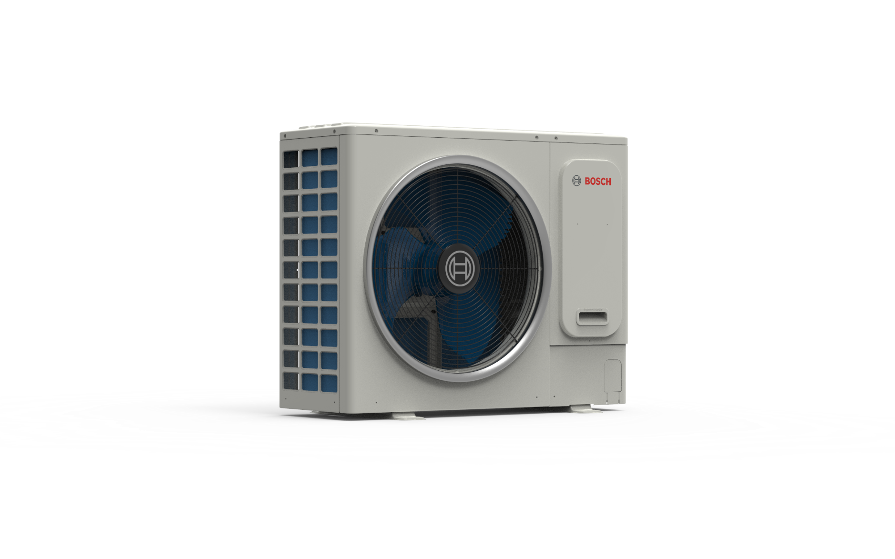
IPI
(ınıtıal PRODUCT INFORMATION) heat-pump mını vrf outdoor unıts
(8 ∼ 18 KW)

Slide 2
Table of Contents
Initial Product Information : AF4300A (8-18kW)
Product overview
Nomenclature
Technical specifications
Part Numbers
Compatibility
System architecture
Features and Functions
Electrical specifications
Sound Levels

Slide 3
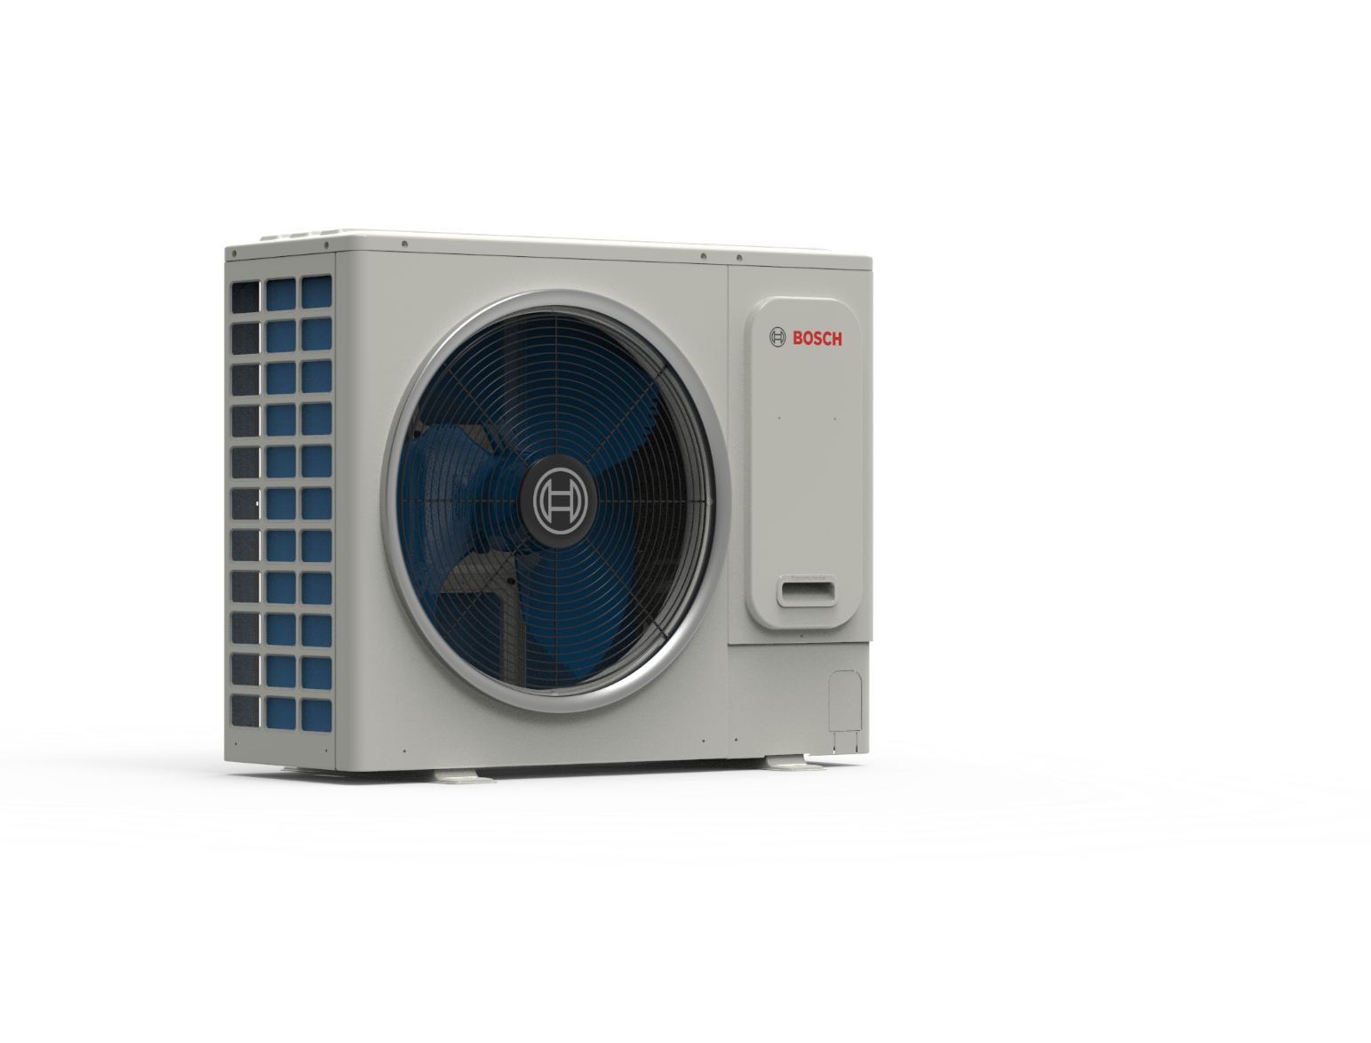
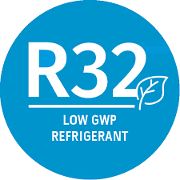

Product Overview
Initial Product Information : AF4300A (8-18kW)
Extended line-up up to 18 kW with same structure
Full DC inverter techonology
Low stand-by power consumption, just 3,5 W
High Efficiency : SEER up to 7,8 and SCOP up to 4,9
Up to 15% higher SEER and 20% higher SCOP compared to predecessor units
New refrigerant with lower GWP – R-32
1-ph or 3-ph power supply options
Extended operation range : Cooling -15º∼+52ºC DB, Heating -20∼+30ºC DB
Totally new industrial design, new structure, COMPACT & slim – Single fan only
Higher combination ratio – up to 160%
Extended piping lenghts up to 300m (total), 120m (max)
Low unit height < 1 meter enabling convenient installations at field
New communication protocol – SuperLink
PCB design is improved for increased electrical safety (SELV PCB)
Low noise levels with DC inverter fan including night silent mode option
Refrigerant leakage detection sensor connection via dry contact (in case needed)
Refrigerant shut-off device connection possibility (In case needed)
Footnote:
GWP:Global warming potential
SELV: Safety extra low voltage
SEER:Seasonal energy efficiency ratio
SCOP:Seasonal coeeficient of perfomance

Slide 4
Nomenclature
Initial Product Information : AF4300A (8-18kW)
Product Type
Product name
Product Line
1 Category name | 2 Value Level | 3 Group Name
Air Flux | 4300 | A / W
1 Category name | 2 Value Level | 3 Group Name | 4 Output / Generation | 6 Power supply
AF | 4300 | A / W | 50 C | - 3
A: Air based system
W Water based system
-1 = Single phase
-3 = Three phase
4300: Mini VRF units, 2-pipe, up to +55ºC
5300: Maxi VRF units, 2-pipe, up to +48ºC
6300: Maxi VRF units, 3-pipe, up to +48ºC
(i) : stands for connected device
C = unit can be combined
- = for single use
Variable refrigerant flow air conditioning unit
12 = 12 kW heat output
Example :
Product name : Air Flux 4300 A
Product line : AF4300A
Product type : AF4300A 12 -1

Slide 5
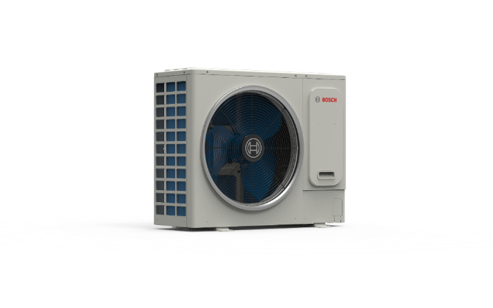
Line-up
Initial Product Information : AF4300A (8-18kW)
Product type | Power supply | Rated cooling capacity | Rated heating capacity | Maximum number of connected indoor units | Unit Structure
 | V/ph/Hz | kW | kW | pcs
AF4300A 8-1 | 220~240/1/50 | 7,2 | 7,2 | 5
AF4300A 10-1 | 220~240/1/50 | 9 | 9 | 6
AF4300A 12-1 | 220~240/1/50 | 12,3 | 12,3 | 8
AF4300A 14-1 | 220~240/1/50 | 14 | 14 | 10
AF4300A 16-1 | 220~240/1/50 | 15,5 | 15,5 | 11
AF4300A 18-1 |  | 17,5 | 17,5 | 12
AF4300A 12-3 | 380~415/3/50 | 12,3 | 12,3 | 8
AF4300A 14-3 | 3-ph | 14 | 14 | 10
AF4300A 16-3 | 3-ph | 15,5 | 15,5 | 11
AF4300A 18-3 | 3-ph | 17,5 | 17,5 | 12
6
Internal | Thermotechnology | TT-CA/PRM-Denizalp | 15/06/2018
© Robert Bosch GmbH 2016. All rights reserved, also regarding any disposal, exploitation, reproduction, editing, distribution, as well as in the event of applications for industrial property rights.

Slide 6

Technical Specs, 1-ph
Initial Product Information : AF4300A (8-18kW)
HP |  |  | 2 | 3 | 4 | 5 | 6 | 7
Product Type |  |  | AF4300A 8-1 | AF4300A 10-1 | AF4300A 12-1 | AF4300A 14-1 | AF4300A 16-1 | AF4300A 18-1
Power supply |  | V/N/Hz | 220~240/1/50 | 220~240/1/50 | 220~240/1/50 | 220~240/1/50 | 220~240/1/50 | 220~240/1/50
Cooling | Capacity | kW | 7,2 | 9 | 12,3 | 14 | 15,5 | 17,5
 | Power input | kW | 1,95 | 2,77 | 3,73 | 4,67 | 5,34 | 6,46
 | EER |  | 3,70 | 3,09 | 3,41 | 2,92 | 3,00 | 2,71
Heating（Rated) | Capacity | kW | 7,2 | 9 | 12,3 | 14 | 15,5 | 17,5
 | Power input | kW | 1,8 | 2,31 | 2,86 | 3,29 | 3,73 | 4,49
 | COP |  | 4,00 | 3,87 | 4,27 | 4,21 | 4,12 | 4,00
Heating（Max) | Capacity | kW | 9 | 10,8 | 14 | 16 | 17,5 | 19,5
 | Power input | kW | 2,50 | 3,18 | 3,59 | 4,21 | 4,73 | 5,57
 | COP |  | 3,6 | 3,4 | 3,9 | 3,8 | 3,7 | 3,5
SEER |  |  | 5,80 | 5,70 | 7,80 | 7,40 | 7,35 | 7,10
ηs,c |  | % | Energy class A+ | Energy class A+ | 309 | 293 | 291 | 281
SCOP |  |  | 3,80 | 3,80 | 4,90 | 4,80 | 4,70 | 4,80
ηs,h |  | % | Energy class A | Energy class A | 193 | 189 | 184 | 189
Connected indoor unit | Total capacity |  | 50 - 160 | 50 - 160 | 50 - 160 | 50 - 160 | 50 - 160 | 50 - 160
 | Maximum quantity |  | 5 | 6 | 8 | 10 | 11 | 12
Compressor | Type |  | DC inverter Rotary | DC inverter Rotary | DC inverter Rotary | DC inverter Rotary | DC inverter Rotary | DC inverter Rotary
 | Quantity |  | 1 | 1 | 1 | 1 | 1 | 1
 | Oil type |  | FW68S | FW68S | FW68S | FW68S | FW68S | FW68S
 | Start-up method |  | Soft start | Soft start | Soft start | Soft start | Soft start | Soft start

Slide 7
Technical Specs, 1-ph
Initial Product Information : AF4300A (8-18kW)
HP |  |  | 2 | 3 | 4 | 5 | 6 | 7
Product Type |  |  | AF4300A 8-1 | AF4300A 10-1 | AF4300A 12-1 | AF4300A 14-1 | AF4300A 16-1 | AF4300A 18-1
Fan | Type |  | Propeller | Propeller | Propeller | Propeller | Propeller | Propeller
 | Motor type |  | DC inverter | DC inverter | DC inverter | DC inverter | DC inverter | DC inverter
 | Quantity |  | 1 | 1 | 1 | 1 | 1 | 1
 | Motor output | kW | 200 | 200 | 200 | 200 | 200 | 200
 | Static pressure | Pa | 0 | 0 | 0 | 0 | 0 | 0
 | Airflow rate | m³/h | 5200 | 5200 | 5000 | 5000 | 5000 | 5500
 | Drive type |  | Direct | Direct | Direct | Direct | Direct | Direct
Refrigerant | Type |  | R-32 | R-32 | R-32 | R-32 | R-32 | R-32
 | Factory charge | kg | 2 | 2 | 2,85 | 2,85 | 2,85 | 2,85
Pipe connections | Liquid pipe | mm | Φ9.5 | Φ9.5 | Φ9.5 | Φ9.5 | Φ9.5 | Φ9.5
 | Gas pipe | mm | Φ15.9 | Φ15.9 | Φ15.9 | Φ15.9 | Φ15.9 | Φ15.9
Sound pressure level |  | dB(A) | 53 | 53 | 55 | 56 | 56 | 58
Sound power level |  | dB(A) | 68 | 69 | 70 | 71 | 72 | 73
Net dimensions (W×H×D) |  | mm | 1038x864x409 | 1038x864x409 | 1038x864x409 | 1038x864x409 | 1038x864x409 | 1038x864x409
Packed dimensions (W×H×D) |  | mm | 1120x980x560 | 1120x980x560 | 1120x980x560 | 1120x980x560 | 1120x980x560 | 1120x980x560
Net weight |  | kg | 77 | 77 | 94 | 94 | 94 | 94
Gross weight |  | kg | 88 | 88 | 105 | 105 | 105 | 105
Ambient temp. operation range | Cooling | ºC | -15 ~ 52 | -15 ~ 52 | -15 ~ 52 | -15 ~ 52 | -15 ~ 52 | -15 ~ 52
 | Heating | ºC | -20 ~ 30 | -20 ~ 30 | -20 ~ 30 | -20 ~ 30 | -20 ~ 30 | -20 ~ 30
First branch to farthest IDU |  | m | 30 | 30 | 40 | 40 | 40 | 40
Max piping from ODU to furthest IDU |  | m | 60 | 60 | 120 | 120 | 120 | 120
Total pipe length (Actual) |  | m | 300 | 300 | 300 | 300 | 300 | 300
Max. difference in level |  | m | 30/20 | 30/20 | 50/40 | 50/40 | 50/40 | 50/40

Slide 8
Technical Specs, 3-ph
Initial Product Information : AF4300A (8-18kW)
HP |  |  | 4 | 5 | 6 | 7
Product Type |  |  | AF4300A 12-3 | AF4300A 14-3 | AF4300A 16-3 | AF4300A 18-3
Power supply |  | V/N/Hz | 380~415/3/50 | 380~415/3/50 | 380~415/3/50 | 380~415/3/50
Cooling | Capacity | kW | 12,3 | 14 | 15,5 | 17,5
 | Power input | kW | 3,73 | 4,67 | 5,34 | 6,46
 | EER |  | 3,41 | 2,92 | 3,00 | 2,71
Heating（Rated) | Capacity | kW | 12,3 | 14 | 15,5 | 17,5
 | Power input | kW | 2,86 | 3,29 | 3,73 | 4,49
 | COP |  | 4,27 | 4,21 | 4,12 | 4,00
Heating（Max) | Capacity | kW | 14 | 16 | 17,5 | 19,5
 | Power input | kW | 3,59 | 4,21 | 4,73 | 5,57
 | COP |  | 3,9 | 3,8 | 3,7 | 3,5
SEER |  |  | 7,80 | 7,40 | 7,35 | 7,10
ηs,c |  | % | 309 | 293 | 291 | 281
SCOP |  |  | 4,90 | 4,80 | 4,70 | 4,80
ηs,h |  | % | 193 | 189 | 184 | 189
Connected indoor unit | Total capacity |  | 50 - 160 | 50 - 160 | 50 - 160 | 50 - 160
 | Maximum quantity |  | 8 | 10 | 11 | 12
Compressor | Type |  | DC inverter Rotary | DC inverter Rotary | DC inverter Rotary | DC inverter Rotary
 | Quantity |  | 1 | 1 | 1 | 1
 | Oil type |  | FW68S | FW68S | FW68S | FW68S
 | Start-up method |  | Soft start | Soft start | Soft start | Soft start

Slide 9
Technical Specs, 3-ph
Initial Product Information : AF4300A (8-18kW)
HP |  |  | 4 | 5 | 6 | 7
Product Type |  |  | AF4300A 12-3 | AF4300A 14-3 | AF4300A 16-3 | AF4300A 18-3
Fan | Type |  | Propeller | Propeller | Propeller | Propeller
 | Motor type |  | DC inverter | DC inverter | DC inverter | DC inverter
 | Quantity |  | 1 | 1 | 1 | 1
 | Motor output | kW | 200 | 200 | 200 | 200
 | Static pressure | Pa | 0 | 0 | 0 | 0
 | Airflow rate | m³/h | 5000 | 5000 | 5000 | 5500
 | Drive type |  | Direct | Direct | Direct | Direct
Refrigerant | Type |  | R-32 | R-32 | R-32 | R-32
 | Factory charge | kg | 2,85 | 2,85 | 2,85 | 2,85
Pipe connections | Liquid pipe | mm | Φ9.5 | Φ9.5 | Φ9.5 | Φ9.5
 | Gas pipe | mm | Φ15.9 | Φ15.9 | Φ15.9 | Φ19.1
Sound pressure level |  | dB(A) | 55 | 56 | 56 | 58
Sound power level |  | dB(A) | 70 | 71 | 72 | 73
Net dimensions (W×H×D) |  | mm | 1038x864x409 | 1038x864x409 | 1038x864x409 | 1038x864x409
Packed dimensions (W×H×D) |  | mm | 1120x980x560 | 1120x980x560 | 1120x980x560 | 1120x980x560
Net weight |  | kg | 110 | 110 | 110 | 110
Gross weight |  | kg | 121 | 121 | 121 | 121
Ambient temp. operation range | Cooling | ºC | -15 ~ 52 | -15 ~ 52 | -15 ~ 52 | -15 ~ 52
 | Heating | ºC | -20 ~ 30 | -20 ~ 30 | -20 ~ 30 | -20 ~ 30
First branch to farthest IDU |  | m | 40 | 40 | 40 | 40
Max piping from ODU to furthest IDU |  | m | 120 | 120 | 120 | 120
Total pipe length (Actual) |  | m | 300 | 300 | 300 | 300
Max. difference in level |  | m | 50/40 | 50/40 | 50/40 | 50/40

Slide 10
Part Numbers
Initial Product Information : AF4300A (8-18kW)
Part number | EAN Number | Family | Product Name | Product Type | SAP Description | PH Product Hierarchy
7733702217 | 4062321733254 | Outdoor unit | AF4300A | AF4300A 8-1 | Air Flux 4300 A - AF4300A 8-1 | 0T1410308600060134
7733702218 | 4062321732448 | Outdoor unit | AF4300A | AF4300A 10-1 | Air Flux 4300 A - AF4300A 10-1 | 0T1410308600060134
7733702219 | 4062321732455 | Outdoor unit | AF4300A | AF4300A 12-1 | Air Flux 4300 A - AF4300A 12-1 | 0T1410308600060134
7733702220 | 4062321732462 | Outdoor unit | AF4300A | AF4300A 14-1 | Air Flux 4300 A - AF4300A 14-1 | 0T1410308600060134
7733702221 | 4062321732479 | Outdoor unit | AF4300A | AF4300A 16-1 | Air Flux 4300 A - AF4300A 16-1 | 0T1410308600060134
7733702222 | 4062321732486 | Outdoor unit | AF4300A | AF4300A 18-1 | Air Flux 4300 A - AF4300A 16-1 | 0T1410308600060134
7733702223 | 4062321732493 | Outdoor unit | AF4300A | AF4300A 12-3 | Air Flux 4300 A - AF4300A 12-3 | 0T1410308600060134
7733702224 | 4062321732509 | Outdoor unit | AF4300A | AF4300A 14-3 | Air Flux 4300 A - AF4300A 14-3 | 0T1410308600060134
7733702225 | 4062321732516 | Outdoor unit | AF4300A | AF4300A 16-3 | Air Flux 4300 A - AF4300A 16-3 | 0T1410308600060134
7733702226 | 4062321732523 | Outdoor unit | AF4300A | AF4300A 18-3 | Air Flux 4300 A - AF4300A 18-3 | 0T1410308600060134

Slide 11
Compatibility
Initial Product Information : AF4300A (8-18kW)
Central Controller
Outdoor Unit Family
Indoor Unit Family
Individual Controls
X1X2
ARC C -2
max. 1 (up to 16 IDUs)
ACC MT
AF4300A
AF2
XYE
M1M2
X1X2
ARC H -2
max. 1 IDU
IR
ARC C IR -2
max. 1 IDU
AF4300A outdoor units are only compatible with AF2 series VRF indoor units

Slide 12

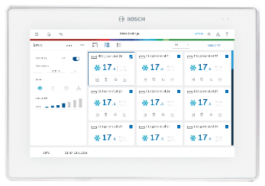



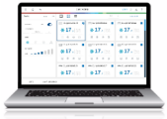
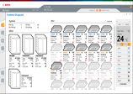

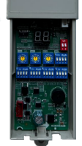
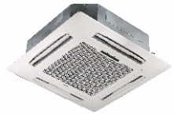
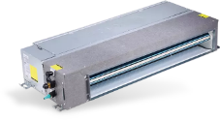
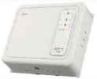

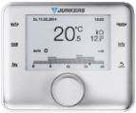

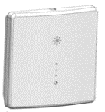
System Architecture
Initial Product Information : AF4300A (8-18kW)
Central Controller
Outdoor
Unit
XYE
USB
software update
ACC MT
Service Tools
RS485-USB converter
M1M2
USB
R32 pump down kit
(safety shut-off valves)
motion detection sensor
(standard on display panel)
Diagnosis software
Indoor Units
Bus signal repeater
D1D2
After-Sales Board –settings after PCB replacement
group control
IR
display board
(ducted units)
Room Controller
X1X2
X1X2
refrigerant detector
(connected to IDU
communication board)
ARC C-2
ARC C-2
ARC H-2
IRC
ARC C-2

Slide 13
Key Features : High Technology
Initial Product Information : AF4300A (8-18kW)
Super Link
Communication bus chip greatly simplifies installation and saves installation cost
Super Sense
13 sensors achieves the state of each part of the refrigerant pipeline
Full DC inverter technology
All electrical components of outdoor units are DC power supply, improving electrical efficiency and achieving energy saving
Low stand-by power consumption
The standby power consumption is as low as 3.5 Watt
60-step energy management
The system runs at 40% to 100% capacity output in 1% increasements
Precise oil control
Ensures all outdoor compressor oil is at a safe level, eliminating any compressor oil shortage problems.
Alarm output
In case of system malfunction, remote output error information reminds installer for maintenance
Fire alarm input
In case of fire, receive fire information in time and stop the system immediately to avoid serious problems

Slide 14



New communication protocol : Super Link
Initial Product Information : AF4300A (8-18kW)
Higher immunity to interference
No polarity (M1M2 can be connected in any way)
Length (M1M2 can be up to 2000m, PQE can only support 1200m)
Allow system to keep operating although single indoor units are unplugged from power
Switching off valves in case of indoor unit power outage
More topology possible (PQE can be used in daisy chain only)
Support Any Topology Communication
In addition to the traditional daisy chain connection, the communication wire supports tree connection, star connection, ring connection and so on. The wring is exible, which greatly reduces the installation cost and has no possibility of wrong connection on site.
Super Anti-interference Capability
Special waveform restoration technology enhances anti-interference performance for more stable communication.
Daisy chain connection
Tree connection
Conventional filtering waveform
Star connection Ring connection
Traditional daisy chain connection
AF4300A Wiring connection
AF4300A system continue to operate in case of disconnection
Distorted waveform reduction
Anti-interference of radio
Anti-interference of high voltage
Anti-interference of equipment

Slide 15
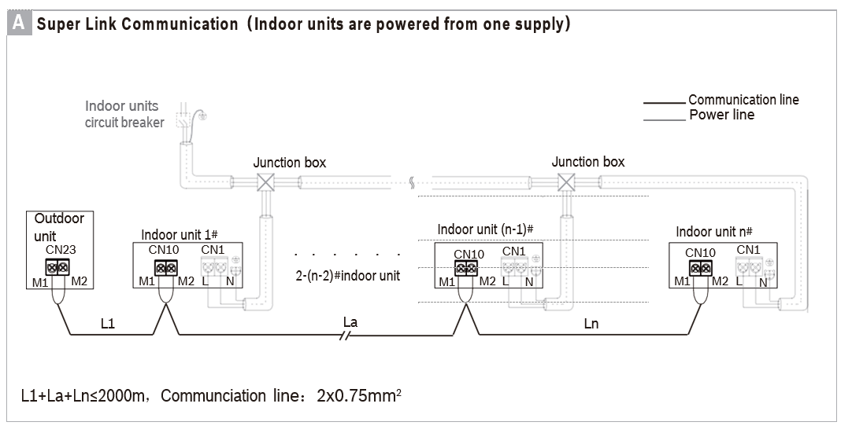
Super-Link (Option A – Common power supply)
Initial Product Information : AF4300A (8-18kW)
Picture shows the serial connection.
Super-link (M1M2) supports any connection type.
For other connection methods, please refer to the installation manuals.
The indoor units of the system must be powered by a unified power supply, and all indoor units must be powered on or off at the same time.
It is forbidden to connect M1M2 to different communication networks such as X1X2, etc. of the internal unit, otherwise the circuit board will be damaged.

Slide 16
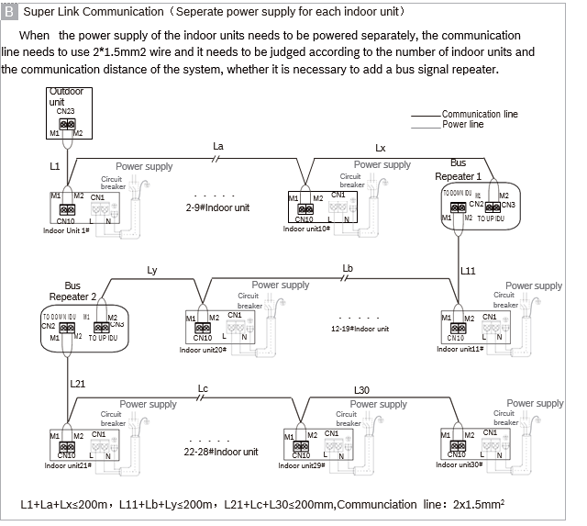
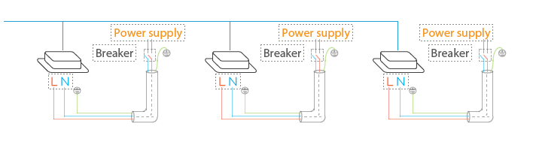
Super-Link (Option B – Individual power supply)
Initial Product Information : AF4300A (8-18kW)
Picture shows the serial connection.
Super-link (M1M2) supports any connection type.
It is forbidden to connect M1M2 to different communication networks such as X1X2, etc of the indoor unit.
The communication line needs to be 2x1.5mm2 and the line resistance should be less than or equal to 1.33Ω/100m
If the total distance is less than or equal to 200m and the total number of indoor units is less than or equal to 10, the bus repeater is not needed.
If the total distance is greater than 200m or the total number of indoor units is greater than 10, bus repeaters need to be added to increase the bus voltage.
The max number of indoor units in the same refrigerant system must be less than or equal to 30 units.
In the same refrigerant system, a maximum of 2 repeater devices can be installed.
The bus repeater is an optional accessory and needs to be purchased seperately.

Slide 17
Key Features : High Comfort & Reliability
Initial Product Information : AF4300A (8-18kW)
Silent mode
5-step silent mode selections provide more freedom and convenience to match the customer needs
Intelligent defrosting technology
Calculates the time required for defrosting according to the actual system status, eliminating heat losses from unnecessary defrosting
Auto cooling-heating changeover
Automatically selects cooling or heating mode to achieve the set temperature (available in changeover priority mode)
Continuous heating in oil return mode
Oil return in heating mode does not need to convert to cooling mode, further enhancing indoor comfort (activated via menu setting)
0.1℃ control precision
Control precision of the sensor can reach 0.1℃, ensuring less room temperature fluctuation
Multiple priority modes
10 different priority modes meets the requirements of all user scenarios
Refrigerant leakage detector connection possibility
(In case needed)
Refrigerant shut-off device
connection possibility
(In case needed)

Slide 18
Key Features : Easy Installation
Initial Product Information : AF4300A (8-18kW)
Long piping capability
Benefits for the system design, installation flexibility, as well as the less installation cost
Auto addressing
Distributes addresses to indoor units automatically, simplifying the installation
Automatic refrigerant recycling
Refrigerant can be recycled to outdoor unit or indoor units making the maintenance easier and more efficient
Digit display
4 digit 7-segment display intuitive for parameter setting, parameter check and error check
High external static pressure
Up to 35Pa ESP setting allows easy handling in various installations conditions
Arbitrary topology of communication wire
Supports any communication topology, greatly simplifies installation and reduces installation cost
2-core non-polarity communication wiring
Simplifies installation and reduces wiring failures
Long communication wiring
Communication wiring up to 2000m makes installation more flexible
Wide combination ratio
Combination ratio can be extended to 50%-160% which meets different project requirements
Manual defrosting and oil return
Improves maintenance efficiency and reduce service time

Slide 19
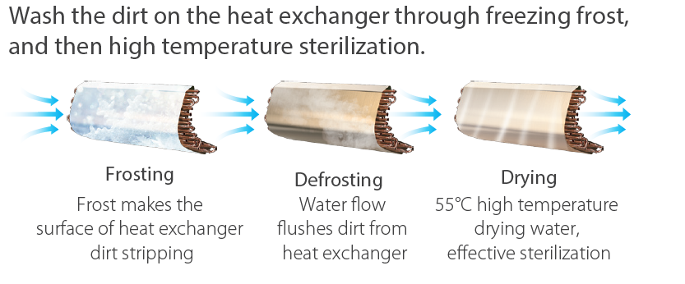
Self Cleaning Function
Initial Product Information : AF4300A (8-18kW)
The self-cleaning function is de-activated in default settings of delivered units.
The self-cleaning function can be activated once from the outdoor unit during the regular maintenance by service professionals.
The self-cleaning function must be configured and started by qualified technicians.
Please get in contact with your installer/service company.
NOTE:
Self clean feature can be activated also from the infrared remote controller by the end user, if requested.
In this case, the VRF system operator must be trained by the service technician before enabling. Otherwise, the VRF system will be interrupted until self cleaning process ends.
This feature is only available for systems running with AF2 indoor units and when the indoor units are connected to AF4300A outdoor unit.
Once the self-cleaning function is activated, all indoor units in the VRF system will start to proceed “Self Clean”. Therefore, this feature should be used for a system cleaning.
Self clean can not be used individually for some indoor units.

Slide 20
Refrigerant Temperature Setting
Initial Product Information : AF4300A (8-18kW)
It is possible to set different evaporation and condensation temperatures in case needed
First-level menu | Second-level menu | Specified menu mode | Description | Default
n6 | 0 | 0 | Evaporation temperature setting (Ke0=-3) | -
 |  | 1 | Evaporation temperature setting (Ke0=0)
 |  | 2 | Evaporation temperature setting (Ke0=3)
 |  | 3 | Evaporation temperature setting (Ke0=6) | √
 |  | 4 | Evaporation temperature setting (Ke0=7) | -
 |  | 5 | Evaporation temperature setting (Ke0=8)
 |  | 6 | Evaporation temperature setting (Ke0=9)
 |  | 7 | Evaporation temperature setting (Ke0=10)
 |  | 8 | Evaporation temperature setting (Ke0=11)
 | 2 | 0 | Condensation temperature setting (Kc0=41) | -
 |  | 1 | Condensation temperature setting (Kc0=42)
 |  | 2 | Condensation temperature setting (Kc0=43)
 |  | 3 | Condensation temperature setting (Kc0=44)
 |  | 4 | Condensation temperature setting (Kc0=45)
 |  | 5 | Condensation temperature setting (Kc0=46)
 |  | 6 | Condensation temperature setting (Kc0=48) | √
 |  | 7 | Condensation temperature setting (Kc0=51) | -

Slide 21
Average SEER for the product family is 7,1
Initial Product Information : AF4300A (8-18kW)
vs MDCI Series
+10%
+10%
+7%
+10%
+7%
+10%
+15%
+8%
+10%
EU min. reqr. 4,8
EU min. reqr. 4,3

Slide 22
Average SCOP for the product family is 4,6
Initial Product Information : AF4300A (8-18kW)
vs MDCI Series
+17%
+20%
+9%
+17%
+20%
+9%
+17%
EU min. reqr. 3,8
EU min. reqr. 3,5

Slide 23

Wide Outdoor Ambient Operation Range
Initial Product Information : AF4300A (8-18kW)
-15˚C
Cooling mode
+52˚C
-20˚C
Heating mode
+30˚C
-20˚C
-15˚C
-10˚C
-5 ˚C
0 ˚C
5 ˚C
10 ˚C
15 ˚C
20 ˚C
25 ˚C
30 ˚C
35 ˚C
40 ˚C
45 ˚C
50 ˚C
55 ˚C
DB: Dry bulb temperature
WB: Wet bulb temperature

Slide 24

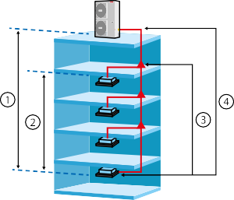
Long Piping
Initial Product Information : AF4300A (8-18kW)
AF4300A – Piping Limits (m) |  |  | 8,10 kW | 12,14,16,18 kW
Piping Length | Actual total pipe length |  | 150 | 300
 | Maximum piping distance between outdoor unit and indoor unit | Actual | 50 | 100
 |  | Equivalent | 60 | 120
 | Maximum piping distance between the first branch joint and the farthest indoor unit |  | 30 | 40
Level difference | Level difference between indoor and outdoor units | Outdoor unit on top | 30 | 50
 |  | Outdoor unit below | 20 | 40
 | Level distance between indoor units |  | 15 | 15
➀ Level difference between indoor unit and outdoor unit is maximum 50 m (ODU on top)
➁ Level difference between indoor units is maximum 15 m
➂ Max piping from the first branch joint to the farthest indoor unit is maximum 40 m
➃ Longest pipe length is 120 m

Slide 25
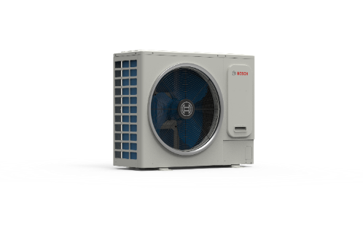
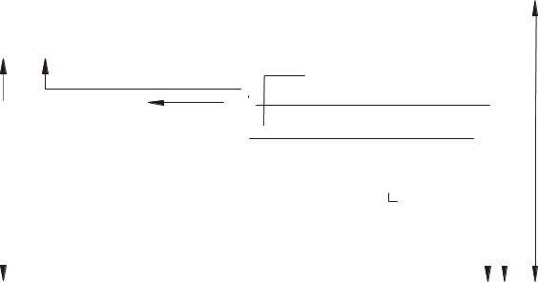
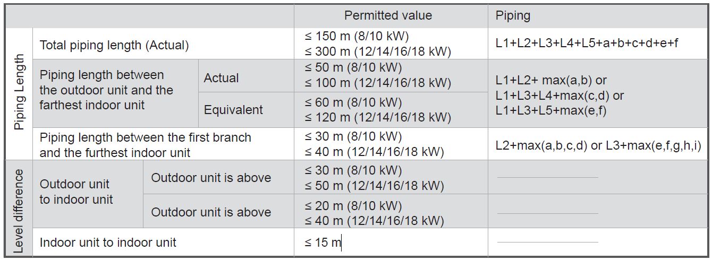
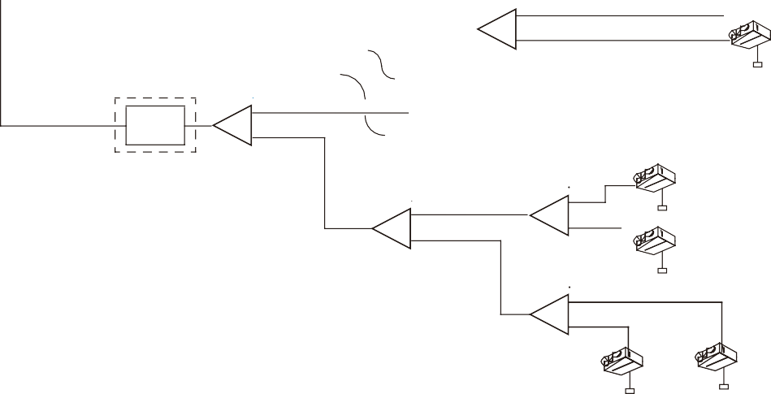
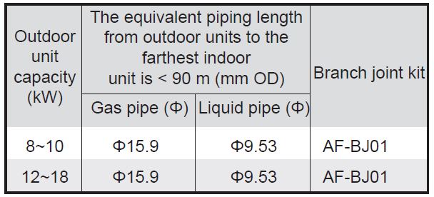
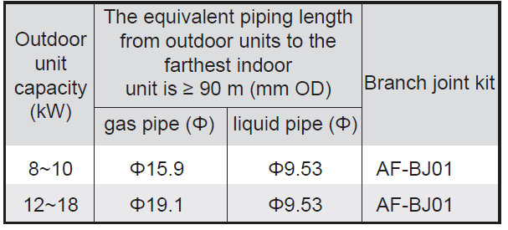
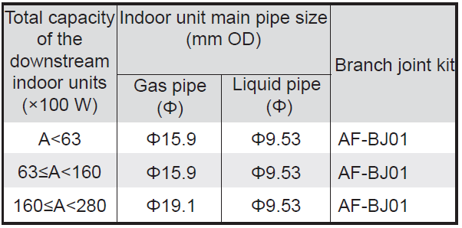
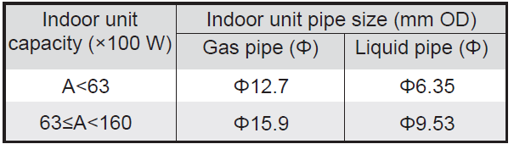
Piping Design
Initial Product Information : AF4300A (8-18kW)
N1
Maximum equivalent piping length from the outdoor
a
N 2
Maximum level difference between Indoor
units is ≤ 15 m
unit to the farthest indoor unit is ≤ 120 m
B
Maximum level difference between the
outdoor unit and indoor unit is ≤ 50 m
b
L 1
L 2
Maximum piping length from the first branch joint
to the farthest indoor unit is ≤ 40 m
RSD
A
Refrigerant shut-off ^{First branch}
N3
device(Optional)
joint
L 3
L 4
c
C
D
d
N4
L 5
E
f
e
N5
N6
Definition | Pipe connection position | Code
Main pipe | The pipe between the outdoor unit and the first branch joint. | L1
Indoor unit main pipe | The pipe between the branch joints. | L2~L5
Indoor unit auxiliary pipe | The pipe between the indoor unit and the nearest branch joint. | a~f
Branch joint | The joint connect with the main pipe, the indoor unit main pipe and auxiliary pipe. | A~E
Indoor unit | / | N1~N6

Slide 26
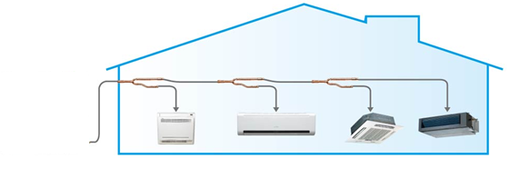

Installation Options
Initial Product Information : AF4300A (8-18kW)
Installation with joints
AF-BJ joints are used at installation.

Slide 27

Electrical Specifications
Initial Product Information : AF4300A (8-18kW)
Power Supply | Model | Outdoor Unit |  |  |  | Power Current |  |  | Compressor |  | Fan Motor
 | Capacity (kW) | Voltage (V) | Frequency (Hz) | Min. (V) | Max. (V) | MCA (Rated current) (A) | TOCA (A) | MFA (A) | MSC (A) | RLA (A) | Power (kW) | FLA (A)
220-240V~ 50Hz | 8 | 220-240 | 50 | 198 | 264 | 21.3 | 18 | 25 | - | 15.9 | 0.2 | 1.0
 | 10 | 220-240 | 50 | 198 | 264 | 24 | 20 | 25 | - | 17.9 | 0.2 | 1.0
220-240V~ | 12 | 220-240 | 50 | 198 | 264 | 32 | 27 | 32 | - | 24.8 | 0.2 | 1.2
50Hz | 14 | 220-240 | 50 | 198 | 264 | 35 | 29 | 40 | - | 26.8 | 0.2 | 1.2
 | 16 | 220-240 | 50 | 198 | 264 | 40 | 33 | 40 | - | 30.3 | 0.2 | 1.2
 | 18 | 220-240 | 50 | 198 | 264 | 40 | 33 | 40 | - | 30 | 0.2 | 1.5
380-415V 3N~ 50Hz | 12 | 380-415 | 50 | 342 | 440 | 14 | 13 | 20 | - | 10.4 | 0.2 | 0.6
380-415V 3N~ | 14 | 380-415 | 50 | 342 | 440 | 15 | 14 | 20 | - | 11.4 | 0.2 | 0.6
50Hz | 16 | 380-415 | 50 | 342 | 440 | 17 | 15 | 20 | - | 12.9 | 0.2 | 0.6
 | 18 | 380-415 | 50 | 342 | 440 | 17 | 15 | 20 | - | 12.9 | 0.2 | 0.7
Abbreviations:MCA: Minimum Circuit Amps;
TOCA: Total Over-current Amps;
MFA: Maximum Fuse Amps;
MSC: Maximum Starting Current (A);
RLA: Rated Load Amps;
FLA: Fan Load Amps.

Slide 28
Sound Levels
Initial Product Information : AF4300A (8-18kW)
Sound Pressure Level dB(A) | 8 kW | 10 kW | 12 kW | 14 kW | 16 kW | 18 kW
Standard | 53 | 53 | 55 | 56 | 56 | 58
Noise Level 1 | 51 | 51 | 53 | 54 | 54 | 55
Noise Level 2 | 48 | 48 | 51 | 52 | 52 | 52
Noise Level 3 | 46 | 46 | 49 | 50 | 50 | 50
Noise Level 4 | 43 | 43 | 47 | 48 | 48 | 48
Noise Level 5 | 40 | 40 | 43 | 44 | 44 | 46
Available Capacity | 8kW | 10kw | 12kW | 14kW | 16kW | 18kW
Standard | 100% | 100% | 100% | 100% | 100% | 100%
Noise Level 1 | 90% | 90% | 90% | 90% | 90% | 90%
Noise Level 2 | 80% | 80% | 80% | 80% | 80% | 80%
Noise Level 3 | 70% | 70% | 70% | 70% | 70% | 70%
Noise Level 4 | 60% | 60% | 60% | 60% | 60% | 60%
Noise Level 5 | 50% | 50% | 50% | 50% | 50% | 50%
Silent mode can be activated and programmed from controllers.
Local standards for sound levels may differ according to legal rules in the countries.
Therefore, silent mode can only be changed in the service menu.
Please contact your installer/service company to set the silent mode correctly according to your VRF system design.

