Slide 1
IPI
(ınıtıal PRODUCT INFORMATION) vrf INDOOR unıts
AF2 SERIES

Slide 2
Table of Contents
Initial Product Information: VRF Indoor Units,AF2 Series
Product overview
Nomenclature
Technical specifications
Part Numbers
System architecture
Product Features

Slide 3
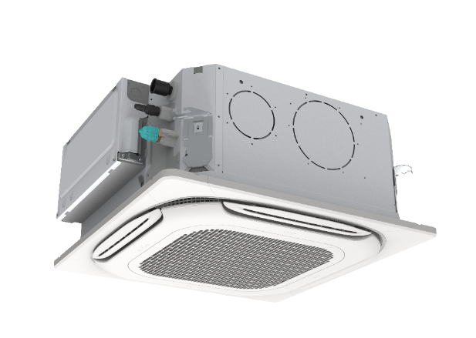
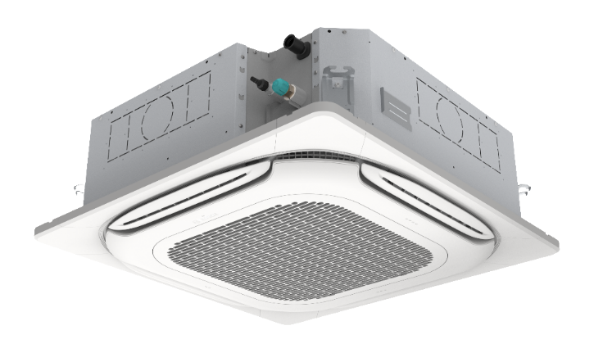

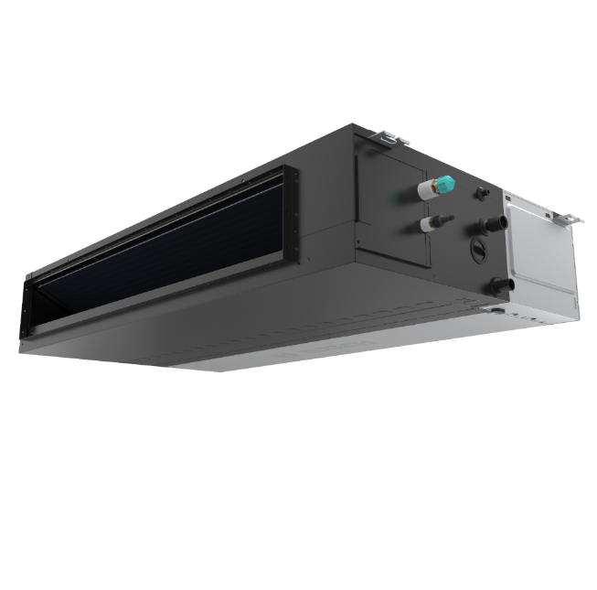
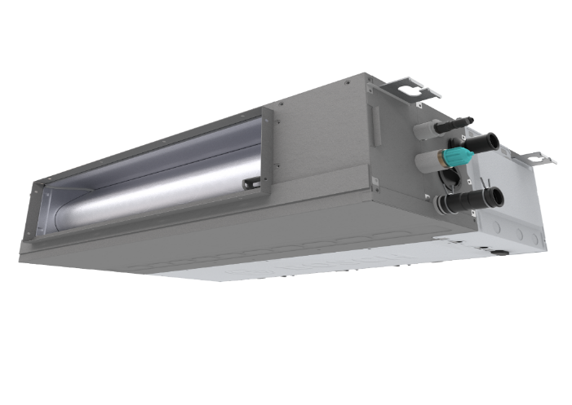
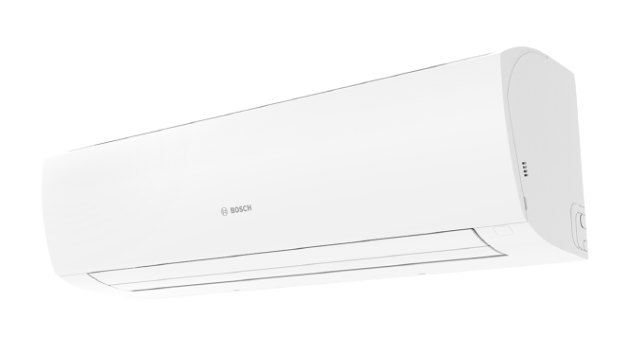
Line-up
Initial Product Information: VRF Indoor Units,AF2 Series
ROUND FLOW CASSETTE (AF2-4CR)
COMPACT CASSETTE (AF2-4CC)
2,8 to 14 kW
1,5 to 6,3 kW
HIGH-WALL (AF2-W)
SLIM DUCTED (AF2-DL)
DUCTED (AF2-DM)
1,5 to 5,6 kW
1,5 to 11,2 kW, ESP 10 ~ 80 Pa
1,5 to 16 kW, ESP 10 ~ 160 Pa
Remark : Other indoor unit types will have successors during the launch of successor AF5300 outdoor units

Slide 4
Nomenclature
Initial Product Information: VRF Indoor Units,AF2 Series
Product Type
Product name
Product Line
Product name is not used
Indicator | Output / Generation |  |  | Additional features
AF2- | XYZ | 45 | -1 | E
E = with electrical heater
P = Drain-pump integrated
Next version 1, 2, 3 ….
Generation 1, 2, 3 ….
Rated capacity (kW) at cooling, multiplied by 10
Example :
Product name : na
Product line : AF2-4CC
Product type : AF2-4CC 45-1 P
Indoor Unit Types
Cassette series
4CC : 4 Way compact
4C : 4 Way
4CR: Round flow
1C : 1 Way
2C : 2 Way
Duct series
DL : Low ESP
DM : Medium ESP
DH : High ESP
DHS : High ESP, slim
DF : Fresh air
Floor series
F : without cabinet
FC : with cabinet
CF : ceiling-floor
Wall series
W : Basic
WP : Premium
AF : Indoor unit for Air Flux (VRF) products

Slide 5

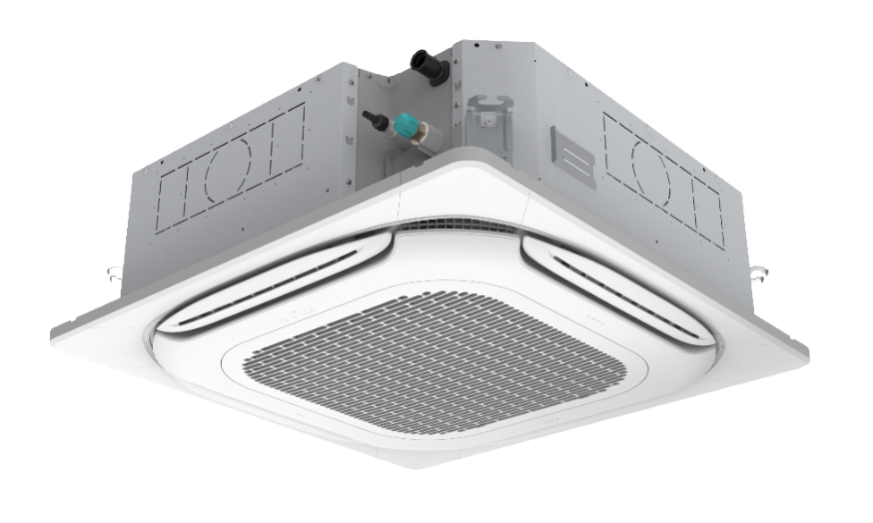

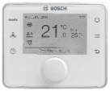


AF2-4CR
Initial Product Information: VRF Indoor Units,AF2 Series
Design
Totally new structure and design
Even air distribution, 360° air flow
Stylish new panel and frame design
Slim design : h=20cm (for units up to 7,1 kW)
Advanced 3D spiral fan design, high performance
LED display on panel
Technical Features
220V, 50Hz
New updated PCB with Super Link communication (M1-M2)
  X1-X2 connection for ARC wired room controllers
  D1-D2 connection only between indoor units for group control
  Remote on-off connection, 12V
New infrared controller , ARC C IR-2
New room controller with updated software
Built-in EEV
DC type fan motor
7-step fan level
Built-in drain pump, h:1200 mm
Other
New Features : Clean ceiling, Independent louver control, block individual air outlets, absence optimization
Washable air filter, class G1
Optional F6 type filter : AF2-FF6-4CR
Auto restart function
Duct connection ports are available on unit
Product is delivered without a controller
Room controllers
Panel : AF2-P 4CR
ARC C IR-2
ARC C-2
ARC H-2
Capacity Index | 28 | 36 | 45 | 56 | 71 | 80 | 90 | 100 | 112 | 140
Rated Cooling Capacity (kW) | 2,8 | 3,6 | 4,5 | 5,6 | 7,1 | 8,0 | 9,0 | 10,0 | 11,2 | 14,0
Rated Heating Capacity (kW) | 3,2 | 4,0 | 5,0 | 6,3 | 8,0 | 9,0 | 10,0 | 11,2 | 12,5 | 16,0
AF2 indoor units are only compatible with AF4300 series VRF outdoor units

Slide 6
AF2-4CR, Technical Specifications
Initial Product Information: VRF Indoor Units,AF2 Series
Product Type | Cooling capacity | Heating capacity | Power Supply | Rated current | Rated input power | Net dimensions (W x D x H) (Unit) | Net dimensions (W x D x H) (Panel) | Net weight (Unit) | Net weight (Panel) | Airflow rate | Sound pressure level (H/L) | Gas pipe | Liquid pipe | Drain pipe
 | kW | kW | V/Hz/ph | A | W | mm | mm | kg | kg | m³/h | dB(A) | mm | mm | mm
AF2-4CR 28-1 P | 2,8 | 3,2 | 220/50/1 | 0,19 | 27 | 840 x 840 x 204 | 950 x 950 x 46 | 18,50 | 6 | 790 | 30/25 | Φ12.7 | Φ6.4 | Φ25
AF2-4CR 36-1 P | 3,6 | 4 | 220/50/1 | 0,19 | 27 | 840 x 840 x 204 | 950 x 950 x 46 | 18,50 | 6 | 790 | 30/25 | Φ12.7 | Φ6.4 | Φ25
AF2-4CR 45-1 P | 4,5 | 5 | 220/50/1 | 0,23 | 33 | 840 x 840 x 204 | 950 x 950 x 46 | 20,00 | 6 | 840 | 33/27 | Φ12.7 | Φ6.4 | Φ25
AF2-4CR 56-1 P | 5,6 | 6,3 | 220/50/1 | 0,23 | 33 | 840 x 840 x 204 | 950 x 950 x 46 | 20,00 | 6 | 840 | 33/27 | Φ12.7 | Φ6.4 | Φ25
AF2-4CR 71-1 P | 7,1 | 8 | 220/50/1 | 0,37 | 41 | 840 x 840 x 246 | 950 x 950 x 46 | 22,50 | 6 | 1000 | 35/28 | Φ15.9 | Φ9.52 | Φ25
AF2-4CR 80-1 P | 8 | 9 | 220/50/1 | 0,37 | 51 | 840 x 840 x 246 | 950 x 950 x 46 | 22,50 | 6 | 1330 | 38/29 | Φ15.9 | Φ9.52 | Φ25
AF2-4CR 90-1 P | 9 | 10 | 220/50/1 | 0,40 | 53 | 840 x 840 x 246 | 950 x 950 x 46 | 22,50 | 6 | 1330 | 38/29 | Φ15.9 | Φ9.52 | Φ25
AF2-4CR 100-1 P | 10 | 11,2 | 220/50/1 | 0,44 | 64 | 840 x 840 x 288 | 950 x 950 x 46 | 24,50 | 6 | 1445 | 39/33 | Φ15.9 | Φ9.52 | Φ25
AF2-4CR 112-1 P | 11,2 | 12,5 | 220/50/1 | 0,54 | 71 | 840 x 840 x 288 | 950 x 950 x 46 | 24,50 | 6 | 1600 | 41/33 | Φ15.9 | Φ9.52 | Φ25
AF2-4CR 140-1 P | 14 | 16 | 220/50/1 | 0,73 | 99 | 840 x 840 x 288 | 950 x 950 x 46 | 27,00 | 6 | 1730 | 43/34 | Φ15.9 | Φ9.52 | Φ25
Notes: 1. Capacity test conditions: cooling 35 ℃ dB / 24 ℃ WB (outdoor), 27 ℃ dB / 19 ℃ WB (indoor); Heating 7 ℃ dB / 6 ℃ WB (outdoor), 20 ℃ dB / 15 ℃ WB (indoor); Equivalent length of refrigerant piping: 5m with zero level difference. 2. Sound pressure level of this unit is the value tested in the full anechoic room. At installation state, due to the influence of the surrounding background noise, it is generally a little different from the recorded value of this unit.

Slide 7
Part Numbers
Initial Product Information: VRF Indoor Units,AF2 Series
Part number | EAN Number | Family | Product Name | Product Type | SAP Description | PH Product Hierarchy
7733702243 | 4062321732691 | Indoor unit | NA | AF2-4CR 28-1 P | Indoor Unit AF2-4CR 28-1 P | 0T1410305700060122
7733702244 | 4062321732707 | Indoor unit | NA | AF2-4CR 36-1 P | Indoor Unit AF2-4CR 36-1 P | 0T1410305700060122
7733702245 | 4062321732714 | Indoor unit | NA | AF2-4CR 45-1 P | Indoor Unit AF2-4CR 45-1 P | 0T1410305700060122
7733702246 | 4062321732721 | Indoor unit | NA | AF2-4CR 56-1 P | Indoor Unit AF2-4CR 56-1 P | 0T1410305700060122
7733702247 | 4062321732738 | Indoor unit | NA | AF2-4CR 71-1 P | Indoor Unit AF2-4CR 71-1 P | 0T1410305700060122
7733702248 | 4062321732745 | Indoor unit | NA | AF2-4CR 80-1 P | Indoor Unit AF2-4CR 80-1 P | 0T1410305700060122
7733702249 | 4062321732752 | Indoor unit | NA | AF2-4CR 90-1 P | Indoor Unit AF2-4CR 90-1 P | 0T1410305700060122
7733702250 | 4062321732769 | Indoor unit | NA | AF2-4CR 100-1 P | Indoor Unit AF2-4CR 90-1 P | 0T1410305700060122
7733702251 | 4062321732776 | Indoor unit | NA | AF2-4CR 112-1 P | Indoor Unit AF2-4CR 112-1 P | 0T1410305700060122
7733702252 | 4062321732783 | Indoor unit | NA | AF2-4CR 140-1 P | Indoor Unit AF2-4CR 140-1 P | 0T1410305700060122
7733702253 | 4062321732790 | Panel | NA | AF2-P 4CR | Panel AF2-P 4CR | 0T1410305700060122

Slide 8


AF2-4CC
Initial Product Information: VRF Indoor Units,AF2 Series
Design
Totally new structure and design
New panel and frame design
Perfectly adapt to 60x60 false ceiling
Net height of 23,5 cm for whole range
LED display on panel
Technical Features
220V, 50Hz
New updated PCBs with Super Link communication (M1-M2)
  X1-X2 connection for new Bosch ARC wired room controllers
  D1-D2 connection only between indoor units for group control
  Remote on-off connection, 12V
New infrared controller from Bosch, ARC C IR-2
New room controller with updated software
Built-in EEV
DC type fan motor
7-step fan level
Built-in drain pump, h:1200 mm
Other
New Features : Clean ceiling, Independent louver control, block individual air outlets, , absence optimization
Washable air filter, class G1
Auto restart function
Port for fresh air connection on unit
Duct connection ports are available on unit
Product is delivered without a controller
Room controllers
Panel : AF2-P 4CC
ARC C IR-2
ARC C-2
ARC H-2
Capacity Index | 15 | 22 | 28 | 36 | 45 | 56 | 63
Rated cooling Capacity (kW) | 1,5 | 2,2 | 2,8 | 3,6 | 4,5 | 5,6 | 6,3
Rated heating Capacity (kW) | 1,8 | 2,4 | 3,2 | 4,0 | 5,0 | 6,3 | 7,1
AF2 indoor units are only compatible with AF4300 series VRF outdoor units

Slide 9
AF2-4CC, Technical Specifications
Initial Product Information: VRF Indoor Units,AF2 Series
Product Type | Cooling capacity | Heating capacity | Power Supply | Rated current | Rated input power | Net dimensions (W x D x H) (Unit) | Net dimensions (W x H x D) (Panel) | Net weight (Unit) | Net weight (Panel) | Airflow rate | Sound pressure level (H/L) | Gas pipe | Liquid pipe | Drain pipe
 | kW | kW | V/Hz/ph | A | W | mm | mm | kg | kg | m³/h | dB(A) | mm | mm | mm
AF2-4CC 15-1 P | 1,5 | 1,8 | 220/50/1 | 0,16 | 14 | 575 x 575 x 235 575 x 638 x 235 (Electric box side) | 620 x 620 x 65 | 13 | 2,5 | 480 | 29/25 | Φ12.7 | Φ6.4 | Φ25
AF2-4CC 22-1 P | 2,2 | 2,4 | 220/50/1 | 0,16 | 14 | 575 x 575 x 235 575 x 638 x 235 (Electric box side) | 620 x 620 x 65 | 13 | 2,5 | 480 | 29/25 | Φ12.7 | Φ6.4 | Φ25
AF2-4CC 28-1 P | 2,8 | 3,2 | 220/50/1 | 0,18 | 16 | 575 x 575 x 235 575 x 638 x 235 (Electric box side) | 620 x 620 x 65 | 13 | 2,5 | 520 | 30/25 | Φ12.7 | Φ6.4 | Φ25
AF2-4CC 36-1 P | 3,6 | 4 | 220/50/1 | 0,21 | 18 | 575 x 575 x 235 575 x 638 x 235 (Electric box side) | 620 x 620 x 65 | 14 | 2,5 | 560 | 31/26 | Φ12.7 | Φ6.4 | Φ25
AF2-4CC 45-1 P | 4,5 | 5 | 220/50/1 | 0,26 | 25 | 575 x 575 x 235 575 x 638 x 235 (Electric box side) | 620 x 620 x 65 | 14 | 2,5 | 670 | 36/27 | Φ12.7 | Φ6.4 | Φ25
AF2-4CC 56-1 P | 5,6 | 6,3 | 220/50/1 | 0,34 | 35 | 575 x 575 x 235 575 x 638 x 235 (Electric box side) | 620 x 620 x 65 | 15 | 2,5 | 780 | 39/32 | Φ12.7 | Φ6.4 | Φ25
AF2-4CC 63-1 P | 6,3 | 7,1 | 220/50/1 | 0,45 | 50 | 575 x 575 x 235 575 x 638 x 235 (Electric box side) | 620 x 620 x 65 | 15 | 2,5 | 910 | 43/34 | Φ15.9 | Φ9.52 | Φ25
Notes: 1. Capacity test conditions: cooling 35 ℃ dB / 24 ℃ WB (outdoor), 27 ℃ dB / 19 ℃ WB (indoor); Heating 7 ℃ dB / 6 ℃ WB (outdoor), 20 ℃ dB / 15 ℃ WB (indoor); Equivalent length of refrigerant piping: 5m with zero level difference. 2. Sound pressure level of this unit is the value tested in the full anechoic room. At installation state, due to the influence of the surrounding background noise, it is generally a little different from the recorded value of this unit.

Slide 10
Part Numbers
Initial Product Information: VRF Indoor Units,AF2 Series
Part number | EAN Number | Family | Product Name | Product Type | SAP Description | PH Product Hierarchy
7733702235 | 4062321732615 | Indoor unit | NA | AF2-4CC 15-1 P | Indoor unit AF2-4CC 15-1 P | 0T1410305700060121
7733702236 | 4062321732622 | Indoor unit | NA | AF2-4CC 22-1 P | Indoor unit AF2-4CC 22-1 P | 0T1410305700060121
7733702237 | 4062321732639 | Indoor unit | NA | AF2-4CC 28-1 P | Indoor unit AF2-4CC 28-1 P | 0T1410305700060121
7733702238 | 4062321732646 | Indoor unit | NA | AF2-4CC 36-1 P | Indoor unit AF2-4CC 36-1 P | 0T1410305700060121
7733702239 | 4062321732653 | Indoor unit | NA | AF2-4CC 45-1 P | Indoor unit AF2-4CC 45-1 P | 0T1410305700060121
7733702240 | 4062321732660 | Indoor unit | NA | AF2-4CC 56-1 P | Indoor unit AF2-4CC 56-1 P | 0T1410305700060121
7733702241 | 4062321732677 | Indoor unit | NA | AF2-4CC 63-1 P | Indoor unit AF2-4CC 63-1 P | 0T1410305700060121
7733702242 | 4062321732684 | Panel | NA | AF2-P 4CC | Panel AF2-P 4CC | 0T1410305700060121

Slide 11
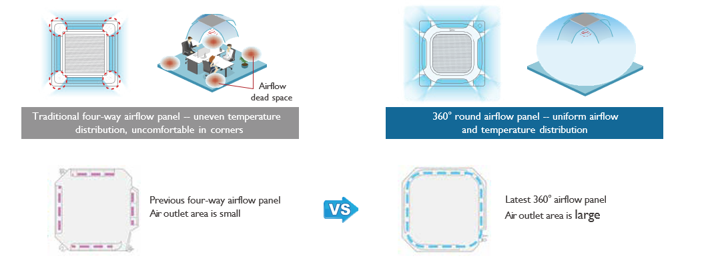
360º Air Flow
Initial Product Information: VRF Indoor Units,AF2 Series
New round airflow panel of AF2-4CC has a 20% larger airflow area than the old four-way airflow panel providing a more even, comfortable airflow.

Slide 12
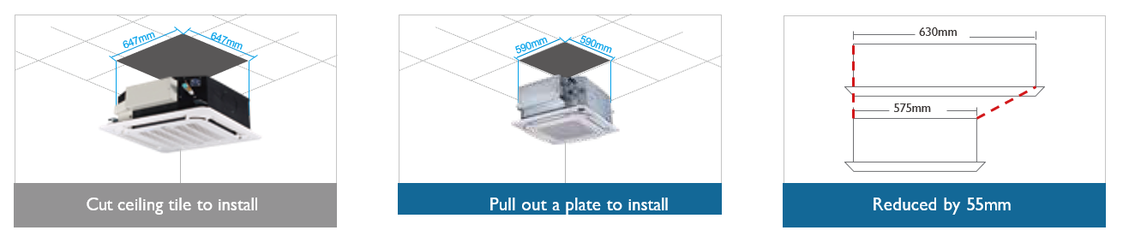
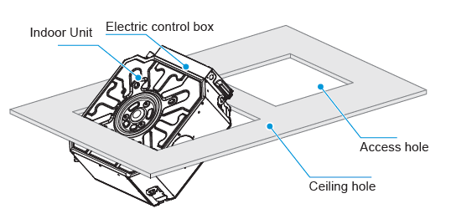
AF2-4CC : New compact design
Initial Product Information: VRF Indoor Units,AF2 Series
New Compact Four-way Cassette fits into the ceiling tile (590mm×590mm), making installation easier.

Slide 13
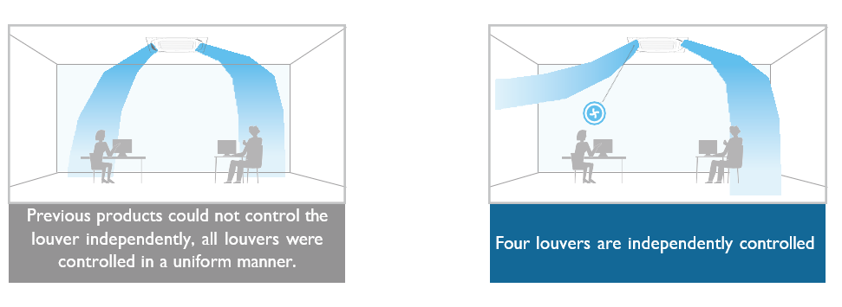
Independent Louver Control
Initial Product Information: VRF Indoor Units,AF2 Series
Flap motors are controlled individually, making it possible to control all four louvers independently.

Slide 14
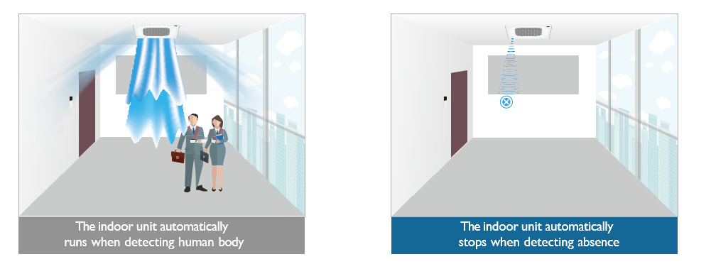
Absence Optimization
Initial Product Information: VRF Indoor Units,AF2 Series
Using millimeter-wave radar sensor, controller automatically turns indoor units on or off upon detecting that the room is occupied or unoccupied, ensuring climate control while minimizing energy consumption.
Setpoint limits can be defined in the room controller.

Slide 15
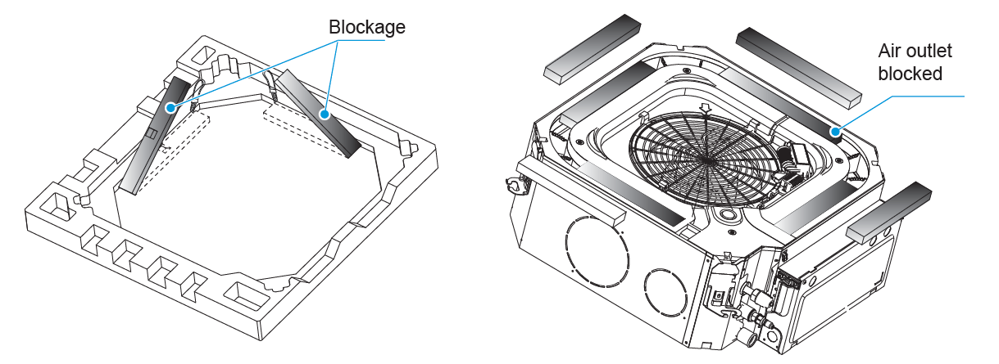
Block Individual Outlets
Initial Product Information: VRF Indoor Units,AF2 Series
Air outlets at corners can be blocked with optional accessories (which can be found in the packaging material, additional purchase is not needed)
In this case, additional setting must be done via room controller.

Slide 16
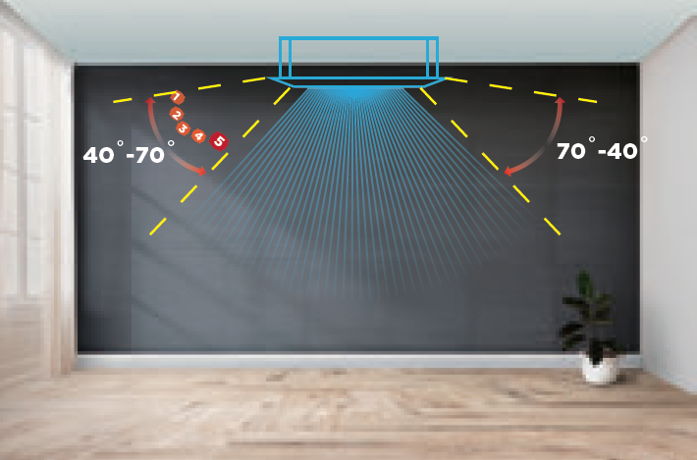
Multiple Steps Vertical Swing
Initial Product Information: VRF Indoor Units,AF2 Series
Cassette units has a wide range of airflow angles from 40° to 70° and is equipped with a 5-step louver control and auto swing mode.

Slide 17
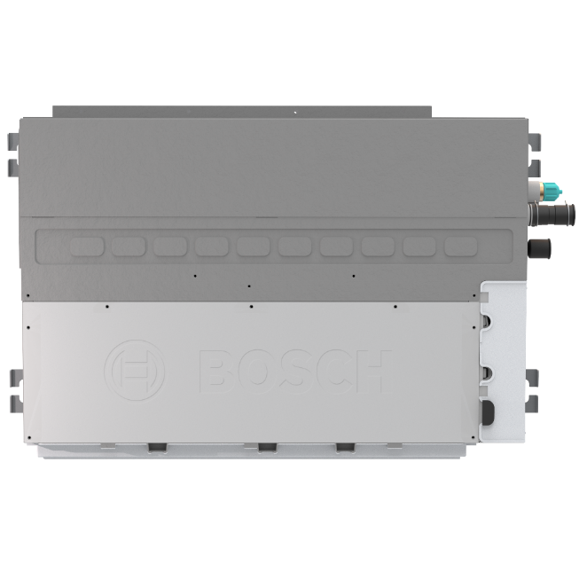
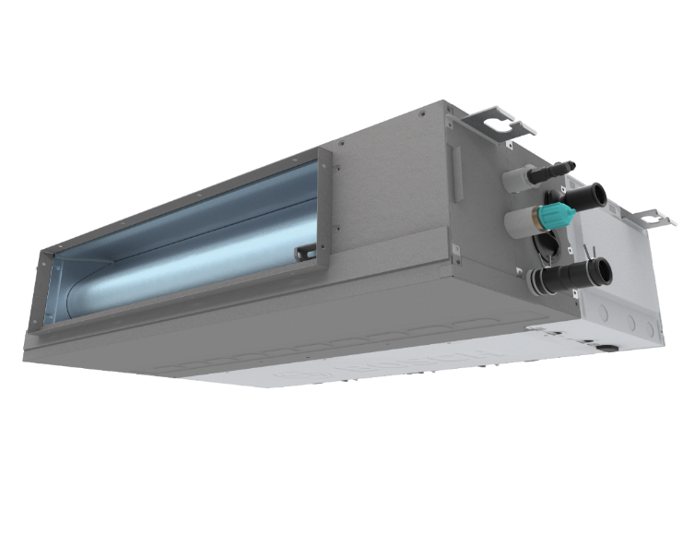


AF2-DL
Initial Product Information: VRF Indoor Units,AF2 Series
Compact & slim NEW design
  Only 199 mm
220V, 1-ph, 50Hz
New updated PCBs with Super Link communication (M1-M2)
  X1-X2 connection for Bosch ARC wired room controller
  D1-D2 connection only between indoor units for group control
  Remote on-off connection, 12V
DC type fan motor, 7-step fan level adjustment
Built-in drain pump , h:1200 mm
Washable air filter, class G1
Optional Accessories
  F6 filter (AF2-FF6-DL)
  Air outlet grille (AF2-AOG-DL)
  Display box for infrared controller incase unit needs to be controlled via infrared controller (AF2-DBB)
Return air inlet from rear or bottom of unit
Auto restart function
Auto ESP setting function
Product is delivered without a controller
  Now unit height
  is only 199 mm
AF2-DL | 15 | 22 | 28 | 36 | 45 | 56 | 71 | 80 | 90 | 112
Rated Cooling Capacity (kW) | 1,5 | 2,2 | 2,8 | 3,6 | 4,5 | 5,6 | 7,1 | 8,0 | 9,0 | 11,2
Rated Heating Capacity (kW) | 1,8 | 2,6 | 3,2 | 4,0 | 5,0 | 6,3 | 8,0 | 9,0 | 10,0 | 12,5
Air Flow Rate – (m³/h) | 340 | 370 | 460 | 605 | 800 | 900 | 1145 | 1400 | 1400 | 1620
Maximum ESP (Pa) | 50 | 50 | 50 | 50 | 50 | 50 | 50 | 80 | 80 | 80
Room controllers
AF2 indoor units are only compatible with AF4300 series VRF outdoor units
ARC C IR-2
ARC C-2
ARC H-2

Slide 18
AF2-DL, Technical Specifications
Initial Product Information: VRF Indoor Units,AF2 Series
Product Type | Cooling capacity | Heating capacity | Power Supply | Rated current | Rated input power | Net dimensions (W x H x D) | Net weight | Airflow rate | ESP (min~max) | ESP (deafult) | Sound pressure level (H/L) | Gas pipe | Liquid pipe | Drain pipe
 | kW | kW | V/Hz/ph | A | W | mm | kg | m³/h | Pa | Pa | dB(A) | mm | mm | mm
AF2-DL 15-1 P | 1,5 | 1,8 | 220/50/1 | 0,26 | 24 | 550 x 199 x 450 | 11,5 | 340 | 10 ~ 50 | tbc | 27/22 | Φ12.7 | Φ6.4 | Φ25
AF2-DL 22-1 P | 2,2 | 2,6 | 220/50/1 | 0,27 | 25 | 550 x 199 x 450 | 11,5 | 370 | 10 ~ 50 | tbc | 28/23 | Φ12.7 | Φ6.4 | Φ25
AF2-DL 28-1 P | 2,8 | 3,2 | 220/50/1 | 0,33 | 31 | 550 x 199 x 450 | 11,5 | 460 | 10 ~ 50 | tbc | 30/24 | Φ12.7 | Φ6.4 | Φ25
AF2-DL 36-1 P | 3,6 | 4 | 220/50/1 | 0,34 | 34 | 700 x 199 x 450 | 13 | 605 | 10 ~ 50 | tbc | 30/25 | Φ12.7 | Φ6.4 | Φ25
AF2-DL 45-1 P | 4,5 | 5 | 220/50/1 | 0,48 | 46 | 900 x 199 x 450 | 16,5 | 800 | 10 ~ 50 | tbc | 34/26 | Φ12.7 | Φ6.4 | Φ25
AF2-DL 56-1 P | 5,6 | 6,3 | 220/50/1 | 0,57 | 61 | 900 x 199 x 450 | 16,5 | 900 | 10 ~ 50 | tbc | 36/28 | Φ12.7 | Φ6.4 | Φ25
AF2-DL 71-1 P | 7,1 | 8 | 220/50/1 | 0,62 | 68 | 1100 x 199 x 450 | 20 | 1145 | 10 ~ 50 | tbc | 37/29 | Φ15.9 | Φ9.52 | Φ25
AF2-DL 80-1 P | 8 | 9 | 220/50/1 | 0,94 | 108 | 1600 x 199 x 450 | 28 | 1400 | 10 ~ 80 | tbc | 36.5/30.5 | Φ15.9 | Φ9.52 | Φ25
AF2-DL 90-1 P | 9 | 10 | 220/50/1 | 0,94 | 108 | 1600 x 199 x 450 | 28 | 1400 | 10 ~ 80 | tbc | 36.5/30.5 | Φ15.9 | Φ9.52 | Φ25
AF2-DL 112-1 P | 11,2 | 12,5 | 220/50/1 | 1,1 | 128 | 1600 x 199 x 450 | 28 | 1620 | 10 ~ 80 | tbc | 39.5/31.5 | Φ15.9 | Φ9.52 | Φ25
Notes: 1. Capacity test conditions: cooling 35 ℃ dB / 24 ℃ WB (outdoor), 27 ℃ dB / 19 ℃ WB (indoor); Heating 7 ℃ dB / 6 ℃ WB (outdoor), 20 ℃ dB / 15 ℃ WB (indoor); Equivalent length of refrigerant piping: 5m with zero level difference. 2. Sound pressure level of this unit is the value tested in the full anechoic room. At installation state, due to the influence of the surrounding background noise, it is generally a little different from the recorded value of this unit.

Slide 19
Part Numbers
Initial Product Information: VRF Indoor Units,AF2 Series
Part number | EAN Number | Family | Product Name | Product Type | SAP Description | PH Product Hierarchy
7733702254 | 4062321732806 | Indoor unit | NA | AF2-DL 15-1 P | Indoor Unit AF2-DL 15-1 P | 0T1410305700060125
7733702255 | 4062321732813 | Indoor unit | NA | AF2-DL 22-1 P | Indoor Unit AF2-DL 22-1 P | 0T1410305700060125
7733702256 | 4062321732820 | Indoor unit | NA | AF2-DL 28-1 P | Indoor Unit AF2-DL 28-1 P | 0T1410305700060125
7733702257 | 4062321732837 | Indoor unit | NA | AF2-DL 36-1 P | Indoor Unit AF2-DL 36-1 P | 0T1410305700060125
7733702258 | 4062321732844 | Indoor unit | NA | AF2-DL 45-1 P | Indoor Unit AF2-DL 45-1 P | 0T1410305700060125
7733702259 | 4062321732851 | Indoor unit | NA | AF2-DL 56-1 P | Indoor Unit AF2-DL 56-1 P | 0T1410305700060125
7733702260 | 4062321732868 | Indoor unit | NA | AF2-DL 71-1 P | Indoor Unit AF2-DL 71-1 P | 0T1410305700060125
7733702261 | 4062321732875 | Indoor unit | NA | AF2-DL 80-1 P | Indoor Unit AF2-DL 80-1 P | 0T1410305700060125
7733702262 | 4062321732882 | Indoor unit | NA | AF2-DL 90-1 P | Indoor Unit AF2-DL 90-1 P | 0T1410305700060125
7733702263 | 4062321732899 | Indoor unit | NA | AF2-DL 112-1 P | Indoor Unit AF2-DL 112-1 P | 0T1410305700060125

Slide 20
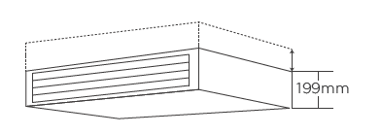
AF2-DL : Ultra thin unit
Initial Product Information: VRF Indoor Units,AF2 Series
Ultra-thin body design : the unit height of the whole series is only 199mm, greatly saving space and more flexiblity at installation.

Slide 21
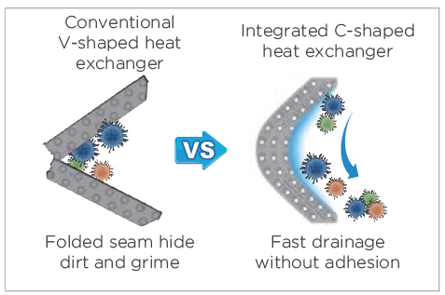
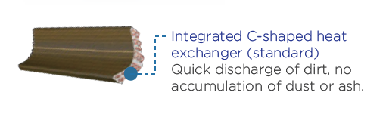
AF2-DL : C-shaped heat exchanger
Initial Product Information: VRF Indoor Units,AF2 Series
An integrated C-shaped heat exchanger that allows for fast drainage and no dust or ash accumulation

Slide 22
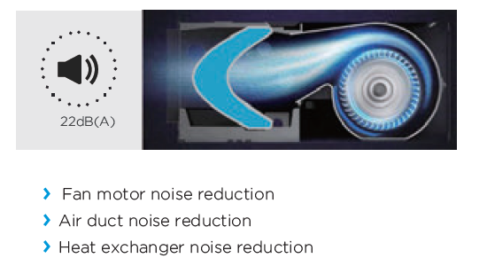
AF2-DL : Quiet operation
Initial Product Information: VRF Indoor Units,AF2 Series
By optimizing the design of fan motor, unit bosy and heat exchanger, the new ducted units operate with a noise level as low as 22dB(A)*, creating a quieter and more comfortable environment.
* Reference model : For 1,5 kW indoor unit

Slide 23
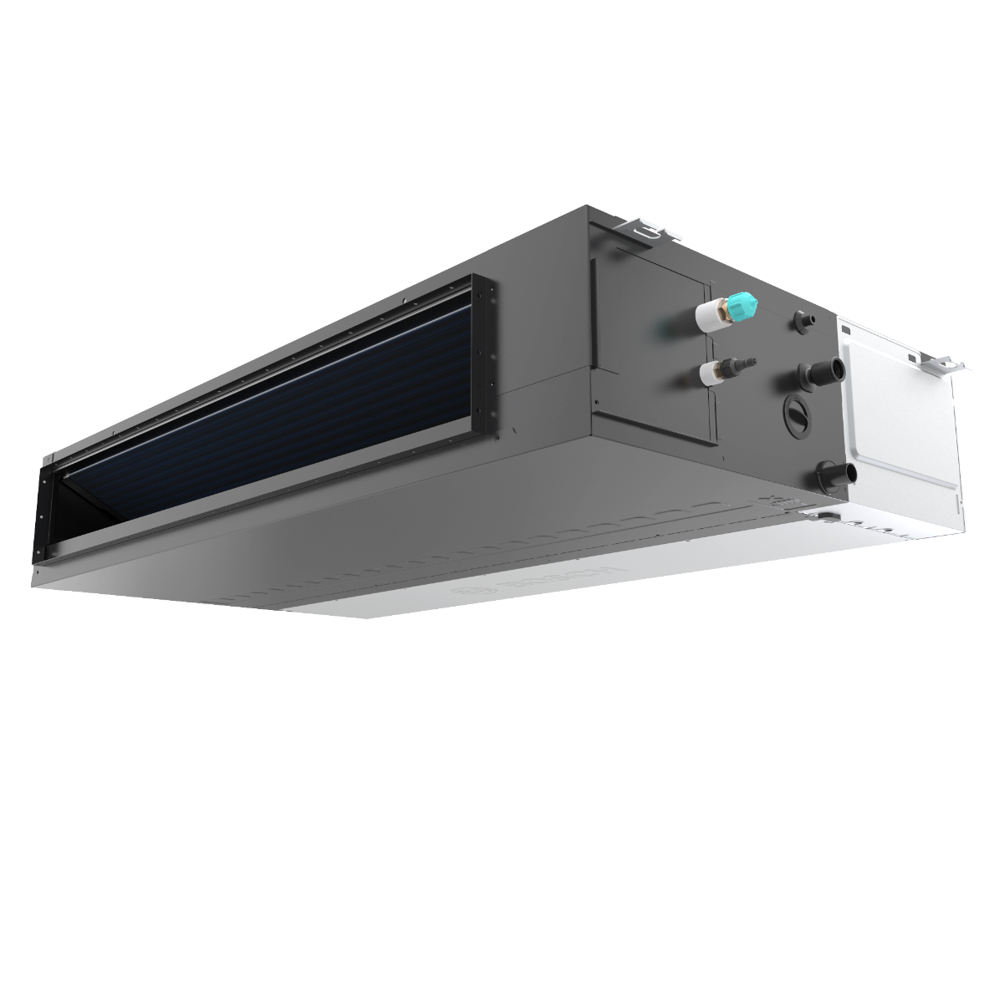
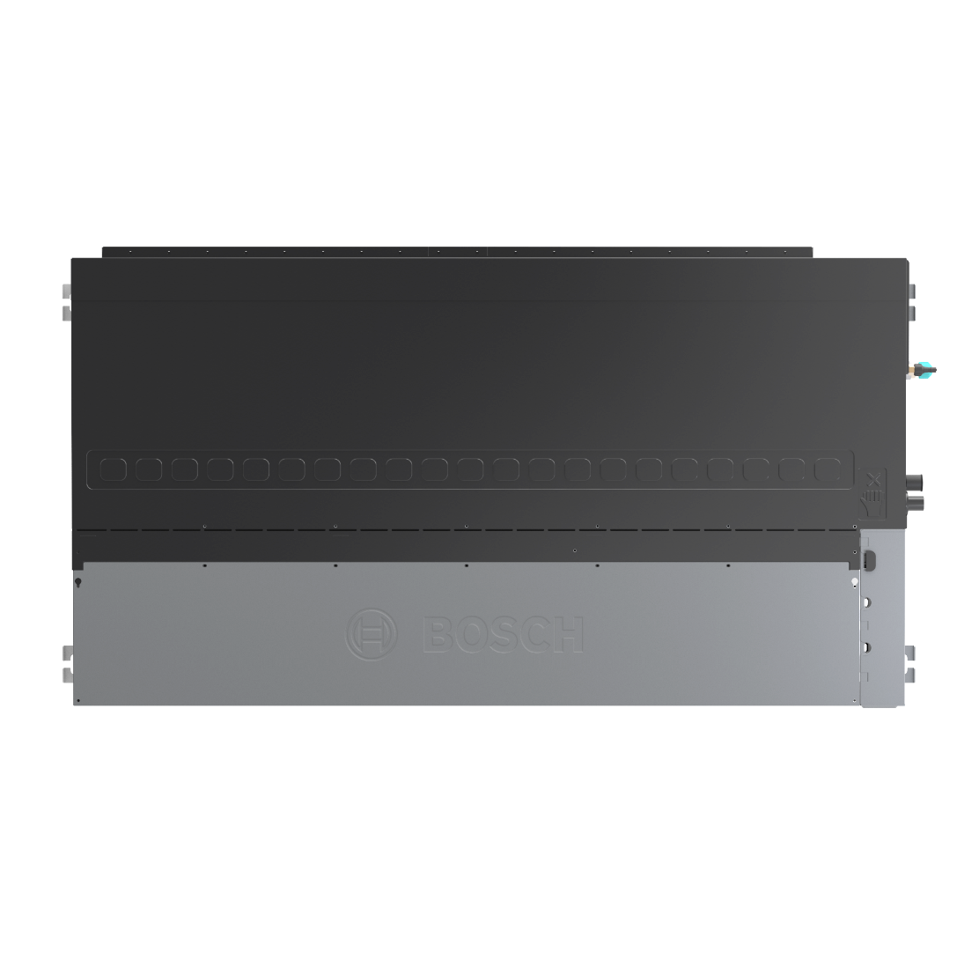

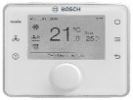
AF2-DM
Initial Product Information: VRF Indoor Units,AF2 Series
Compact & slim NEW design
  Only 245 mm height for whole range
External static pressure up to 160Pa
Extended line-up from 1,5 to 16 kW
220V, 1-ph, 50Hz
New updated PCBs with Super Link communication (M1-M2)
  X1-X2 connection for Bosch ARC wired room controller
  D1-D2 connection only between indoor units for group control
  Remote on-off connection, 12V
DC type fan motor, 7-step fan level adjustment
Built-in drain pump , h:1200 mm
Washable air filter, class G1
Optional filters
  G3+H12 filter + flange (AF2-FH12-DM)
  G3+F7 filter + flange (AF2-FF7-DM)
Return air inlet from rear or bottom of unit
Optional : Display box for infrared controller incase unit needs to be controlled via infrared controller (AF2-DBB)
Auto restart function
Auto ESP setting function
Product is delivered without a controller
AF2-DM | 15 | 22 | 28 | 36 | 45 | 56 | 71 | 80 | 90 | 112 | 125 | 140 | 160
Rated Cooling Capacity (kW) | 1,5 | 2,2 | 2,8 | 3,6 | 4,5 | 5,6 | 7,1 | 8,0 | 9,0 | 11,2 | 12,5 | 14,0 | 16,0
Rated Heating Capacity (kW) | 1,8 | 2,6 | 3,2 | 4,0 | 5,0 | 6,3 | 8,0 | 9,0 | 10,0 | 12,5 | 14,0 | 16,0 | 18,0
Air Flow Rate – (m³/h) | 470 | 500 | 540 | 575 | 665 | 970 | 1150 | 1355 | 1420 | 1950 | tbc | 2105 | tbc
Maximum ESP (Pa) | 160 | 160 | 160 | 160 | 160 | 160 | 160 | 160 | 160 | 160 | 160 | 160 | 160
Room controllers
AF2 indoor units are only compatible with AF4300 series VRF outdoor units
ARC C IR-2
ARC C-2
ARC H-2

Slide 24
AF2-DM, Technical Specifications
Initial Product Information: VRF Indoor Units,AF2 Series
Product Type | Cooling capacity | Heating capacity | Power Supply | Rated current | Rated input power | Net dimensions (W x H x D) | Net weight | Airflow rate | ESP (min~max) | ESP (deafult) | Sound pressure level (H/L) | Gas pipe | Liquid pipe | Drain pipe
 | kW | kW | V/Hz/ph | A | W | mm | kg | m³/h | Pa | Pa | dB(A) | mm | mm | mm
AF2-DM 15-1 P | 1,5 | 1,8 | 220/50/1 | 0,32 | 33 | 600 x 245 x 750 | 18,5 | 470 | 10 ~ 160 | 30 | 26.5/22 | Φ12.7 | Φ6.4 | Φ25
AF2-DM 22-1 P | 2,2 | 2,5 | 220/50/1 | 0,35 | 36 | 600 x 245 x 750 | 18,5 | 500 | 10 ~ 160 | 30 | 26.5/22 | Φ12.7 | Φ6.4 | Φ25
AF2-DM 28-1 P | 2,8 | 3,2 | 220/50/1 | 0,39 | 40 | 600 x 245 x 750 | 18,5 | 540 | 10 ~ 160 | 30 | 26.5/22 | Φ12.7 | Φ6.4 | Φ25
AF2-DM 36-1 P | 3,6 | 4 | 220/50/1 | 0,44 | 50 | 600 x 245 x 750 | 18,5 | 575 | 10 ~ 160 | 30 | 29/22 | Φ12.7 | Φ6.4 | Φ25
AF2-DM 45-1 P | 4,5 | 5 | 220/50/1 | 0,58 | 70 | 600 x 245 x 750 | 19,5 | 665 | 10 ~ 160 | 30 | 33/24 | Φ12.7 | Φ6.4 | Φ25
AF2-DM 56-1 P | 5,6 | 6,3 | 220/50/1 | 0,58 | 70 | 800 x 245 x 750 | 24,0 | 970 | 10 ~ 160 | 30 | 33/25 | Φ12.7 | Φ6.4 | Φ25
AF2-DM 71-1 P | 7,1 | 8 | 220/50/1 | 0,77 | 96 | 800 x 245 x 750 | 25,0 | 1150 | 10 ~ 160 | 30 | 35/26 | Φ15.9 | Φ9.52 | Φ25
AF2-DM 80-1 P | 8 | 9 | 220/50/1 | 0,81 | 102 | 1050 x 245 x 750 | 30,0 | 1355 | 10 ~ 160 | 40 | 37/28 | Φ15.9 | Φ9.52 | Φ25
AF2-DM 90-1 P | 9 | 10 | 220/50/1 | 0,85 | 110 | 1050 x 245 x 750 | 31,0 | 1420 | 10 ~ 160 | 40 | 37/28 | Φ15.9 | Φ9.52 | Φ25
AF2-DM 112-1 P | 11,2 | 12,5 | 220/50/1 | 1,01 | 138 | 1400 x 245 x 750 | 37,0 | 1950 | 10 ~ 160 | 40 | 39/28 | Φ15.9 | Φ9.52 | Φ25
AF2-DM 125-1 P | 12,5 | 14 | 220/50/1 | 1,26 | 172 | 1400 x 245 x 750 | 39,0 | 1960 | 10 ~ 160 | 50 | 40/29 | Φ15.9 | Φ9.52 | Φ25
AF2-DM 140-1 P | 14 | 16 | 220/50/1 | 1,26 | 172 | 1400 x 245 x 750 | 39,0 | 2105 | 10 ~ 160 | 50 | 40/29 | Φ15.9 | Φ9.52 | Φ25
AF2-DM 160-1 P | 16 | 18 | 220/50/1 | 1,56 | 210 | 1400 x 245 x 750 | 39,0 | 2350 | 10 ~ 160 | 50 | 42/31 | Φ15.9 | Φ9.52 | Φ25
Notes: 1. Capacity test conditions: cooling 35 ℃ dB / 24 ℃ WB (outdoor), 27 ℃ dB / 19 ℃ WB (indoor); Heating 7 ℃ dB / 6 ℃ WB (outdoor), 20 ℃ dB / 15 ℃ WB (indoor); Equivalent length of refrigerant piping: 5m with zero level difference. 2. Sound pressure level of this unit is the value tested in the full anechoic room. At installation state, due to the influence of the surrounding background noise, it is generally a little different from the recorded value of this unit.

Slide 25
Part Numbers
Initial Product Information: VRF Indoor Units,AF2 Series
Part number | EAN Number | Family | Product Name | Product Type | SAP Description | PH Product Hierarchy
7733702264 | 4062321732905 | Indoor unit | NA | AF2-DM 15-1 P | Indoor Unit AF2-DM 15-1 P | 0T1410305700060125
7733702265 | 4062321732912 | Indoor unit | NA | AF2-DM 22-1 P | Indoor Unit AF2-DM 22-1 P | 0T1410305700060125
7733702266 | 4062321732929 | Indoor unit | NA | AF2-DM 28-1 P | Indoor Unit AF2-DM 28-1 P | 0T1410305700060125
7733702267 | 4062321732936 | Indoor unit | NA | AF2-DM 36-1 P | Indoor Unit AF2-DM 36-1 P | 0T1410305700060125
7733702268 | 4062321732943 | Indoor unit | NA | AF2-DM 45-1 P | Indoor Unit AF2-DM 45-1 P | 0T1410305700060125
7733702269 | 4062321732950 | Indoor unit | NA | AF2-DM 56-1 P | Indoor Unit AF2-DM 56-1 P | 0T1410305700060125
7733702270 | 4062321732967 | Indoor unit | NA | AF2-DM 71-1 P | Indoor Unit AF2-DM 71-1 P | 0T1410305700060125
7733702271 | 4062321732974 | Indoor unit | NA | AF2-DM 80-1 P | Indoor Unit AF2-DM 80-1 P | 0T1410305700060125
7733702272 | 4062321732981 | Indoor unit | NA | AF2-DM 90-1 P | Indoor Unit AF2-DM 90-1 P | 0T1410305700060125
7733702273 | 4062321732998 | Indoor unit | NA | AF2-DM 112-1 P | Indoor Unit AF2-DM 112-1 P | 0T1410305700060125
7733702274 | 4062321733001 | Indoor unit | NA | AF2-DM 125-1 P | Indoor Unit AF2-DM 125-1 P | 0T1410305700060125
7733702275 | 4062321733018 | Indoor unit | NA | AF2-DM 140-1 P | Indoor Unit AF2-DM 140-1 P | 0T1410305700060125
7733702276 | 4062321733025 | Indoor unit | NA | AF2-DM 160-1 P | Indoor Unit AF2-DM 160-1 P | 0T1410305700060125

Slide 26
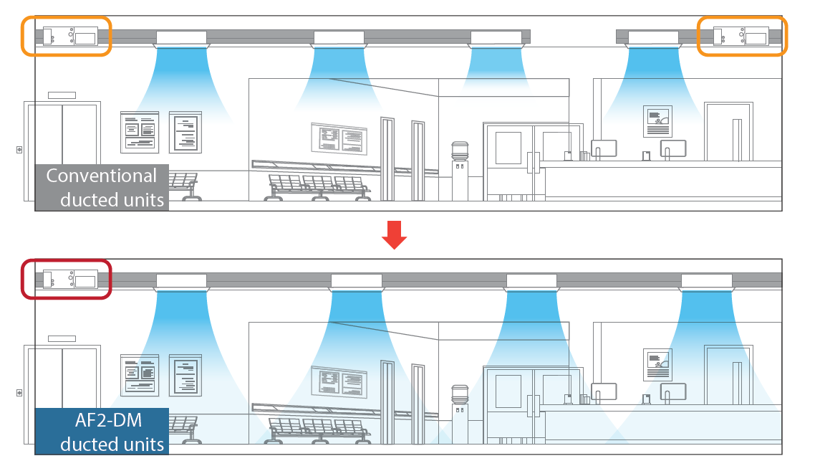
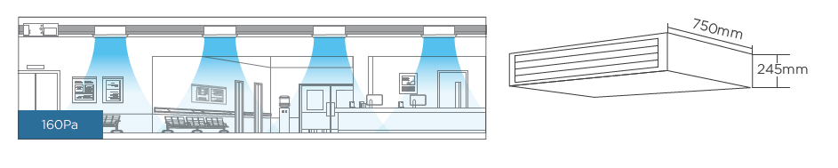
Thin Unit with High External Static Pressure
Initial Product Information: VRF Indoor Units,AF2 Series
All models have a static pressure of max 160 Pa and a unit height of only 245 mm.
High static pressure allows air to be delivered over longer distances without loss of cooling and heating effect. Especially suitable for long and narrow spaces.
Especially in long ducted applications, it can reduce the number of units used and save investment costs.
Automatic ESP Setting
There is no need to adjust the static pressure setting of the indoor unit during commissioning, and the indoor unit will automatically adjust to the rated air volume via controller

Slide 27
AF2-W
Initial Product Information: VRF Indoor Units,AF2 Series
Design
NEW stylish panel design
LED Display
Technical Features
220V, 50Hz
New updated PCBs with Super Link communication (M1-M2)
  New Bosch ARC wired room controllers connection
  D1-D2 connection for group control (up to 16) Remote on-off connection, 12V
New infrared controller from Bosch, ARC C IR
Built-in EEV
DC type fan motor
7-step fan level
Extra energy saving : Absence optimization
Other
Easy piping connection: from left, right or rear
Auto swing function
Washable air filter, class G1
Auto restart function
Product is delivered without a controller
Room controllers
ARC C IR-2
ARC C-2
ARC H-2
1,5 to 5,6 kW
71-80-90 will be available in Q2.2023
AF2-W | 15 | 22 | 28 | 36 | 45 | 56 | 71 | 80 | 90
Rated Cooling Capacity (kW) | 1,5 | 2,2 | 2,8 | 3,6 | 4,5 | 5,6 | 7,1 | 8,0 | 9,0
Rated Heating Capacity (kW) | 1,8 | 2,6 | 3,2 | 4,0 | 5,0 | 6,3 | 8,0 | 9,0 | 10,0
AF2 indoor units are only compatible with AF4300 series VRF outdoor units

Slide 28
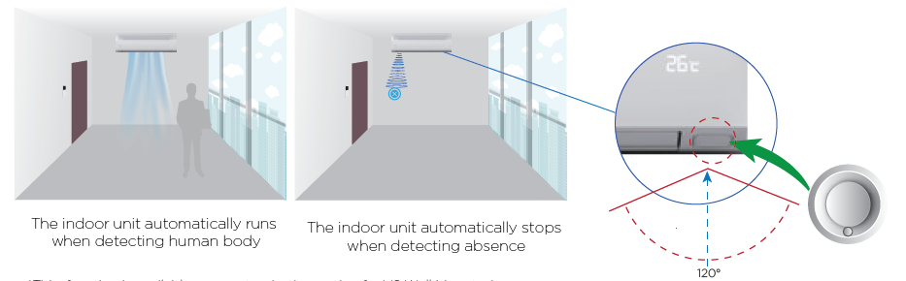
Absence Optimization
Initial Product Information: VRF Indoor Units,AF2 Series
Using millimeter-wave radar sensor, controller automatically turns indoor units on or off upon detecting that the room is occupied or unoccupied, ensuring climate control while minimizing energy consumption.
Setpoint limits can be defined in the room controller.

Slide 29
AF2-W, Technical Specifications
Initial Product Information: VRF Indoor Units,AF2 Series
Product Type (draft) | Cooling capacity | Heating capacity | Power Supply | Rated current | Rated input power | Net dimensions (W x H x D) | Net weight | Airflow rate | Sound pressure level (H/L) | Gas pipe | Liquid pipe | Drain pipe
 | kW | kW | V/Hz/ph | A | W | mm | kg | m³/h | dB(A) | mm | mm | mm
AF2-W 15-1 | 1,5 | 1,8 | 220/50/1 | 0,28 | 18 | 750 x 295 x 260 | 9,5 | 460 | 32/27 | Φ12.7 | Φ6.4 | Φ17
AF2-W 22-1 | 2,2 | 2,6 | 220/50/1 | 0,29 | 21 | 750 x 295 x 260 | 9,5 | 500 | 33/27 | Φ12.7 | Φ6.4 | Φ17
AF2-W 28-1 | 2,8 | 3,2 | 220/50/1 | 0,36 | 24 | 750 x 295 x 260 | 10,5 | 540 | 35/28 | Φ12.7 | Φ6.4 | Φ17
AF2-W 36-1 | 3,6 | 4 | 220/50/1 | 0,39 | 27 | 750 x 295 x 260 | 10,5 | 580 | 37/28 | Φ12.7 | Φ6.4 | Φ17
AF2-W 45-1 | 4,5 | 5 | 220/50/1 | 0,41 | 30 | 950 x 295 x 260 | 12 | 720 | 37/29 | Φ12.7 | Φ6.4 | Φ17
AF2-W 56-1 | 5,6 | 6,3 | 220/50/1 | 0,45 | 40 | 950 x 295 x 260 | 12 | 860 | 41/29 | Φ12.7 | Φ6.4 | Φ17
Notes: 1. Capacity test conditions: cooling 35 ℃ dB / 24 ℃ WB (outdoor), 27 ℃ dB / 19 ℃ WB (indoor); Heating 7 ℃ dB / 6 ℃ WB (outdoor), 20 ℃ dB / 15 ℃ WB (indoor); Equivalent length of refrigerant piping: 5m with zero level diffrence. 2. Sound pressure level of this unit is the value tested in the full anechoic room. At installation state, due to the influence of the surrounding background noise, it is generally a little different from the recorded value of this unit.

Slide 30
Part Numbers
Initial Product Information: VRF Indoor Units,AF2 Series
Part number | EAN Number | Family | Product Name | Product Type | SAP Description | PH Product Hierarchy
7733702277 | 4062321733032 | Indoor unit | NA | AF2-W 15-1 | Indoor Unit AF2-W 15-1 | 0T1410305700060120
7733702278 | 4062321733049 | Indoor unit | NA | AF2-W 22-1 | Indoor Unit AF2-W 22-1 | 0T1410305700060120
7733702279 | 4062321733056 | Indoor unit | NA | AF2-W 28-1 | Indoor Unit AF2-W 28-1 | 0T1410305700060120
7733702280 | 4062321733063 | Indoor unit | NA | AF2-W 36-1 | Indoor Unit AF2-W 36-1 | 0T1410305700060120
7733702281 | 4062321733070 | Indoor unit | NA | AF2-W 45-1 | Indoor Unit AF2-W 45-1 | 0T1410305700060120
7733702282 | 4062321733087 | Indoor unit | NA | AF2-W 56-1 | Indoor Unit AF2-W 56-1 | 0T1410305700060120
7733702283 | 4062321733094 | Indoor unit | NA | AF2-W 71-1 | Indoor Unit AF2-W 71-1 | 0T1410305700060120
7733702284 | 4062321733100 | Indoor unit | NA | AF2-W 80-1 | Indoor Unit AF2-W 80-1 | 0T1410305700060120
7733702285 | 4062321733117 | Indoor unit | NA | AF2-W 90-1 | Indoor Unit AF2-W 90-1 | 0T1410305700060120

Slide 31
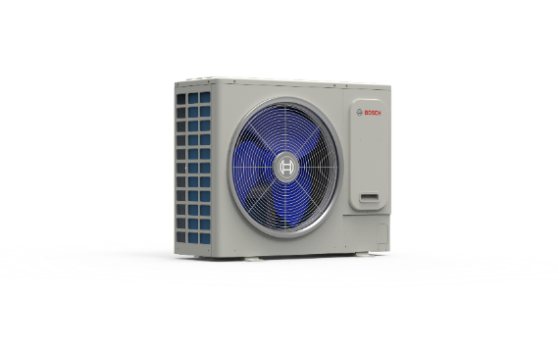
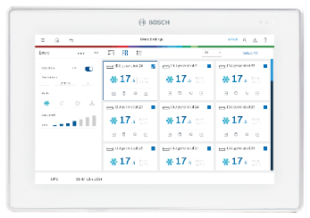



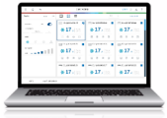
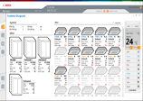

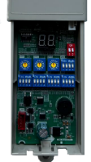
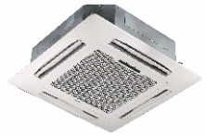
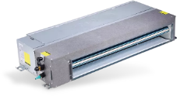
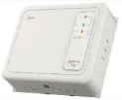

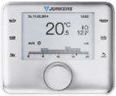

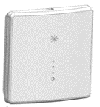
System Architecture
Initial Product Information: VRF Indoor Units,AF2 Series
Outdoor
Unit
XYE
Central Controller
USB
software update
ACC MT
Service Tools
RS485-USB converter
M1M2
USB
R32 pump down kit
(safety shut-off valves)
motion detection sensor (absence optimization)
(standard on display panel)
Diagnosis software
Indoor Units
Bus signal repeater
After-Sales Board –settings after PCB replacement
IR
display board
(ducted units)
Room Controller
X1X2
X1X2
refrigerant detector
(connected to IDU
communication board)
ARC C-2
ARC C-2
ARC H-2
IRC
ARC C-2

Slide 32
Common Features
Initial Product Information: VRF Indoor Units,AF2 Series
Feature | Description | AF2-4CR | AF2-4CC | AF2-W | AF2-DL | AF2-DM
Super Link | New communication technology between indoor and outdoor units. Compared to previous communication technology, Super Link has a higher immunity to interference, no polarity (M1M2 can be connected in any way), extended length (M1M2 can be up to 2000m), allows the system to keep operating although individual indoor units are disconnected from power supply (switching off valves in case of indoor unit power outage), more possible topology setups (not only daisy chain). | ü | ü | ü | ü | ü
Standard water level switch | The water level switch avoids an overflow of condense water at the drain pan if the drain pipe is blocked or the drainage is not smooth. | ü | ü | ü | ü | ü
7-step DC inverter fan | Fan speeds can be adjusted at 7 different steps, which gives the user more freedom to control the indoor air speed. | ü | ü | ü | ü | ü
Heat-exchanger self-cleaning (Only for R-32 systems) | Self-cleaning program of the indoor unit heat exchanger. The system will first freeze the heat exchanger to collect dirt and wash it off with the condense water. A thermal desinfection will finish the cleaning process. During the self-cleaning process, the indoor unit will blow cold and warm air into the room. Self-cleaning will interrupt the normal operation of the complete system until the cleaning and drying process is finished. | ü | ü | ü | ü | ü
Ion air purifier (Only for R-410A systems) (This feature will be available by end of 2023) | Ionization to reduce germs, allergenic or odors in the room air.) | ü | ü | ü | ü | ü
Humidity sensor | Humidity sensor to control the room humidity in the dry mode. | ü | ü | ü | ü | ü
Safe mode | In case of a sensor failure, safe mode keeps the system running for 72 hours with basic functionality. A failure of critical sensors will not allow to activate the safe mode. | ü | ü | ü | ü | ü
Shutdown fan delay | After shutdown of the indoor unit, the fan keeps running for a short time to dry the heat exchanger and prevent mold growth. | ü | ü | ü | ü | ü
Remote ON/OFF dry contact | Dry contact input can realize linkage between air conditioner and other smart home signals, eg. Window is opened - AC units turns off, window is closed - AC unit turns on. | ü | ü | ü | ü | ü
Refrigerant detector dry contact | Increase safety with a standard refrigerant detector dry contact, e.g. to receive an alarm or malfuction signal. | ü | ü | ü | ü | ü
Independent power supply | The indoor unit can be power supplied independently | ü | ü | ü | ü | ü
Temperature compensation | Set a compensation value for the temperature sensor for the heating and cooling mode. | ü | ü | ü | ü | ü
Anti cold air | Protect users of cold air blowing from the indoor unit after starting the heating mode. The fan does not run when the indoor unit heat exchanger mid-point temperature is at the set temperature value or below. | ü | ü | ü | ü | ü
Fan deactivation time | After reaching the temperature setpoint in the heating mode, the fan will keep operating for the set time period in an automatic off / 1 minute on a repeating cycle. | ü | ü | ü | ü | ü
Low noise at heating stand-by | The EXV (electronic expansion valve) can be fully closed during standby operation in heating mode to reduce refrigerant flow noise. | ü | ü | ü | ü | ü

Slide 33
Other Features
Initial Product Information: VRF Indoor Units,AF2 Series
Feature | Description | AF2-4CR | AF2-4CC | AF2-W | AF2-DL | AF2-DM
ECO+ mode | A simulation model calculates the required room load and adjusts the capacity output of the air conditioner in real time. Energy is saved and power of the air conditioner is not wasted. | ü | ü | ü | ü | -
Absence optimization | Detect presence in a room and optimize the setpoints to save energy during absence. Setpoint limits can be defined in the room controller. | ü | ü | ü | - | -
Anti-condensation | Automatic adjustment of the louver angle and fan settings to avoid water condensation on the flaps. | ü | ü | ü | - | -
Independent louver control | The vertical louvers can be adjusted independently. The number of the louver can be seen on the marks next to the indoor unit flaps. | ü | ü | - | - | -
New panel design - 360° Airflow | The new round airflow panel of Cassette unit has a 20% larger airflow area than the old four-way airflow panel, providing a more even, comfortable airflow. | ü | ü | - | - | -
Ceiling height setting | Adjust the louver angle and the fan strength to accomodate high mounting positions. | ü | ü | - | - | -
Clean ceiling | The ceiling stays clean, because the minimum louver angle will be modified to direct the airflow away from the ceiling. | ü | ü | - | - | -
Disable louver | Air outlet flaps can be deactivated with an optional accessory (included in the packaging material), e.g. if they are placed close to a wall or corner. | ü | ü | - | - | -
High ESP | The whole series achieves the industry-leading static pressure of 160Pa, so the air supply distance is longer. Especially in long and narrow spaces such as corridors, it can reduce the number of units used and save investment costs. | - | - | - | - | ü
Built-in drain pump | A silent DC pump, with a head of 1.2m, is built in the unit, to realize zero slope and long-distance drainage | ü | ü | - | ü | ü
Automatic ESP setting | External static pressure (ESP) adapts automatically to the duct resistance to ensure constant airfow. | - | - | - | ü | ü
Filter change reminder | The filter change reminder measures the filter blockage rate and reminds to change the filter to keep optimal operating conditions. | - | - | - | ü | ü
Optional F6 filter | can be purchased seperately as an accesory | ü | - | - | ü | -
Optional F7 or H12 filter | can be purchased seperately as an accesory | - | - | - | - | ü

Slide 34
Accessories
Initial Product Information: VRF Indoor Units,AF2 Series
Part number | EAN Number | Family | Product Name | Product Type | SAP Description | PH Product Hierarchy
7733702287 | 4062321733131 | Accessory | NA | AF2-LS 01 | Refrigerant leakage sensor | 0T0300011500050946
7733702288 | 4062321733148 | Accessory | NA | AF2-PD 01 | Pump down kit (Refrigerant shut-off device) | 0T0300011500050946
7733702289 | 4062321733155 | Accessory | NA | AF2-DBB | Display box, infrared sensor | 0T0300011500050946
7733702290 | 4062321733162 | Accessory | NA | AF2-FF6-DL | F6 filter for DL | 0T0300011500050946
7733702291 | 4062321733179 | Accessory | NA | AF2-FH12-DM | G3+H12 filter for DM + flange | 0T0300011500050946
7733702292 | 4062321733186 | Accessory | NA | AF2-FF7-DM | G3+F7 filter for DM + flange | 0T0300011500050946
7733702293 | 4062321733193 | Accessory | NA | AF2-FF6-4CR | F6 filter for 4CR | 0T0300011500050946
7733702294 | 4062321733209 | Accessory | NA | AF2-AOG-DL | Air outlet grille for DL | 0T0300011500050946
7733702295 | 4062321733216 | Accessory | NA | AF2-PBR | Power bus repeater | 0T0300011500050946
A seperate product information will be send for accessorries later on.

